Slide 1
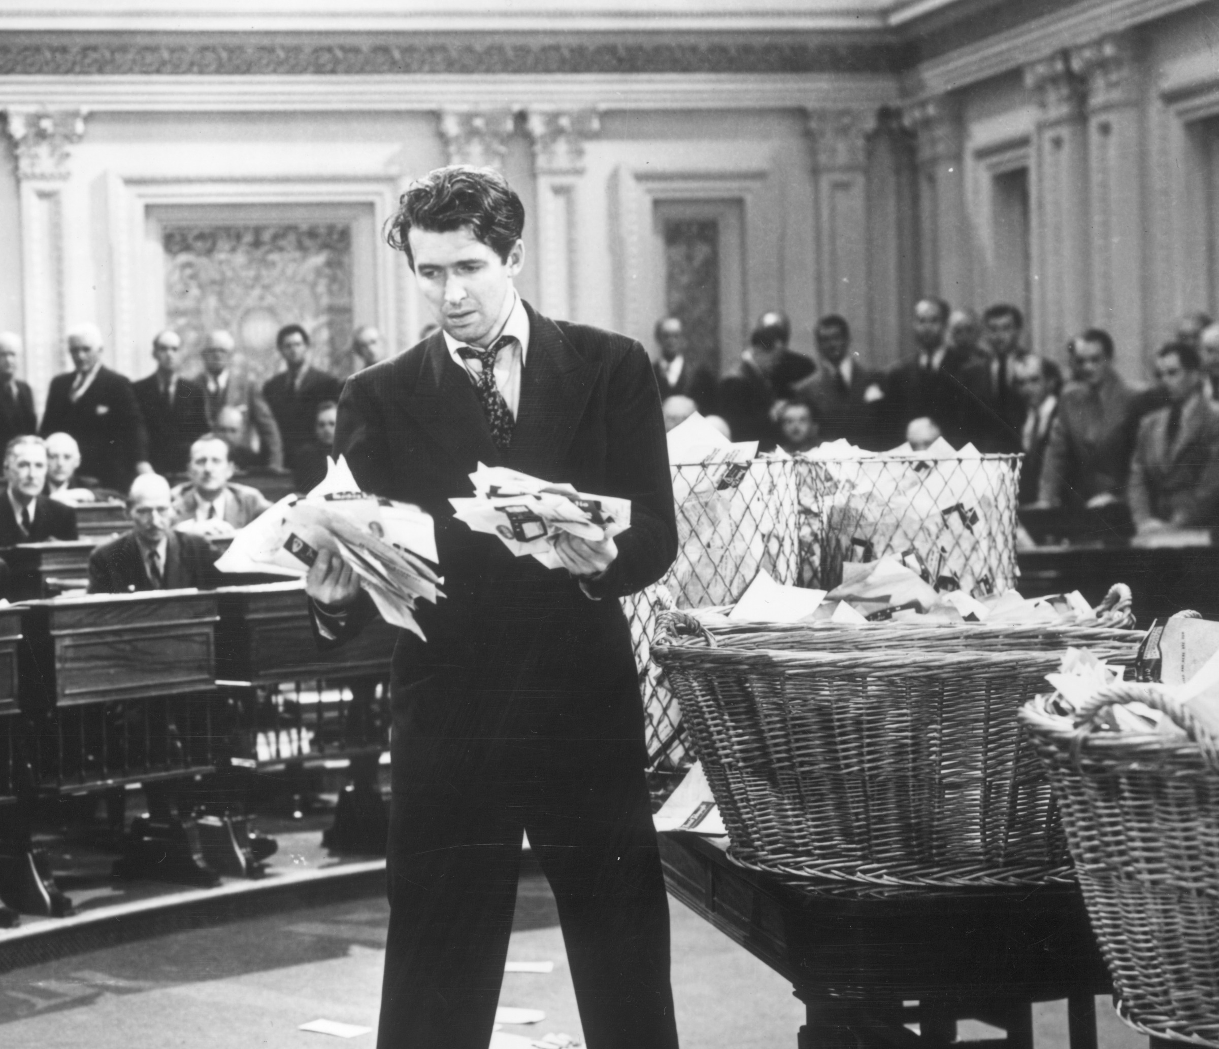
Teaching Electronic Privacy and
Civil Liberties to Government
Teaching Electronic Privacy and
Civil Liberties to Government
Greg Conti // West Point // gregory.conti@usma.edu
Greg Conti // West Point // gregory.conti@usma.edu
Photo: Mr. Smith Goes to Washington

Slide 2
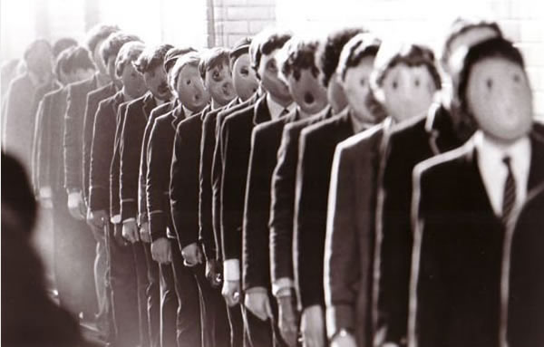
Disclaimer
The views in this talk are the speaker’s and don’t reflect the official policy or position of the United States Military Academy, the Department of the Army, the Department of Defense, or the United States Government.
Photo: Pink Floyd The Wall

Slide 3
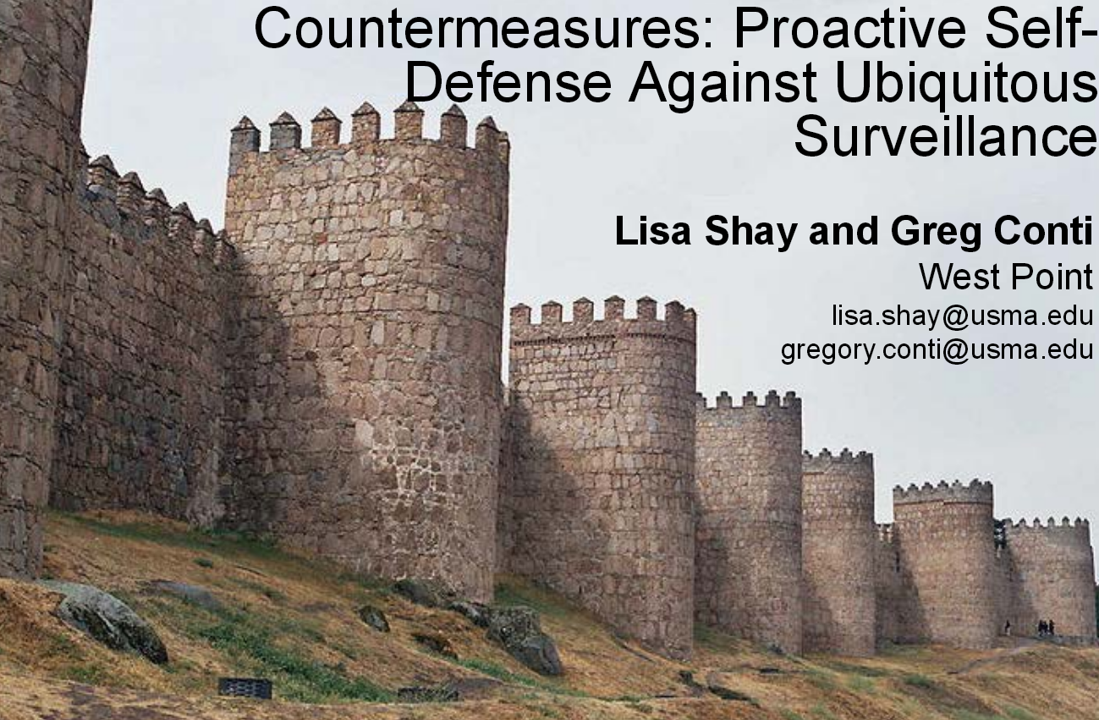
HOPE 9

Slide 4
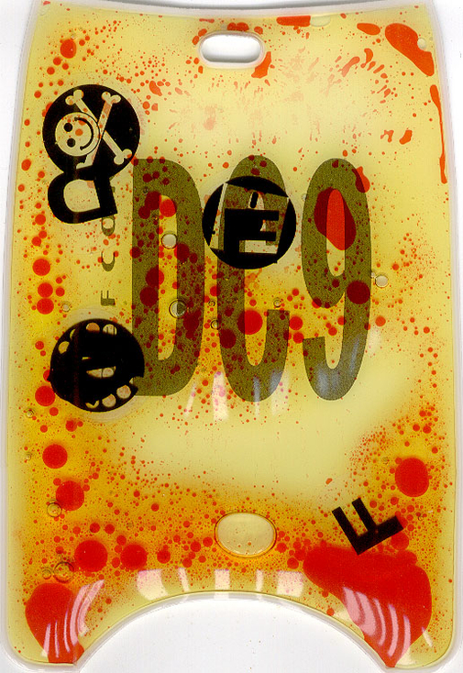
Book
Googling Security: How Much Does Google Know About You, Addison Wesley, 2008
Journal and Magazine
"Deconstructing the Relationship Between Privacy and Security;" IEEE Technology and Society, Vol. 33, No. 2, Summer 2014.
Gregory Conti, Edward Sobiesk, Paul Anderson, Steven Billington, Alex Farmer, Cory Kirk, Patrick Shaffer, and Kyle Stammer; "Unintended, Malicious, and Evil Applications of Augmented Reality;" InSecure, Issue 35, September 2012, pp. 20-27.
Gregory Conti, Dominic Larkin, David Raymond and Edward Sobiesk; "The Military's Cultural Disregard for Personal Information;" Small Wars Journal, 6 Dec 2010. New York Times (Front Page), Government Information Security, Army Times 1 2, USAA, and SWJ coverage, DoD SWJ Response
Gregory Conti; "There's a Fly in My Digital Soup;" ACM netWorker, Vol 13, Issue 2 (Summer 2009).
Gregory Conti and Edward Sobiesk; "Malicious Interfaces and Personalization's Uninviting Future;" IEEE Security and Privacy, May/June 2009.
Gregory Conti; "Could Googling Take Down a President?;" Communications of the ACM (50th Anniversary Issue), January 2008.
Edward Sobiesk and Gregory Conti; "The Cost of Free Web Tools;" IEEE Security and Privacy, May/June 2007. BBC Documentary video
Conference and Workshop Publications
Gregory Conti, Woodrow Hartzog, John Nelson, and Lisa Shay. "A Conservation Theory of Governance for Automated Law Enforcement." We Robot, Miami, April 2014.
Lisa Shay, Gregory Conti, and Woodrow Hartzog. "Beyond Sunglasses and Spray Paint: A Taxonomy of Countermeasures Against Overly-Intrusive Surveillance." IEEE International Symposium on Technology and Society (ISTAS), Toronto, June 2013.
Lisa Shay, Woodrow Hartzog, John Nelson, and Gregory Conti. "Do Robots Dream of Electric Laws? An Experiment in the Law as Algorithm." We Robot, Stanford, April 2013. (24% selection rate) datasets Ars Technica, Slashdot, and San Francisco Chronicle coverage.
Lisa Shay, Gregory Conti, Dominic Larkin and John Nelson. "A Framework for Analysis of Quotidian Exposure in an Instrumented World." IEEE Carnahan Conference on Security Technology, Boston, October 2012.
Greg Conti, Lisa Shay, and Woody Hartzog. "Life Inside a Skinner Box: Confronting our Future of Automated Law Enforcement." DEFCON 20, Las Vegas, July 2012. PPT Slides [12.4M] Bloomberg coverage
Lisa Shay and Greg Conti. "Countermeasures: Proactive Self-Defense Against Ubiquitous Surveillance." HOPE, New York City, July 2012. PDF Slides [7.0M] Off the Hook and Computerworld coverage.
Lisa Shay, Woodrow Hartzog, John Nelson, Dominic Larkin and Gregory Conti. "Confronting Automated Law Enforcement." We Robot, Miami, April 2012.
Greg Conti; "Our Instrumented Lives: Sensors, Sensors, Everywhere"; DEFCON 18; July 2010. Talk PPT Slides [31.8M] PDF Slides [7.6M]
Gregory Conti and Edward Sobiesk; "Malicious Interface Design: Exploiting the User"; International World Wide Web Conference (WWW 2010); April 2010. Slashdot, EFF, and MSNBC coverage.
Greg Conti; "Could Googling Take Down a President, a Prime Minister, or an Average Citizen?; DEFCON 16; August 2008. Talk PPT Slides [8.0M]
Greg Conti; "Evil Interfaces: Violating the User;" HOPE; July 2008. Talk PPT Slides [15.5M]
Kulsoom Abdullah, Gregory Conti and Raheem Beyah; "A Visualization Framework for Self-monitoring of Web-based Information Disclosure;" International Conference on Communications (ICC); May 2008.
Kulsoom Abdullah, Gregory Conti and Edward Sobiesk; "Self-monitoring of Web-based Information Disclosure;" Workshop on Privacy in the Electronic Society; October 2007.
Gregory Conti and Edward Sobiesk; "An Honest Man Has Nothing to Fear: User Perceptions on Web-based Information Disclosure;" Symposium on Usable Privacy and Security (SOUPS); July 2007.
Gregory Conti; "Googling Considered Harmful;" New Security Paradigms Workshop; October 2006. (See also the eWeek and USENIX LOGIN coverage)
Greg Conti; "Googling: I'm Feeling (un)Lucky;" DEFCON 14; July 2006. Talk PDF Slides(0.8M) Talk Audio(MP3 21.0M) Talk Video(MP4 78.5M)
Greg Conti; "Google: Don't Be Evil or Don't Be Good;" Interz0ne 5; March 2006. Talk PPT Slides (2.6M)
G. Conti, M. Ahamad and J. Stasko; "Attacking Information Visualization System Usability: Overloading and Deceiving the Human;" Symposium on Usable Privacy and Security (SOUPS); July 2005.
Panels
Gregory Conti, Maureen O'Connor, David Raymond, and Raymond Odierno. Leadership in Cyberspace: Game Has Changed, Korn-Ferry, New York, 22http://en.wikipedia.org/wiki/Yossi_Vardi October 2013.
Gregory Conti, Helen Greiner, Peter Singer, James Stavridis, and Yossi Vardi. Beyond Software: The Future of Conflict, Google Ideas, New York, 22 October 2013.
Chris Rouland, Robert Clark, and Gregory Conti (moderator). The Ethics of Hacking Back: Cybersecurity and Active Network Defense, Carnegie Council, New York, 18 September 2013. Forbes coverage
Dmitri Alperovich, Gregory Conti, and Simson Garfinkel. How Do We Create a Viable Cyber Profession: Opportunities and Challenges, AFCEA TechNet Land Forces - East, Baltimore, MD, August 2012.
Marcia Hoffman, Congressman Jim Langevin, Vice Admiral Mike McConnell, Jeff Moss, and Sami Saydjari (Gregory Conti Moderator). The Role of the U.S. Government in Cyberspace, United States Military Academy Senior Conference, West Point, NY, June 2012.
Alessandro Acquisti, Ryan Calo, Gregory Conti, and Woodrow Hartzog (Chris Hoofnagle Moderator); Human Computer Interaction and Consumer Protection, Samuelson Law, Technology & Public Policy Clinic, Privacy Scholars Speaker Series. UC Berkeley; 30-31 March 2011.
Judit Bar-Ilan, Tom Cross, Martin Kratz and Wendy Seltzer (Gregory Conti Moderator); Web Search Privacy Issues, World Wide Web Conference (WWW2007); May 2007.
Gregory Conti; Googling Considered Harmful (as part of the 2006 Highlights of the New Security Paradigms Workshop Panel), Annual Computer Security Applications Conference(ACSAC); December 2006.
http://www.hakim.ws/DEFCONXX/Extra%20Bonus%20Material/DEF%20CON%20Archive/DEF%20CON%20Badges%201-19/DEFCON-9.jpg

Slide 5
Is it possible to protect cyberspace without damaging or destroying Democracy?

Slide 6
What would you teach Senior Leaders, Mid-Career, and Junior people in government or the military?

Slide 7
Take privacy and civil liberties into account when making decisions.
Not out of “compliance” but from a true appreciation.

Slide 8
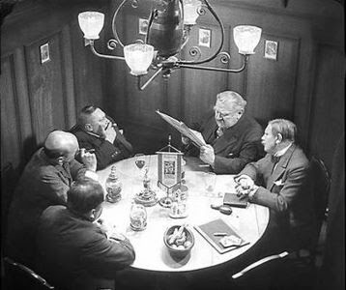

Slide 9

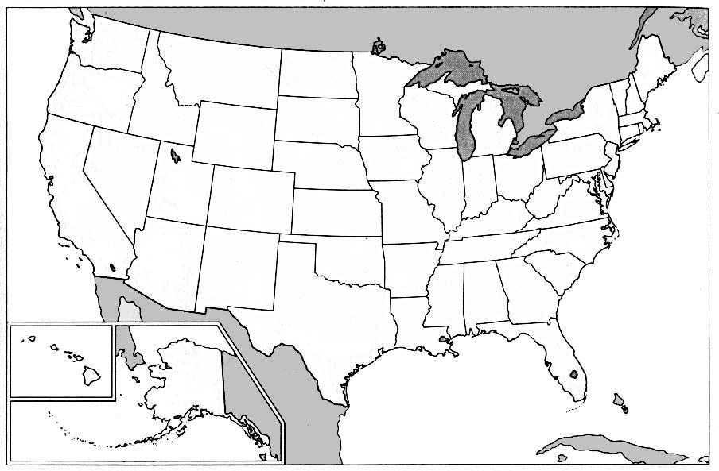
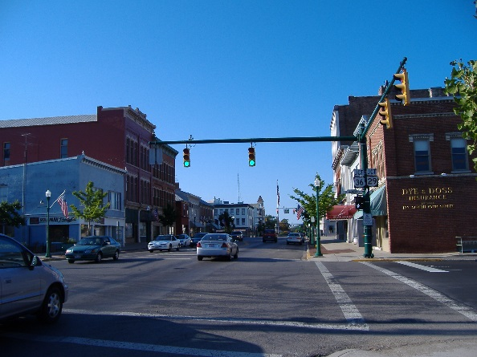


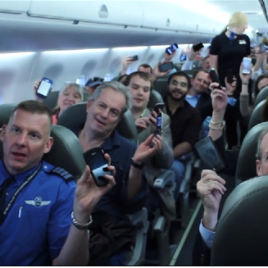
Instrumented World
Planet
Nation
Community
Car
Home
Person

Slide 10
Attention Span of General Public
AOL Search Query
Disclosure
~Weeks
Wikileaks
~ Months
Edward Snowden’s
Disclosures
June 2013 - Until

Slide 11
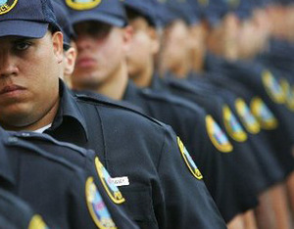
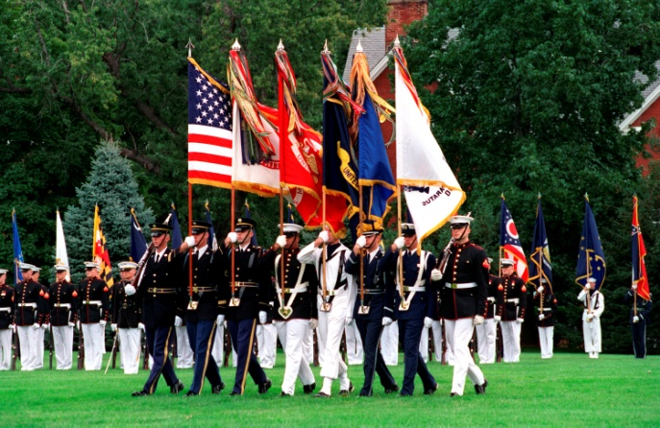

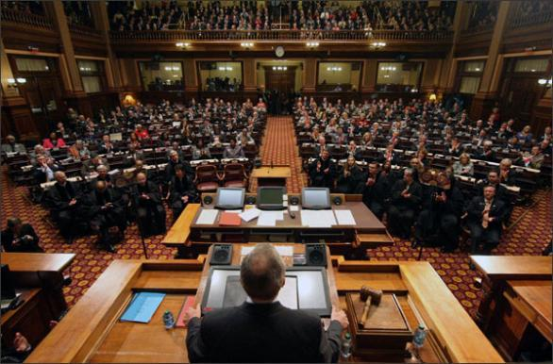
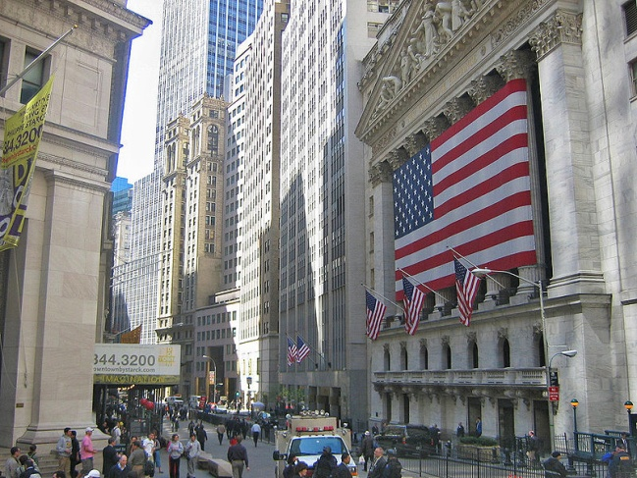
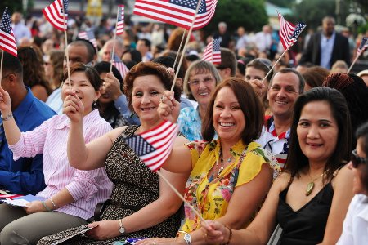
Various Perspectives…
Law Enforcement
Military
Advocates
Policy Makers
Business
Citizens

Slide 12

Patriotism
http://www.loc.gov/wiseguide/july03/images/patriotism-a.jpg

Slide 13

Awareness of the Threat
http://goodoldneon.files.wordpress.com/2012/02/munstertreeofknowledge.jpg

Slide 14
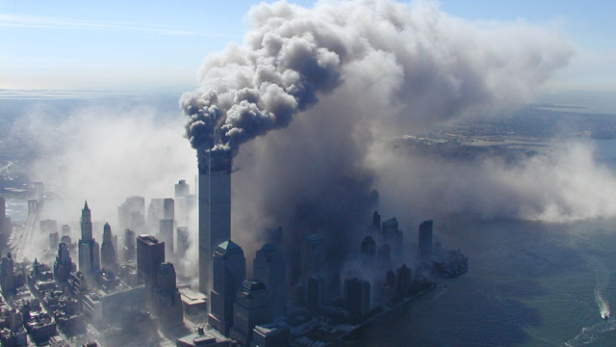
Trying to stop bad things happening again…
http://cdn.fusion.net/images/ABC_Univision/120917-9_11_wmain.jpg

Slide 15

Inability to speak
http://www.executedtoday.com/images/Someone_Blabbed.jpg

Slide 16
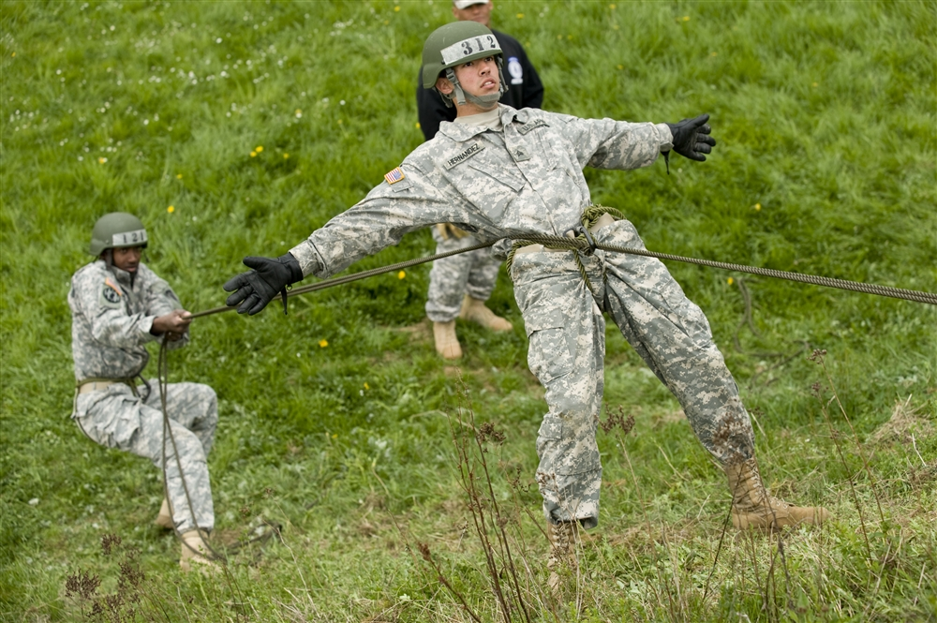
Trust what they are building won’t be abused
http://www.eucom.mil/article/19853/students-attend-first-air-assault-school-held-in-europe-in-5-years

Slide 17
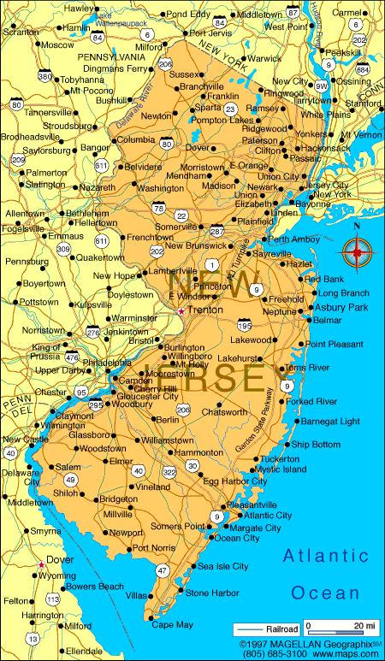
Hands Tied…
“If DOD defended the land domain in the same manner as cyberspace, a Russian land invasion of New Jersey would have to be fought by U.S. citizens and commercial entities with whatever weapons they happened to possess. DOD would only defend Fort Monmouth and Fort Dix.”
– David Hollis
US Cyber Command
http://i.infoplease.com/images/mnewjersey.gif
http://www.army.mil/article/41585/USCYBERCOM__The_Need_for_a_Combatant_Command_versus_a_Subunified_Command/

Slide 18
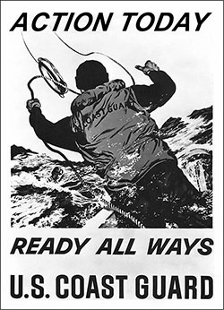
Desire to protect
http://www.dtic.mil/doctrine/nco/images/COAST-GUARD_fmt.jpg

Slide 19
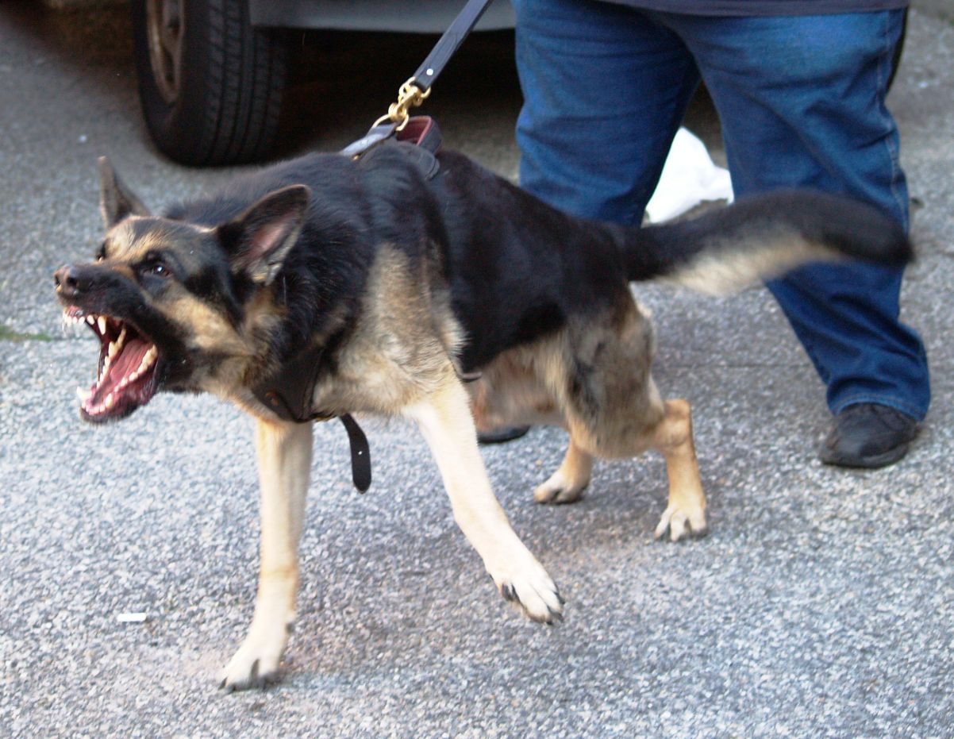
And straining at the leash…
http://www.abcsofdogtraining.com/files/1992084/uploaded/rex2.JPG

Slide 20

How far, how fast?
Image: http://tuningintoscifitv.com/wp-content/uploads/2009/11/Alice_04.JPG

Slide 21
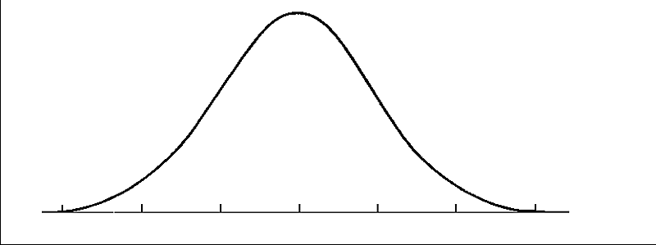
Target Audience
Will never get it
May get it
Predisposed to getting it
Already
get it
Image: http://andihammer.com/bell-curve/

Slide 22
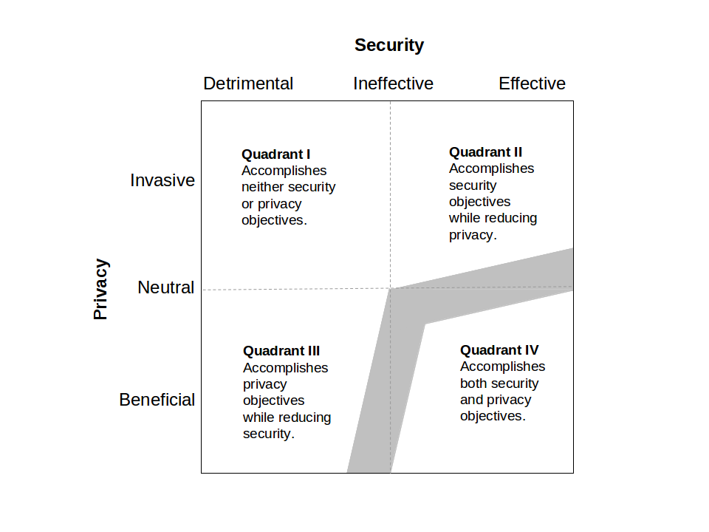
Win-Win Solutions

Slide 23
Win-Win Solutions

Slide 24
Win-Win Solutions

Slide 25
Win-Win Solutions

Slide 26
Win-Win Solutions

Slide 27
Win-Win Solutions

Slide 28
Win-Win Solutions

Slide 29
Recent Successes

Slide 30


Slide 31

Marcia Hoffman, Congressman Jim Langevin, Vice Admiral Mike McConnell, Jeff Moss, and Sami Saydjari (Gregory Conti Moderator). The Role of the U.S. Government in Cyberspace, United States Military Academy Senior Conference, West Point, NY, June 2012.

Slide 32
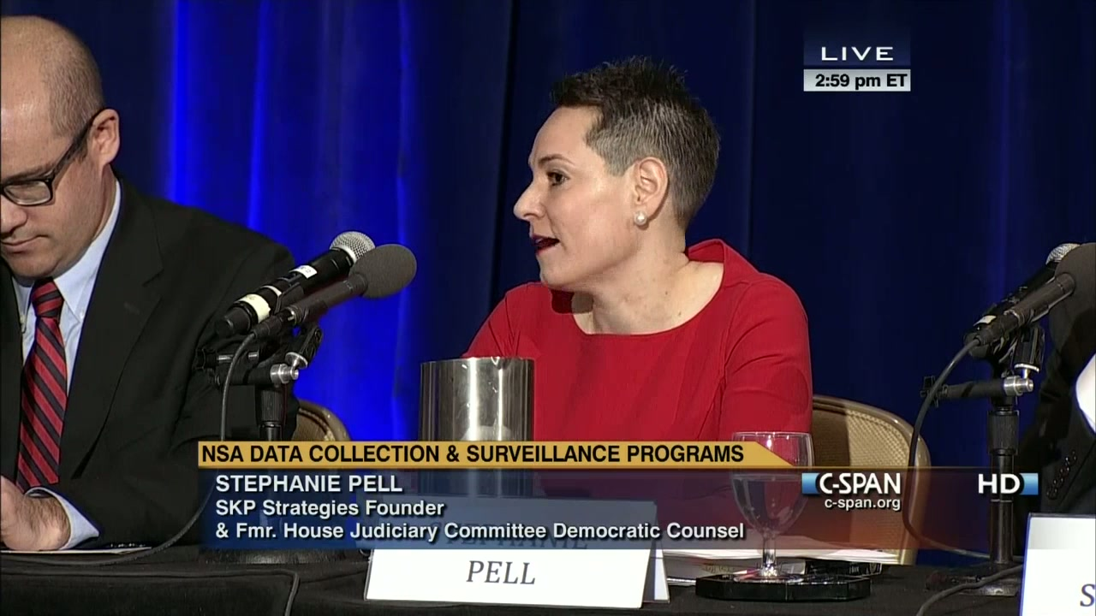
Ethics Fellow

Slide 33
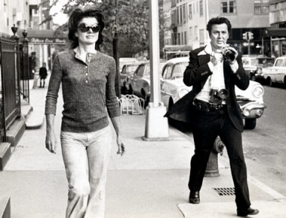
Online Privacy
Description: Surveillance was once the domain of nation states, but the rise of the Internet brings surveillance into the day to day lives of everyone. This project studies the impact of our instrumented world and how we should live within it.
Publications:
  “Do Robots Dream of Electric Laws? An Experiment in the Law as Algorithm.” We Robot, Stanford, April 2013.
  “A Framework for Analysis of Quotidian Exposure in an Instrumented World.” IEEE Carnahan Conference on Security Technology, 2012.
  "Confronting Automated Law Enforcement." We Robot, Miami, April 2012.
  “The Military’s Cultural Disregard for Personal Information,” Small Wars Journal, 2010
  “Self-monitoring of Web-based Information Disclosure," Workshop on Privacy in the Electronic Society, 2007.
  “An Honest Man Has Nothing to Fear: User Perceptions on Web-based Information Disclosure,” Symposium on Usable Privacy and Security, 2007.
Surveillance has moved from
celebrities to large swaths
of the population

Slide 34
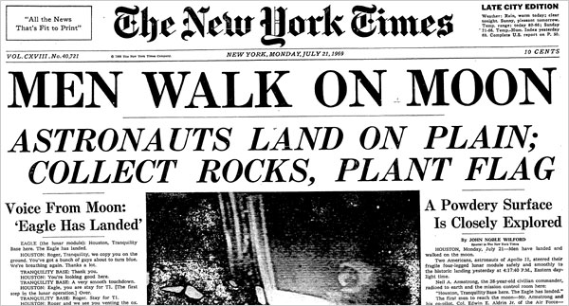
What Will End Progress?
Insert Embarrassing
Headline Here

Slide 35
Towards solutions…

Slide 36
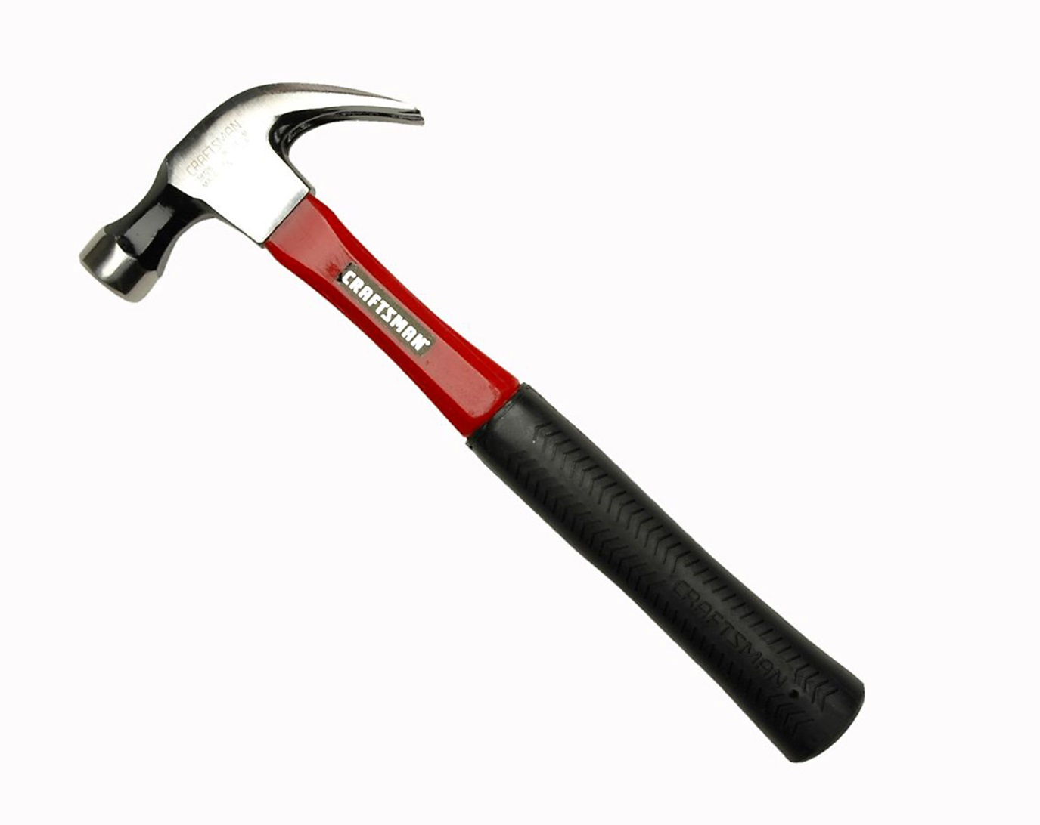
Available Tools
Posters / Pamphlets
Professional reading lists
Required annual training
Training courses
  Both online and physical
Civ/Mil professional education
Professional writing
Privacy research groups
Chief Privacy Officers
Conferences and workshops
Senior leader support

Slide 37
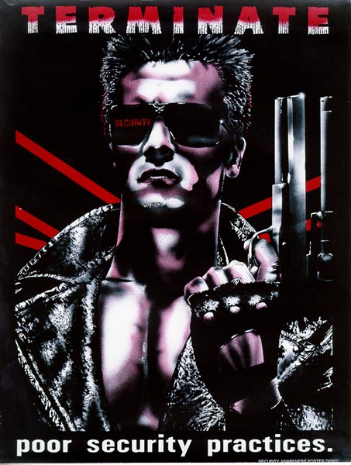
Posters

Slide 38
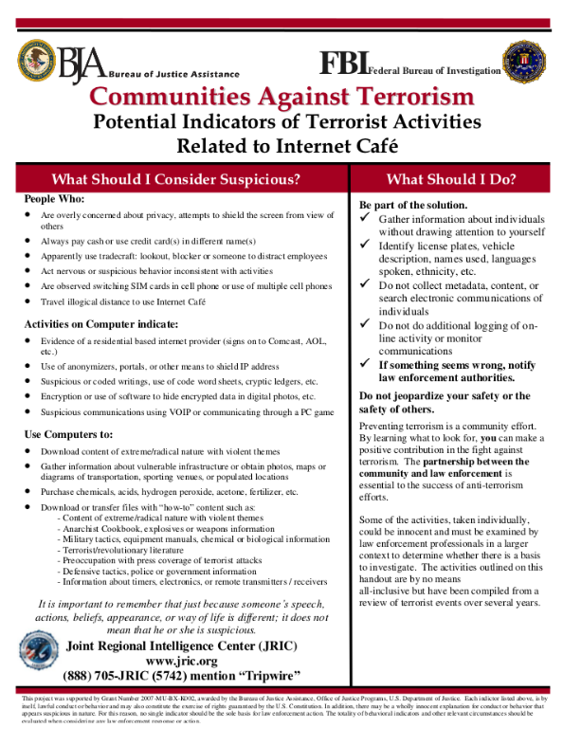
Pamphlets
Suspicious Activities
“Overly concerned about privacy”
“Always pays cash”
“Use of anonymizers … to shield IP address”
“Uses encryption”
“Downloads information about electronics”

Slide 39
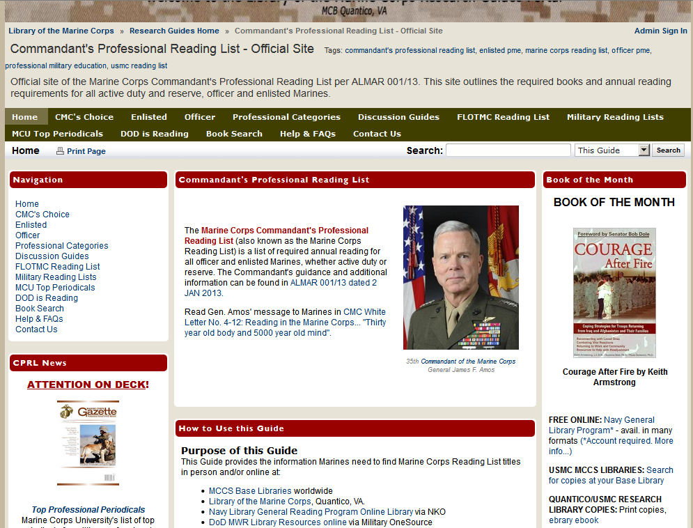
Professional Reading Lists

Slide 40
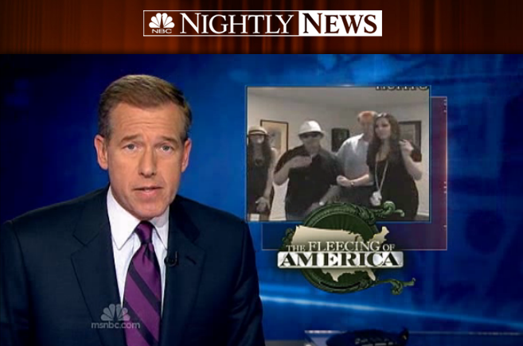
Conferences
“Photos Emerge from GSA Vegas Spending Spree”

Slide 41
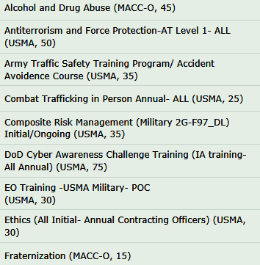
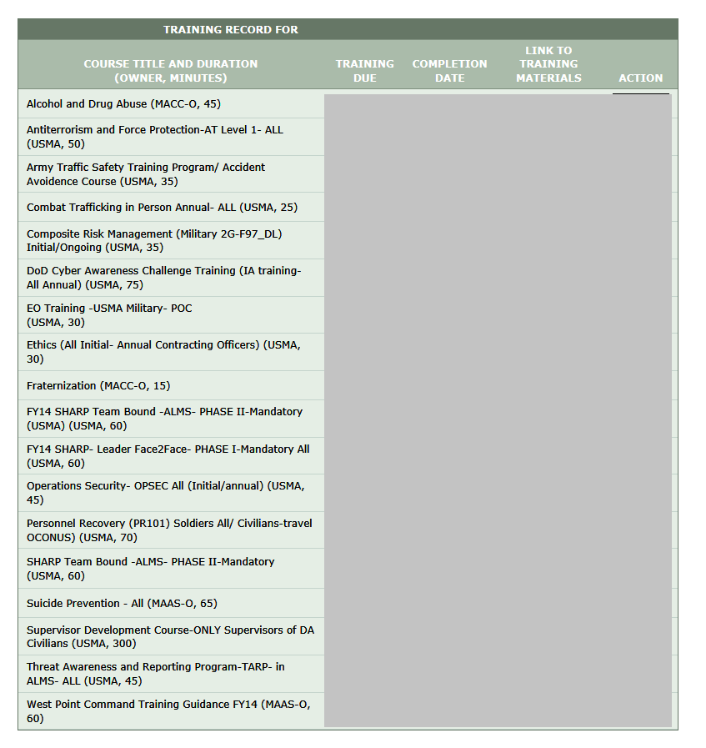
Required Annual Training

Slide 42
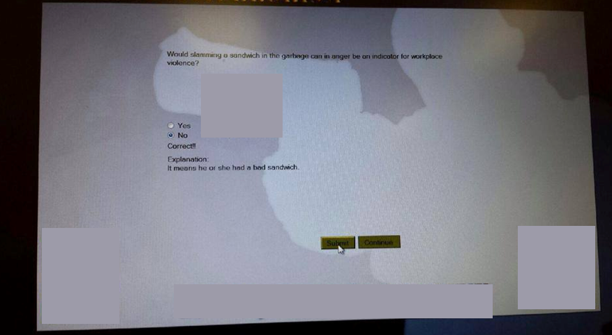
Training at Boot Time

Slide 43
An Unfair Example…
Would slamming a sandwich in the garbage can in anger be an indicator for workplace violence?

Slide 44
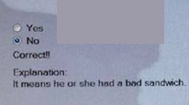
And the answer…

Slide 45
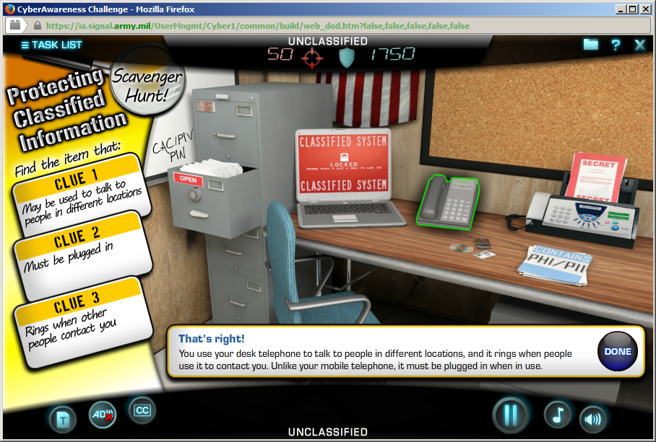

Slide 46
Clue 1
May be used to talk to people in different locations

Slide 48
Clue 2
Must be plugged in

Slide 50
Clue 3
Rings when other people contact you

Slide 52
That’s right!
“You use your desk telephone to talk to people in different locations, and it rings when people use it to contact you.
Unlike your mobile telephone, it must be plugged in when in use.”

Slide 53
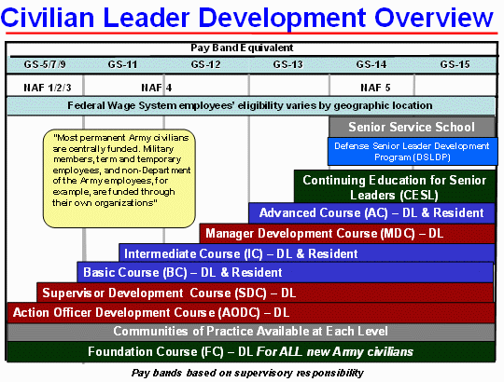
Professional Education Programs

Slide 54
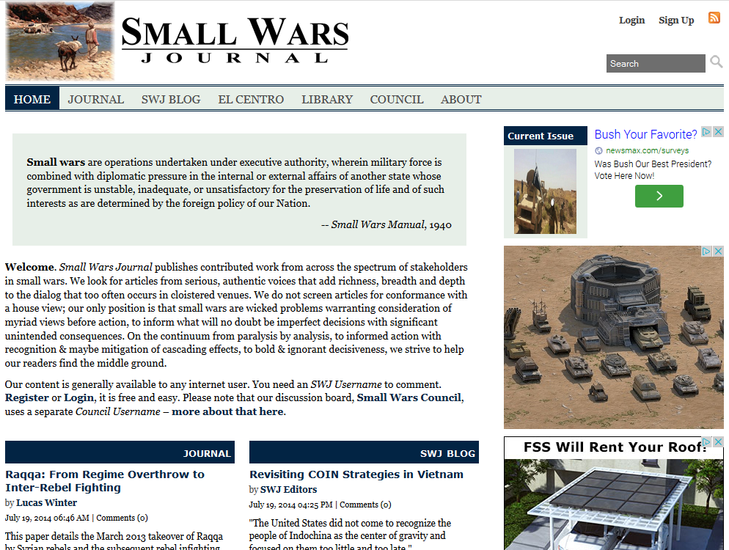
Professional Writing

Slide 55
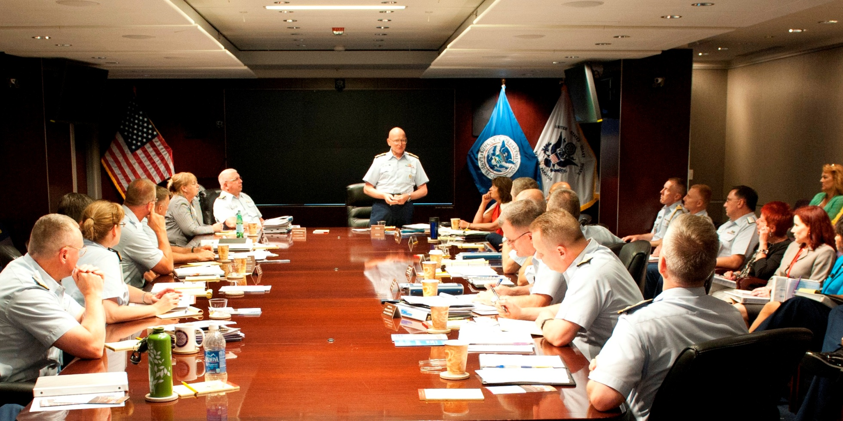
Senior Leader Support

Slide 56

And an upcoming opportunity…

Slide 57
Strategies
Seek to win over mindset, not out of “compliance”
Accommodate the limited rate of cultural change
Develop mutual respect
Seek broad impact
Find allies within target communities
If possible, send the right messengers with street cred in target community
Speak the language of the target community
Facilitate grassroots efforts
Educate senior leaders
Research as an enabler for outreach, advising, and education

Slide 58
Strawman Content
Other Concepts
Understand that the perspective of the citizen is equally important to democracy.
Teach that you can’t always be so certain that your perspective is right.
Transparency and citizen engagement is positive.
Freedom of thought, freedom of expression, our democracy depends on it.
Introduction
  Why, who cares, and so what
History of privacy and civil liberties
  General examples
  Examples of abusive States
Legal and policy concepts
  Ideological underpinnings
  Representative case law
The Rise of the instrumented world & IoT
  Did you know examples…
    Microdots on print outs
    Every envelop and package is scanned
    What the future portends
Alternative views

Slide 59
Conclusions
No overnight solution
Progress will be fragile at first
Requires engagement/empathy on all sides
Inside the given tribe is better
Actionable solutions
Reach beyond military to policy makers

Slide 60
- When/how did your “awakening” occur?
- If you were running training for junior, mid-career, or senior government officials, what would you teach them?
- What teaching strategies and techniques would you employ?
- What sources do you recommend for ideas and content? Other courses to draw upon?
- What are the best ways to generate momentum and distribute content?

Slide 61
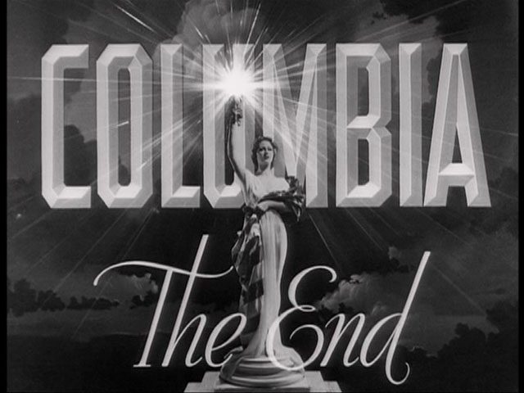
Greg Conti // gregory.conti@usma.edu

