Slide 1

Towards a Cyber Leader Course Modeled on
Army Ranger School
COL Gregory Conti
Army Cyber Institute
This work has been cleared for public release. Distribution unlimited.
Notes:
Since 1950, the U.S. Army Ranger School has garnered a well-earned reputation as one of the most demanding military schools in the world. Graduates have served with distinction in special operations units including the Ranger Regiment and Special Operations Command as well as line units throughout the Army. With the emergence of cyberspace as an operational domain and the critical shortage of technically and operationally competent cyber leaders, the time has come to create a U.S. Army Cyber Leader Course of equal intensity, reputation, and similar duration, but focused on cyber operations. This article presents a model for the creation of such a school. We are not attempting to create a longer-term training program akin to the U.S. Special Forces Qualification Course or to replicate classroom training programs found in industry, academia, government, or the intelligence community. What we propose is unique, demanding, immersive, and fills a necessary gap in Army cyber leader development.

Slide 2
The views expressed in this talk are those of the speaker and do not reflect the official policy or position of West Point, the Department of the Army, the Department of Defense, or the United States Government.

Slide 3
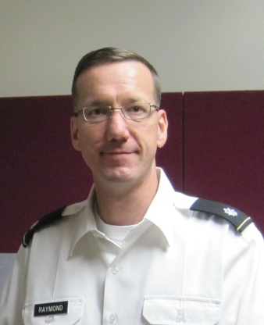

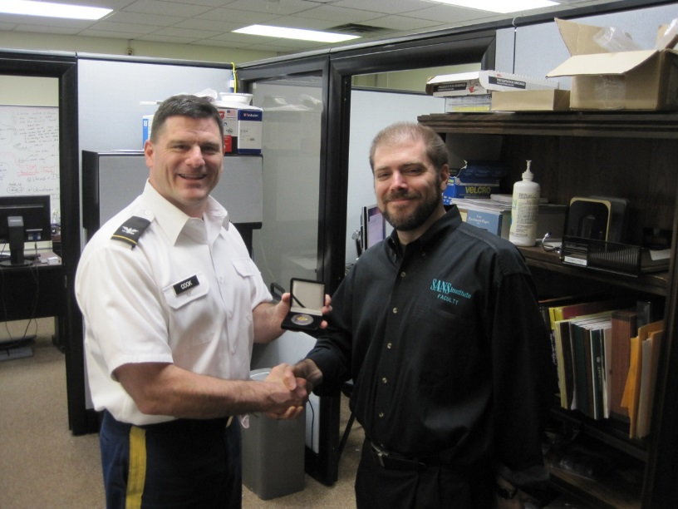
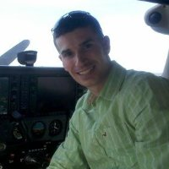
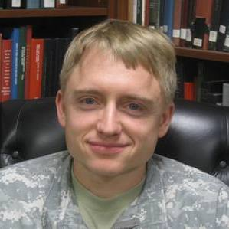
Collaborators
LTC Dave Raymond
COL(R) Dan Ragsdale
COL Tom Cook and Mr. Ed Skoudis
1LT Michael Weigand
MAJ Todd Arnold

Slide 4
“Elite, Trusted, Precise, Disciplined”

Slide 5
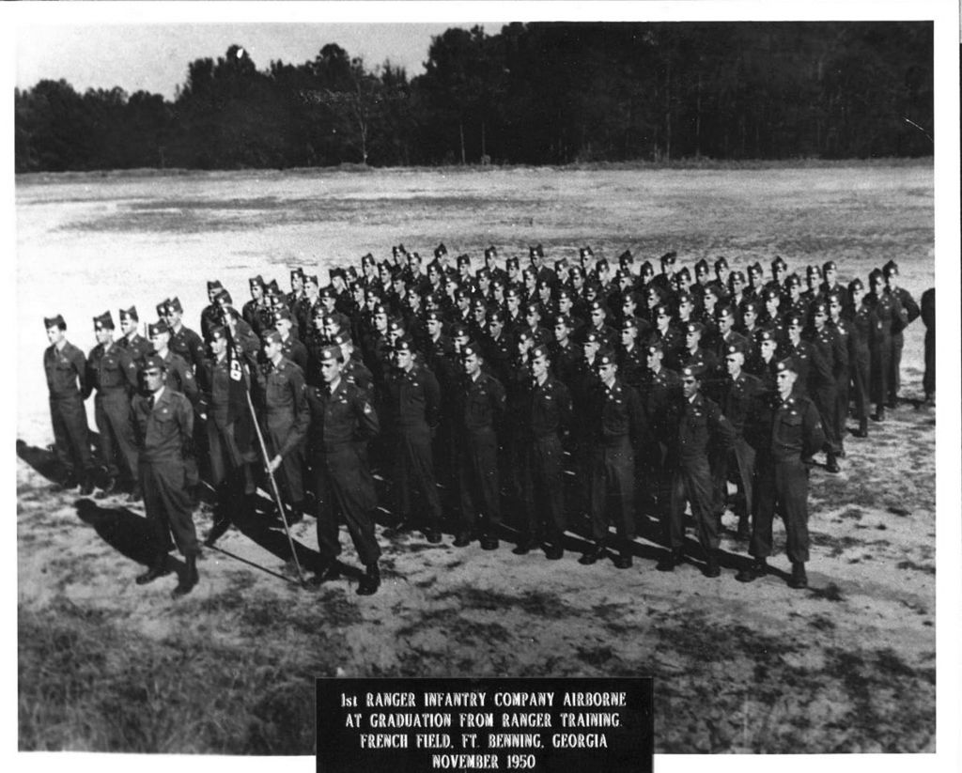
https://en.wikipedia.org/wiki/Ranger_School#mediaviewer/File:First_Ranger_Class_Graduation_Ceremony.jpg
Notes:
1st Ranger Class Graduation 1950

Slide 6
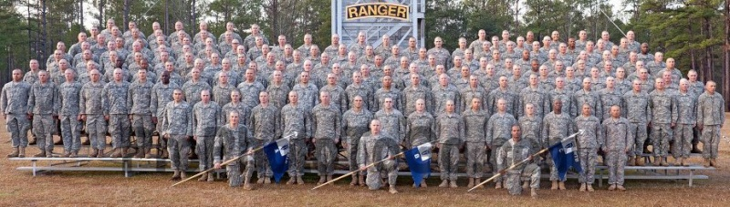
http://www.msgunowners.com/t36272p40-lets-see-something-cool-that-you-have-that-others-likely-don-t

Slide 7
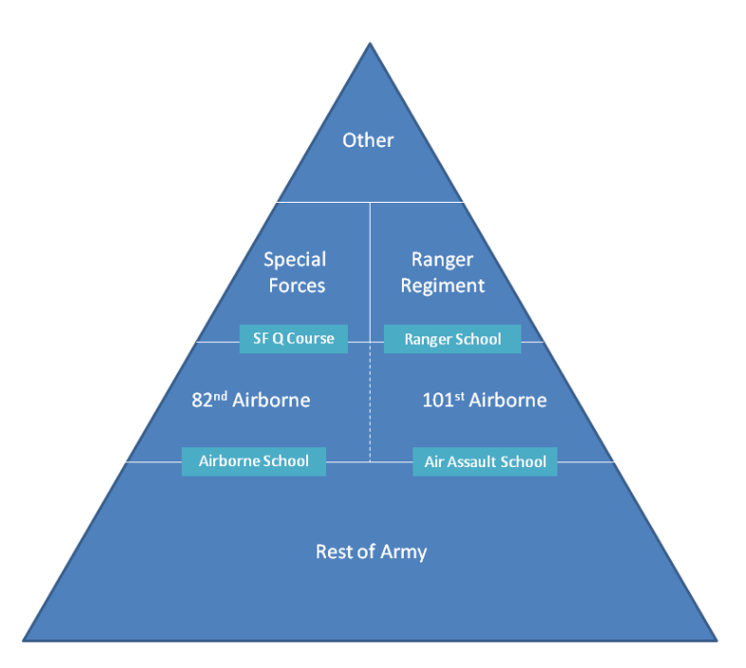
Notes:
How do develop, and validate cyber leaders
Tactical cyber

Slide 8
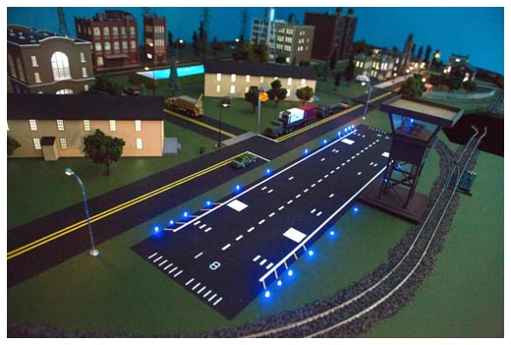
Cyber City

Slide 9
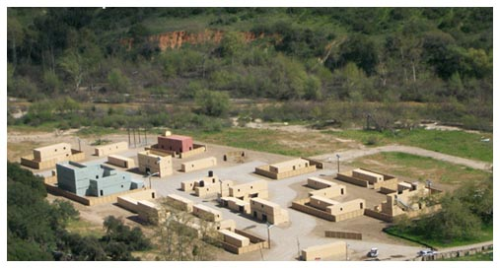
MOUT Site

Slide 10
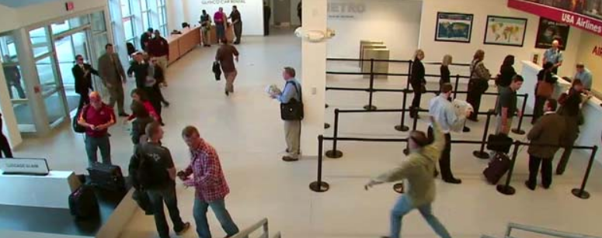
FLETC

Slide 11
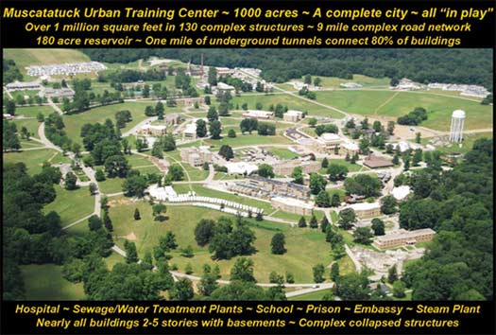
FLETC
http://usacac.army.mil/cac2/call/docs/10-46/files/Fig_4-8.jpg
Notes:
Gary Deckard

Slide 12
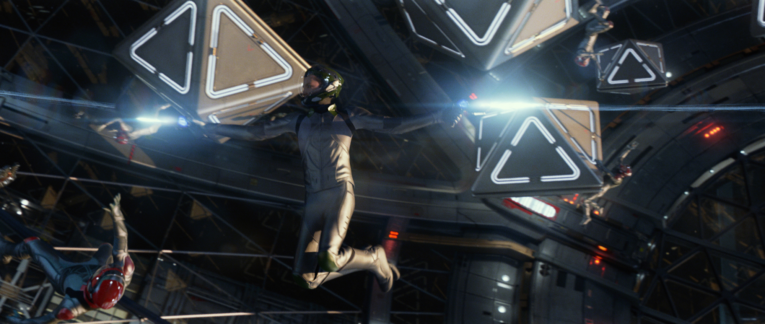
Battle School
http://cdn.screenrant.com/wp-content/uploads/Enders-Game-Battle-School-Fight-Sequence.jpg

Slide 13
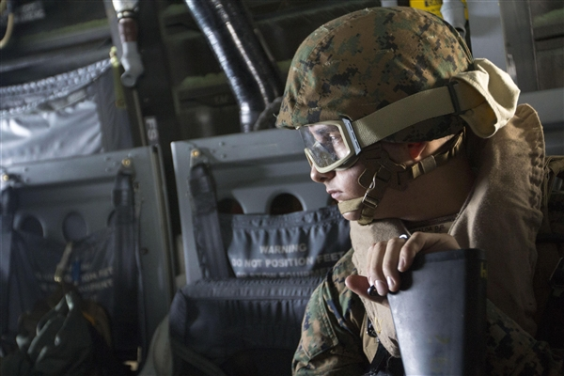
Overview / Characteristics
Rigorous, immersive experience
61 Days
Not just a “tough classroom experience”
Mission based with rotating leadership positions
Remote and close access
Open to Women and Men
  - Wounded warriors too?
Periods of high-stress and sleep deprivation
Balance student backgrounds, in course training, reachback support and improvisation for mission success
Complement, extend, reinforce prior training, push students to new level
Attrition and Recycles
http://www.defense.gov/DODCMSShare/NewsStoryPhoto/2013-06/scr_121215-M-BS001-003.JPG

Slide 14
Objectives
Leadership
  A warrior ethos - adapt, overcome, and fight through adversity to accomplish the mission
  Sound leadership of cyber warriors
  Work individually and as part of a team.
Technical and Tactical
  A sound understanding of the technical operation and dynamic nature of cyberspace
  The ability to teach themselves new technologies and new capabilities
  The ability to plan and execute cyber and cyber/kinetic military operations
Mental
  An adversary mindset
  The ability to attack the system
Interpersonal
  Appreciate and fit within both the military and civilian cyber security communities
  The communication skills to communicate technical subjects to non-technical and technical audiences.
Ethical
  - Respect for the dangerous skills which they have been taught
All in the Context of Cyber Leadership

Slide 15
Phases
 | Phase 1 | Phase 2 | Phase 3 | Phase 4
Mission Construct | Individual | Small co-located teams | Distributed cyber teams | Distributed cyber and kinetic teams
Training/Mission Balance | 80/20 | 50/50 | 50/50 | 20/80

Slide 16
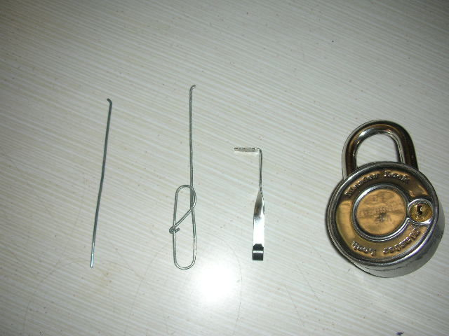
Representative Training
Phase 1
Safety Brief
Cyber Leaders Reaction Course
Lock Picking and Key Fabrication
Social Engineering
Battlefield Forensics
3D Printing
Botnets
Cyber Threat
Space Systems
Battlefield Robotics
Coding Exam
Reverse Engineering
…
Exam
Mission
http://cdn.instructables.com/FUX/A9LM/FLLZYA98/FUXA9LMFLLZYA98.LARGE.jpg

Slide 17
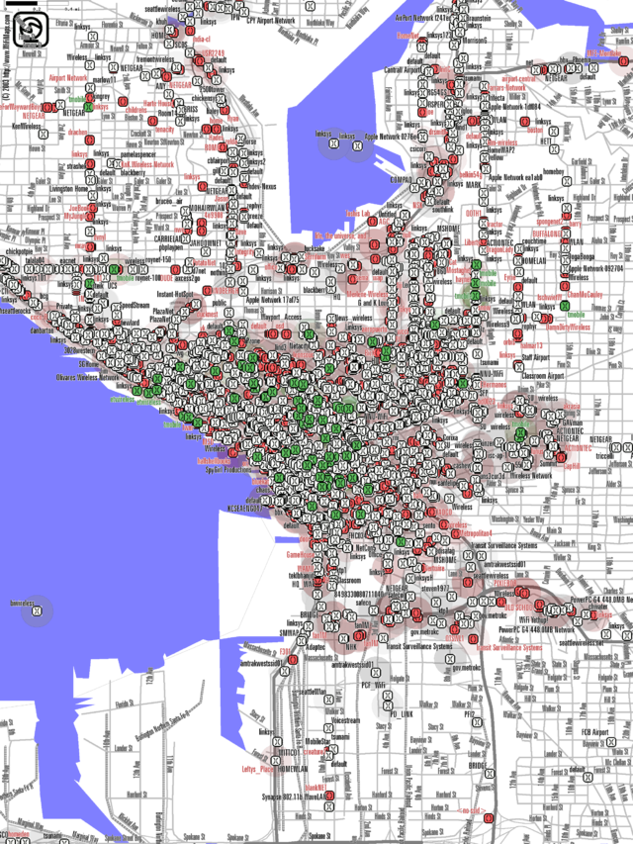
Representative Training
Phase 2
Cyber Operational Preparation of the Environment
Network Mapping
Cyber Mission Planning
Cyber Call for Fire Process
Metadata Analysis
Magnetic Barcode Readers, Smart Cards and Related Technologies
Electronic Locks
Supply Chain Security
Penetration Testing
Electronics Lab
Wired and Wireless Network Sniffing
Legal Authorities / ROE
Exploit Creation
…
Missions
Exam
https://en.wikipedia.org/wiki/Wardriving#mediaviewer/File:Seattle_Wi-Fi_map_UW-300-letter-3.png

Slide 18

Representative Training
Phase 3
Hardware Enhanced Processing
Advanced Forensics Techniques
Trojan Horse Software
Cyber Battlefield Deception
Fabricating a Wireless Sniffing Toaster
Man In The Middle Attacks
Domain Name System
AntiVirus Evasion
Shredded Paper Reconstruction
Fuzzing
Hash Cracking Lab
Defensive Driving
Distributed Denial of Service Attacks
Advanced Eavesdropping Techniques
Drone Lab
…
Missions
Exam
http://cnet2.cbsistatic.com/hub/i/2011/11/17/9bce317b-fdbe-11e2-8c7c-d4ae52e62bcc/52f57ad9c7d9ceac1fbcaa4479bd3e8e/puzzle31.png

Slide 19
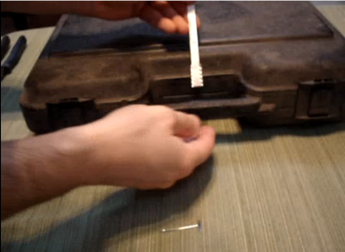
Representative Training
Phase 4
Emerging Technologies
Hacker Community
Medical Device Security
Disruptive Technologies
Media Relations
Satellite Systems Security
Vehicular and Transportation System Security
Countering Anti-Tampering Hardware and
Magic and Mischief
…
Exam
Missions
Graduation
https://cdn.shopify.com/s/files/1/0177/9886/files/metal_antitamper.png?4

Slide 20
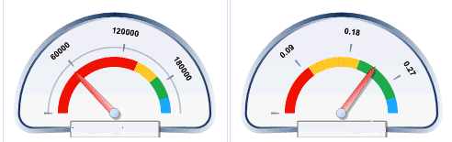

Dialing In Optimal Learning
Stress
Sleep
Available time
Reachback support
Improvisation vs. Training
Required prior knowledge
…
http://www.claimcare.net/Portals/11609/images%5C/sample%20dashboard%20report%201.gif

Slide 21
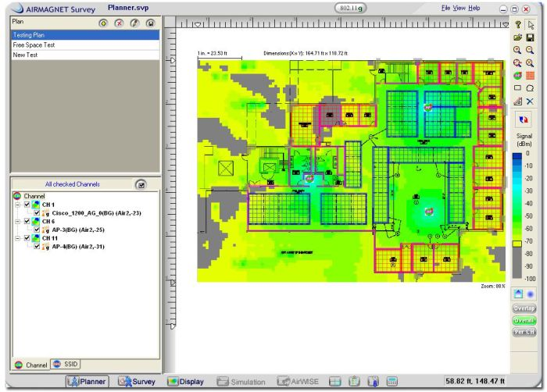
Mission – Wireless Survey and Exploitation
The team must penetrate an adversary’s wireless network. Techniques could include war driving, war flying, wireless access point spoofing, among others.
http://s3.egospodarka.pl/grafika/oprogramowanie-sieciowe/Programy-AirMagnet-Planner-i-Survey-do-sieci-WiFi-Tiv2nC.jpg

Slide 22
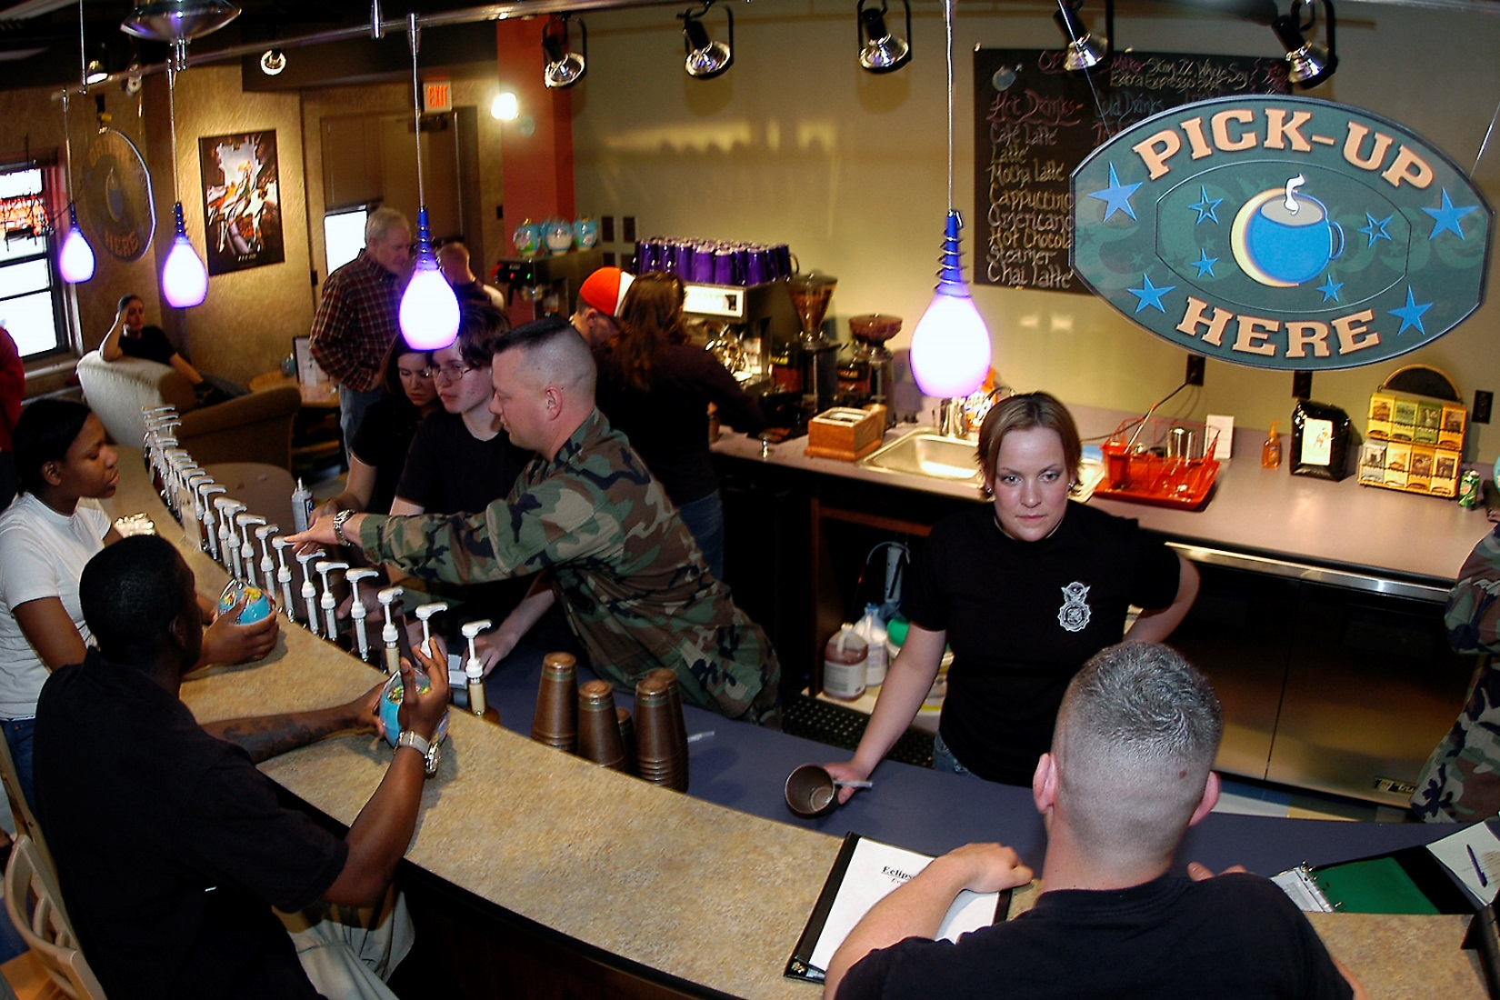
Mission – Cyber Cafe
The local cyber cafe is a hotbed of adversary activity.
The team is tasked to collect information.
http://www.peterson.af.mil/shared/media/photodb/photos/050408-F-8636B-002.jpg

Slide 23
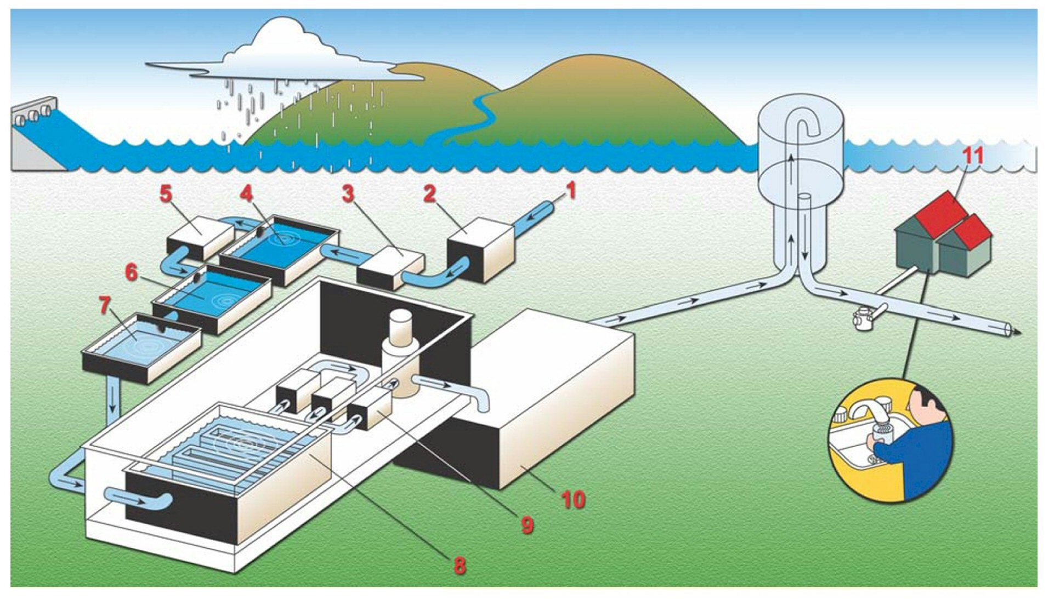
Mission – Water, Water Everywhere
The local water plant is under cyber attack. The team must defend it. Alternatively, the team could attack a water plant or set up a water plant honeypot. The “water plant” could be replaced with a bank, library, hospital, power plant, Internet provider, cell phone provider etc.
http://columbus.gov/uploadedImages/Public_Utilities/AboutUs/Treatment4ColorFullSz.jpg

Slide 24
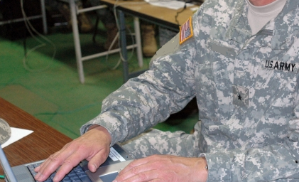
Mission – The General’s Laptop
The General wants to hook a laptop to an official network.
The team only has 30 minutes to make it safe to do so
http://columbus.gov/uploadedImages/Public_Utilities/AboutUs/Treatment4ColorFullSz.jpg

Slide 25
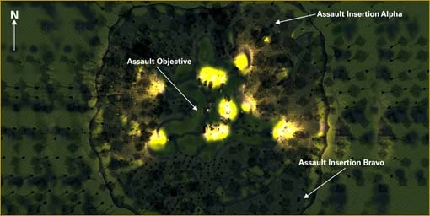
Mission – Support a Kinetic Raid
A military unit needs timely cyber effects precisely delivered in order to accomplish their kinetic attack. Unfortunately they provide little warning for the team to prepare.
http://manual.americasarmy.com/images/4/49/Swamp_Raid.jpg

Slide 26
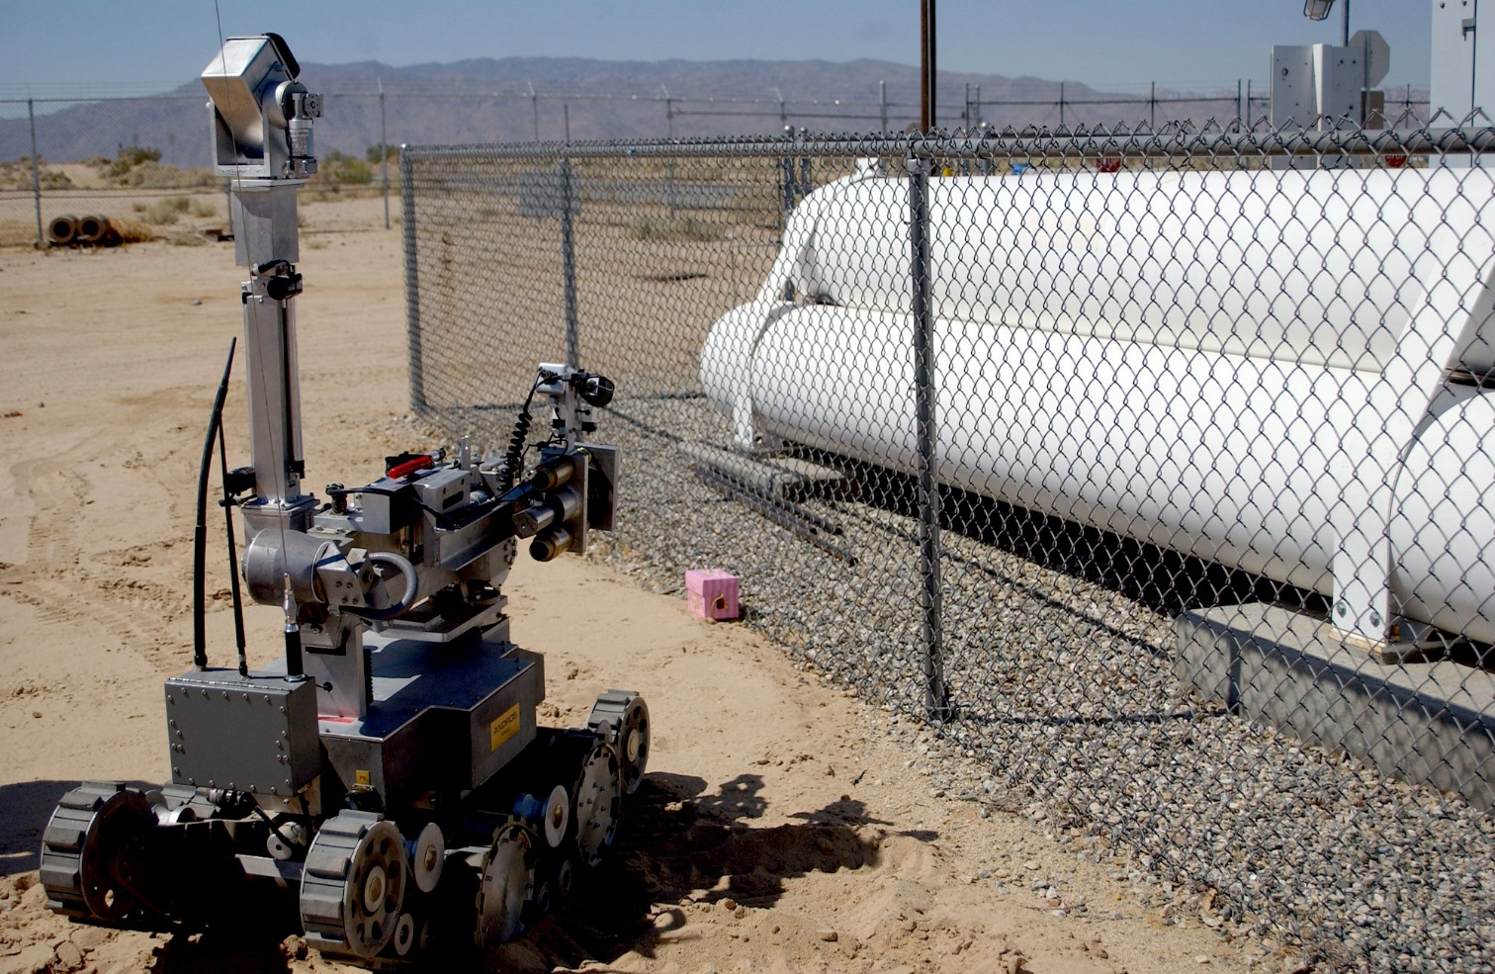
Mission – Judgment Day
The adversary is using a new type of battlefield robot. The team must reverse engineer a captured bot and improvise a countermeasure.
http://www.defense.gov/transformation/images/photos/2005-08/Hi-Res/EODHighRes.jpg

Slide 27
Graduation Requirements
To graduate, students must successfully pass
  All peer reviews
  All qualification examinations
  and must receive a “GO” on one mission leadership position per phase
  and a “GO” on at least 50% of the mission leadership positions held during the course.
Borderline students can recycle
Ethical failures and other violations will be reviewed on a case-by-case basis
Instructor issued SPOT Reports – positive and negative
  Too many negative, potential removal from course
  Positive reports, combined with strong performance, may lead to “honor graduate”

Slide 28
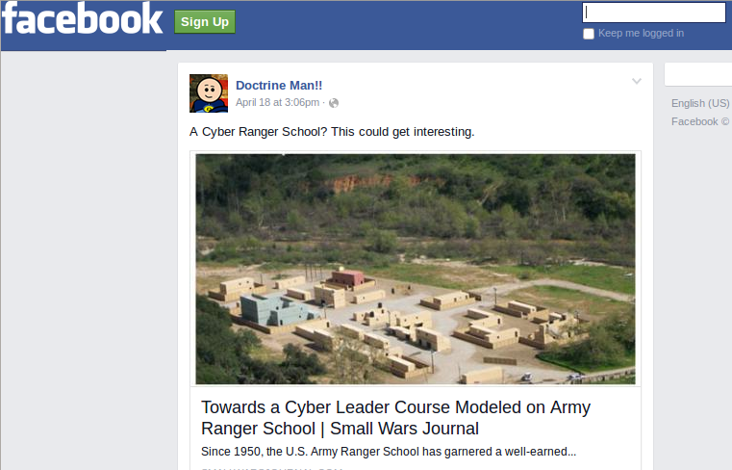
Doctrine Man

Slide 29
You have to write code 19 hours a day for 60 days with little food.

Slide 30
I knew Ranger School would eventually become an online school.

Slide 31
If they go thru in winter do they get to sew on their cyber tab with white thread?

Slide 32

Feedback

Slide 33
Is it humanly possible for an individual to possess the skills required for all the listed missions?*
* Summarized for brevity.
http://smallwarsjournal.com/jrnl/art/towards-a-cyber-leader-course-modeled-on-army-ranger-school

Slide 34
Just as I do not wear my TS/SCI clearance on my sleeve, might not be a good idea to do the same thing with a CYBER tab.
http://smallwarsjournal.com/jrnl/art/towards-a-cyber-leader-course-modeled-on-army-ranger-school

Slide 35
This was fascinating. I really enjoyed how the authors noted that cyber MOSs might make for a good second career for our Wounded Warriors.
http://smallwarsjournal.com/jrnl/art/towards-a-cyber-leader-course-modeled-on-army-ranger-school

Slide 36
Has anyone considered the possibility that Cyber Leaders should learn to command and control Artificially Intelligent Entities (AIE) to help fight cyber battles?
http://smallwarsjournal.com/jrnl/art/towards-a-cyber-leader-course-modeled-on-army-ranger-school

Slide 37
I'm a 27 year old prior enlisted Marine 2005-2012. If this was an honest to god thing. Call me. Sign me up, no bonus needed.
http://smallwarsjournal.com/jrnl/art/towards-a-cyber-leader-course-modeled-on-army-ranger-school

Slide 38
Personal Assessment
The course is necessary and doable, but challenges convention
Senior leader support is critical
Appropriate facilities exist
Qualified uniformed instructors in short supply (for now)
  But bootstrapping is possible
Could be expanded to Joint Community for critical mass and pooling of resources
Strong potential as recruiting, leader validation, and retention tool
Ultimately, this school must be “owned” by the military (Army)
Tab invites cultural pushback, but captures essence
Reputation will only be earned through accomplishments of the school’s graduates

Slide 39
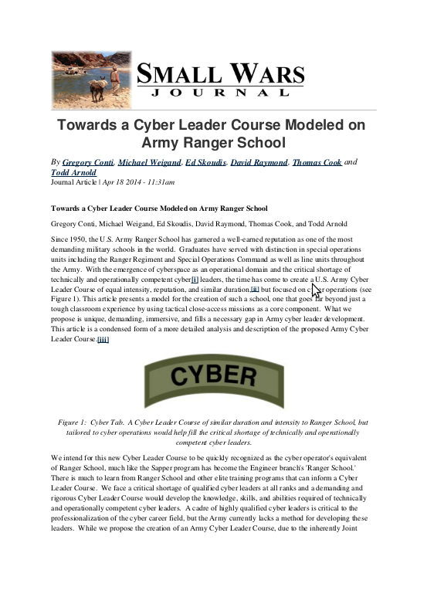
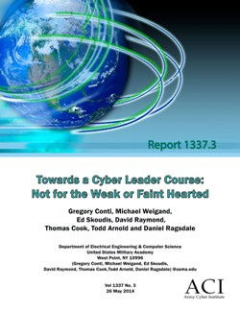
More Information

Slide 40
Towards a Cyber Leader Course Modeled on
Army Ranger School
COL Gregory Conti
Army Cyber Institute

