Slide 1
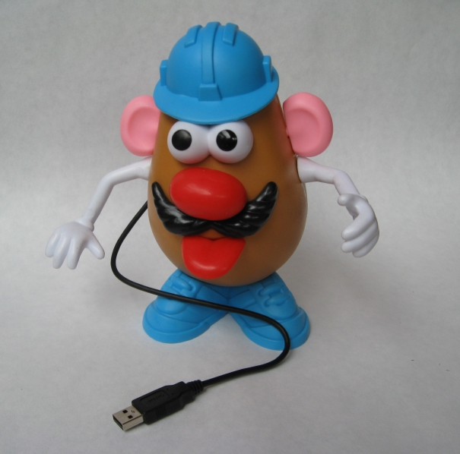
Deception for the Cyber Defender: To Err is Human; to Deceive, Divine
Tom Cross, Drawbridge Networks
Dave Raymond, West Point
Greg Conti, West Point
Notes:
provide structured understanding
wider variety of applications than you might have thought
more than honey pot
we don’t really talk enough about defensive perspective
can’t give you a recipe then it won’t be effective
have to do your own thing and understand how it fits into your overall operation

Slide 2
Disclaimer
The views expressed in this talk are those of the authors and do not reflect the official policy or position of Drawbridge Networks, West Point, the Department of the Army, the Department of Defense, or the United States Government.
We are not lawyers, nor are we giving legal advice. Please consult your legal advisor before even considering deception activities.

Slide 3
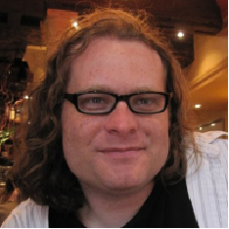


Our Background...
Tom Cross
Drawbridge Networks
David Raymond
West Point
Greg Conti
West Point

Slide 4

Planning…*
DerbyCon (1 Jan)
TOORCON (29 Jan)
ShmooCon (26 April)
DEFCON / BH (8 Nov)
Avoid_Date = Favorite_Con_Date - 266
We are not doctors, do not plan your pregnancy around these figures.

Slide 5

Gift That Keeps on Giving…
https://en.wikipedia.org/wiki/Birthday_cake#mediaviewer/File:Birthday_cake_for_one-year_old.jpg

Slide 6

Baby Gift Collection…
https://4.bp.blogspot.com/-WixNOxdaC04/UNPO5B1Ei1I/AAAAAAAACXA/Y2n41V5qaYQ/s1600/IMG_1906+12-14-2012+9-58-52+PM.JPG

Slide 7
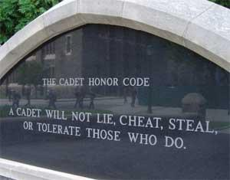
Lie, Cheat, Steal...
“Cadets violate the Cadet Honor Code by lying if they deliberately deceive another person by stating an untruth, or by any direct form of communication, to include the telling of a partial truth or the vague or ambiguous use of information or language, with the intent to deceive or mislead.”
“Though fraud [deception] in other activities be detestable, in the management of war it is laudable and glorious, and he who overcomes an enemy by fraud is as much to be praised as he who does so by force.” - Niccolo Machiavelli
http://upload.wikimedia.org/wikipedia/commons/9/9e/TheCadetHonorCodeMonument.jpg
http://www.usma.edu/scpme/ncea/siteassets/sitepages/resources/uscc%20pam%2015-1%20%2811%20nov%2009%29%20v5.pdf
Notes:
Machiavelli quote from Discourses, 1517 (Dave)

Slide 8
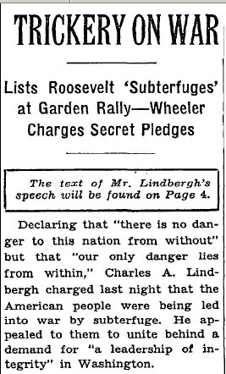
Definitions
Denial - Blocking of adversary access to accurate information, regarding one’s actions or intentions.
Deception - Construction of a false reality for the adversary, via intentionally “leaked” false information, or other measures.
False Flag - Covert operation designed to deceive, such that ops appear to be carried out by other entities, groups or nations.
http://en.wikipedia.org/wiki/False_flag
http://en.wikipedia.org/wiki/Denial_and_deception

Slide 9

Why, So What, Who Cares...
Deception is a powerful, but under utilized tool
(at least by defenders)
Detect insider threats
Full range of “effects” on adversaries possible through deception

Slide 10
Attribution and Information Campaigns
“Parts of the malicious computer code used against Target's credit-card readers had been on the Internet's black market since last spring and were partly written in Russian.”
“For example, XXX's report says that more than half of the malicious files it analyzed were set to Russian language settings, which suggests "that a significant portion of APT28 malware was compiled in a Russian-language build environment consistently over the course of six years." Also, 96 percent of the malware was compiled between a Monday and Friday during an 8 AM to 6 PM work day in the Moscow time zone.”
http://online.wsj.com/articles/SB10001424052702304419104579324902602426862
http://www.pcworld.idg.com.au/article/558341/clues-point-russia-long-running-spying-campaign/

Slide 11
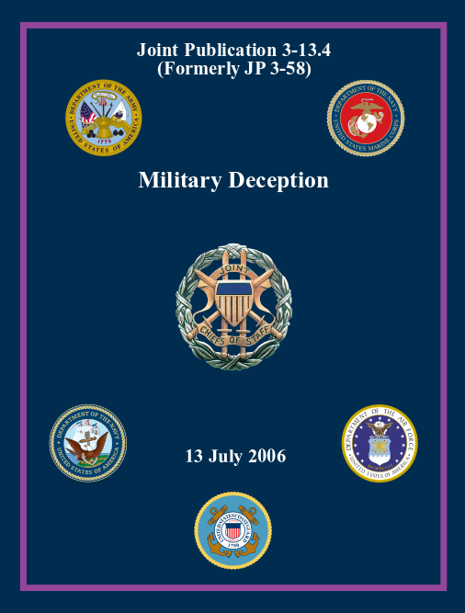
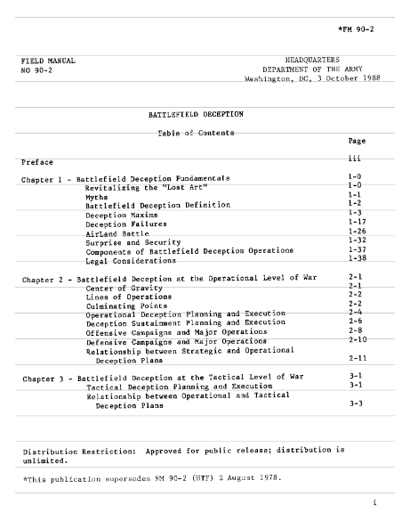
Useful Reference
JP 3-13.4
https://cyberwar.nl/d/jp3_13_4.pdf
FM 90-2
http://www.cgsc.edu/carl/docrepository/FM90_02_1988.pdf

Slide 12
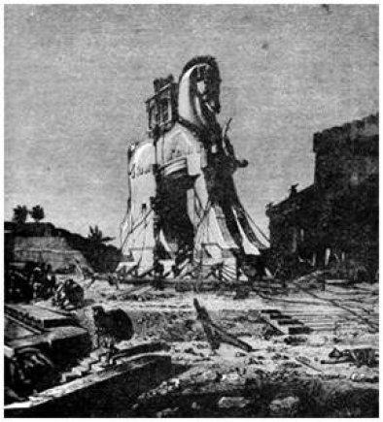
Considerations
Resources
  Skill Level (yours and theirs)
  Resources
    Financial
    Technical
    Intelligence
  Novice to APT/Nation State
Predictability
Attribution
Active Defense
Legality

Slide 13
Focus - Target for Cyber Deception
 | Attacker | Defender
Human | Decoy web page Honeynet | Convincing IT Help Desk to reset password Phishing
Code / Machine | Analysis VM environment convinces malware it is “real” Spoofed network service banners | Spoofing browser user agent Spoofing IP address Spoof packet header data

Slide 14

Effects
Deceive - Cause a person to believe what is not true
Degrade - Temporary reduction in effectiveness
Delay - Slow the time of arrival of forces or capabilities
Deny - Withhold information about capabilities
Destroy - Enemy capability cannot be restored
Disrupt - Interrupt or impede capabilities or systems
Divert - Force adversary to change course or direction
Exploit - Gain access to systems to collect or plant information
Neutralize - Render adversary incapable of interfering with activity
Suppress - Temporarily degrade adversary/tool below level to accomplish mission
http://armypubs.army.mil/doctrine/DR_pubs/dr_a/pdf/fm3_60.pdf
http://armypubs.army.mil/doctrine/DR_pubs/dr_a/pdf/fm3_09.pdf
https://openclipart.org/image/800px/svg_to_png/191794/william-morris-letter-d.png

Slide 15
Example Cyber Deception Effects for Attacker and Defender
 | Attacker | Defender
Fail to observe | Prevent the defender from detecting the attack. | Prevent the attacker from discovering their target.
Reveal | Trick the defender into providing access. | Trick the attacker into revealing their presence.
Waste Time | Focus the defender’s attention on the wrong aspects of the incident. | Focus the attacker’s efforts on the wrong target.
Underestimate | Induce the defender to think the attack is unsophisticated, not targeted. | Induce the attacker into thinking that the sought after thing is not here.
Disengage | Induce the defender into thinking that the attack is contained or completed. | Induce the attacker into thinking that their have already achieved their goal.
Misdirect | Focus the defender on a different attacker. | Encourage the attacker to target a different victim.
Misattribute | Induce the defender into thinking that the attacker is someone else. | Induce the attacker into thinking that they’ve compromised the wrong network.
Notes:
I really think this slide is important.
A lot of the techniques that are listed on the attacker side are things that are common that have happened in real life, such as the relatively recent use of DDOS attacks to tie up incident response teams while other, targeted attacks are taking place.
On the defender side, there are two things that I think its important to emphasize:
“No Security Through Obscurity” is a mantra that has its place in combatting the sale of snake oil encryption systems, but people in infosec are sometimes too dogmatic about it and they apply it in too many different contexts. Security through obscurity is the reason that the Army wears green clothes. Its a time tested thing that really works. Armies aren’t going to start wearing orange any time soon.
2. When you are dealing with persistent adversaries, you aren’t necessarily going to win on a technical level. Some of the outcomes listed here for defenders speak to the need to target the person on the other side of the screen, and get them to decide to stop attacking you, because they’ve concluded that there is no point in continuing to do so. Thats how you win.

Slide 16
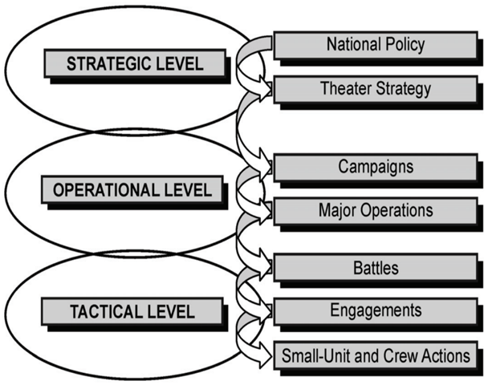
Levels of Deception
Strategic: Disguises basic objectives, intentions, strategies, and capabilities.
Operational: Confuses an adversary regarding a specific operation or action you are preparing to conduct.
Tactical: Mislead others while they are actively involved in competition with you, your interests, or your forces.
JW Caddel, Deception 101 - Primer on Deception, Strategic Studies Institute. At http://www.strategicstudiesinstitute.army.mil/pdffiles/pub589.pdf
Notes:
Categorization is not based on the type of deception being practiced, rather it depends on the objective of the deception.

Slide 17
Deception Maxims
Multiple Forms of Surprise
“Jones’ Dilemma”
Choice of Types of Deception
“Axelrod’s Contribution”
“The Monkey’s Paw”
Don’t Make it too Easy
“Magruder’s Principle”
Limits of Human Information Processing
Carefully Sequence deception activities to tell story
Collect Feedback
JP 3-13.4 (2006)
Notes:
Maxim
Magazine
Maxim is an international men's magazine based in New York, and prominent for its photography of actresses, singers, and female models whose careers are at a current peak.
dictionary an expression of a general truth or principle, especially an aphoristic or sententious one:
Magruder’s Principle - easier to maintain pre-existing belief
Limits of Human Information Processing
Law of small numbers
Difficulty in detecting small changes / conditioning
Cry Wolf
Multiple forms of Surprise (size/activity/location/unit/time/equipment/intent/sytle)
“Jones’ Dilemma” - deception is difficult if more “real” sources > “false” sources
“Choice of Types of Deception”
Ambiguity reducing
Ambiguity enhancing
Husband Deception Assets
Carefully Sequence deception activities to tell story
Feedback
Monitor for enemy deception
Monitor for success of your deception
Beware of Possible Unwanted Reactions
Monkey’s Paw story
Carefully Design Planned Placement of Deceptive Material
Make target “work” for it, don’t boldly announce what you are doing

Slide 18

Multiple forms of surprise
Surprise can be achieved in multiple categories: (traditionally) size, activity, location, unit, time, equipment, intent and style.
Notes:
Attacker: Who I am, what I’m after, where I’m coming from, my technical skill level.
Defender: What kind of gear we have in our security stack, what hours our SOC keeps, how the incident response team communicates,
Who:
location - where they are coming from
unit - what organization is responsible
How:
equipment -
intent -
style -
activity -
when - time?
lt

Slide 19

Jones’ Dilemma
Deception becomes more difficult as the number of sources available to confirm the real increases.
Notes:
Attacker - Do you have multiple ways of observing the target? Often, attackers don’t think this through because deceptive defensive operations aren’t expected.
Defender - Are you cross correlating different sources of information (ids vs pcap vs netflow)? What assumptions do you make when things don’t line up? (Probably that your gear isn’t working properly and not that you are being deceived.)

Slide 20

A Choice Among Types of Deception
Ambiguity Deception (A-type) - Increases doubt by providing multiple possible truths (noise). Too many possible truths can end the target’s suspension of disbelief.
Misdirection Deception (M-type) - Decreases doubt by focusing the target on a particular falsehood.
Notes:
In military parlance, you’ll hear these referred to as “A-type” (ambiguity) and “M-type” (misdirection or misleading).
I was just going to talk about this one from the perspective of the attacker. Lets say you create a piece of malware that has a bunch of IP addresses in it that look like command and control points, but are really just there to throw off the analyst and cause misattribution. Pointing them at a bunch of random servers associated with different threat actors is going to be much less effective, as a deception, then pointing them all at servers that are only associated with one nation state. In the later case you are focusing the target on one falsehood rather than presenting many.

Slide 21

Axelrod’s Contribution: Husband Deception Assets

Slide 22

The Monkey’s Paw
Watch for unanticipated reactions to deception events, particularly by friendly forces.
Notes:
You see this happen with pen tests - people believe they are real and take actions accordingly. If you don’t ever tell them it was a drill, years later they may still be telling war stories about that sophisticated attack their organization experienced that was really just a pen test.

Slide 23
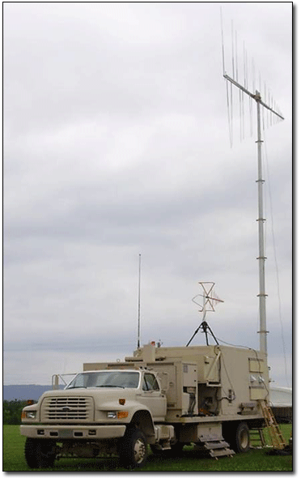
Information Fratricide
“Information fratricide is the result of employing information operations elements in a way that causes effects in the information environment that impede the conduct of friendly operations or adversely affect friendly forces ”
Wideband Configurable
Jammer System
http://www.peostri.army.mil/PRODUCTS/WCCJ/images/2010_WCCJ.gif
http://www.globalsecurity.org/military/library/policy/army/fm/3-07-22/ch3-iv.htm
Notes:
“A familiar example is friendly force jamming degrading friendly radio communications. However, information fratricide covers other IO aspects as well. Actions, perceptions, and information from friendly forces that create improper impressions can adversely affect IO in sensitive situations.“

Slide 24
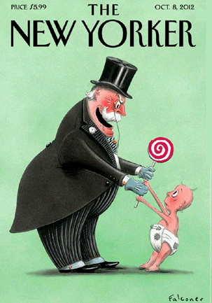
Don’t Make it too Easy
Carefully design planned placement of deceptive material. Make the target “work” for it. Don’t boldly announce what you are doing.
Notes:
As an attacker - make the malware analyst unpack your malware or fiddle with some poorly designed “encryption” or encoding before they can get the phony list of IP addresses you’ve embedded in there. If they have to work for it they are more likely to think that the product of their efforts is something valuable that you didn’t want them to find.
fake passwords on post it notes in lap drawer
usb thumb drives
obfuscation of malware
Childs’ diary - left on her desk? Likely fake.
Operation MINCEMEAT - used to convince Axis powers that the Allied main effort after North Africa would be the Balkans rather than Sicily. In April 1943, a man who had died of pneumonia was dressed as a British staff officer and was deposited off the coast Spain where he was picked up by a fisherman and handed over to the Germans. In his briefcase he had documents alluding to the Balkans plan (among other personal items). The Germans fell for the deception and Allies were able to capture the lightly-defended Sicily.

Slide 25

Magruder’s Principle
Confirmation Bias: A deception is most likely to be believed if it reinforces the target’s pre-existing beliefs rather than forcing the target to change their beliefs.
Notes:
Operation Fortitude in World War II: the effort to deceive the German High Command as to the primary landing point for the Allied invasion.
1. The Pas de Calais in northern France is the closest crossing from England.
2. GEN George Patton, arguably the Allies’ best field commander, was in command of the fictitious First US Army Group
The ‘rubber army’ and fake radio transmissions of the First Army Group only served to reinforce the German’s belief that the main invasion force would arrive at Calais, even long after the Allies landed and secured a beachhead at Normandy.
Cool terms:
“Cognitive dissonance” - where one ignores vital information simply because it interferes with pre-existing concepts or theories.
“Inertia of rest” - the tendency of people to believe certain assumptions remain valid even after they have been undermined by events. (Also has a physics definition.)

Slide 26
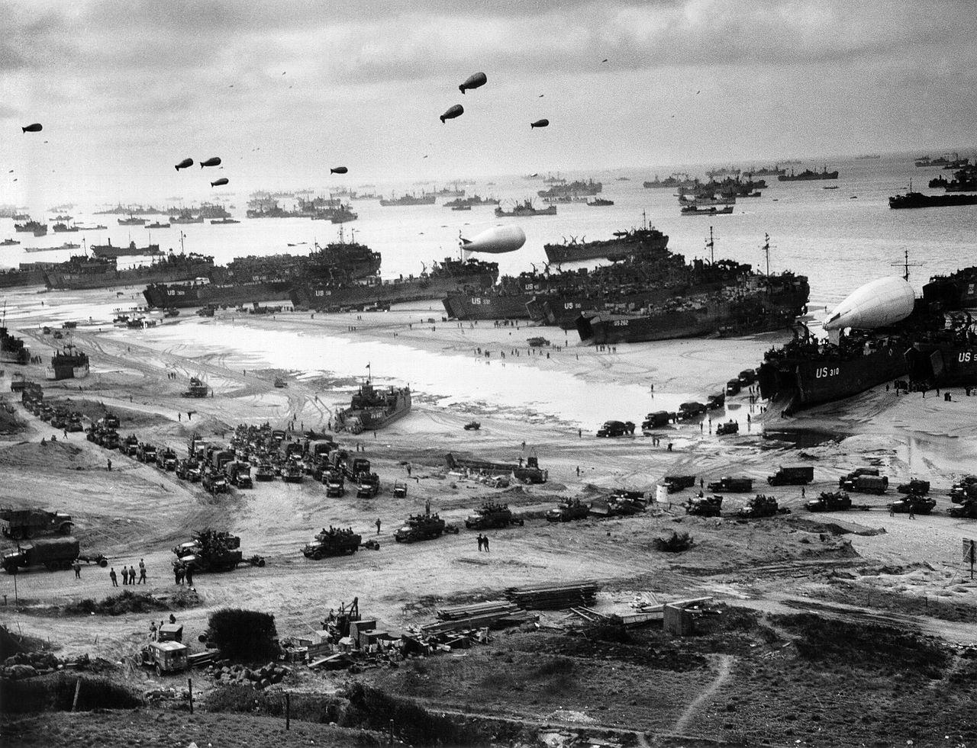
http://en.wikipedia.org/wiki/Operation_Overlord
Notes:
Landing ships putting cargo ashore on Omaha Beach, at low tide during the first days of the operation, mid-June, 1944.
As an attacker, if you want to cause misattribution, magruder’s principle means it’ll work better if you look like an attacker that the defender is expecting, rather than appearing to be something out of the ordinary or unexpected.
As a defender, if you’re creating honeypots, you want them to look like systems that are popular and normally found on networks. The key is that the deceptive thing should be what the target expects to find.

Slide 27
Limits of Human Information Processing
The Law of Small Numbers - People will draw conclusions based on an insufficient number of datapoints.
Susceptibility to Conditioning - If every time the boy cries wolf, there is no wolf, people will start assuming that every cry is a false alarm.
Unlikely Events - People assume that unlikely things are impossible.
Sensor Aperture - Deceptions need only be as effective as demanded by the bandwidth of the tool that is used to observe them.
Notes:
As an attacker, benignly trigger the same IDS alarms on a regular basis, so the SOC gets used to seeing them and won’t carefully investigate when they see them again.
As a defender, this is where I was going to use my server with lots of interfaces example. There may be questions about how practical it is, but it does a good job of illustrating the point.
You’ve got an application server with lots of valuable data on it and you fear that attackers on your network might get into the app easily because authentication is tied to the domain or something. So you stand up a second system alongside the first one, running the same application, but with no data. You then configure lots of sub interfaces on that second machine, each with a different IP. Fill the entire /24.
From an attacker’s perspective, there aren’t two machines - there is a forrest of them, and they are all serving the same app. This achieves 3 effects.
1. Reveal - if anyone is messing with the honeypots, you know they are up to no good.
2. Delay - the attacker has to check a large number of systems, which will slow him down, and give you time to react.
3. Condition - Once the attacker goes through 20 of these things and sees that they are all the same and they don’t have any valuable data, he may abandon the lot and never find the real one hidden in the crowd.
Greg, your question about whether the bad guy can see through this ruse by observing network traffic is an example of Jones’ Dilemma.

Slide 28
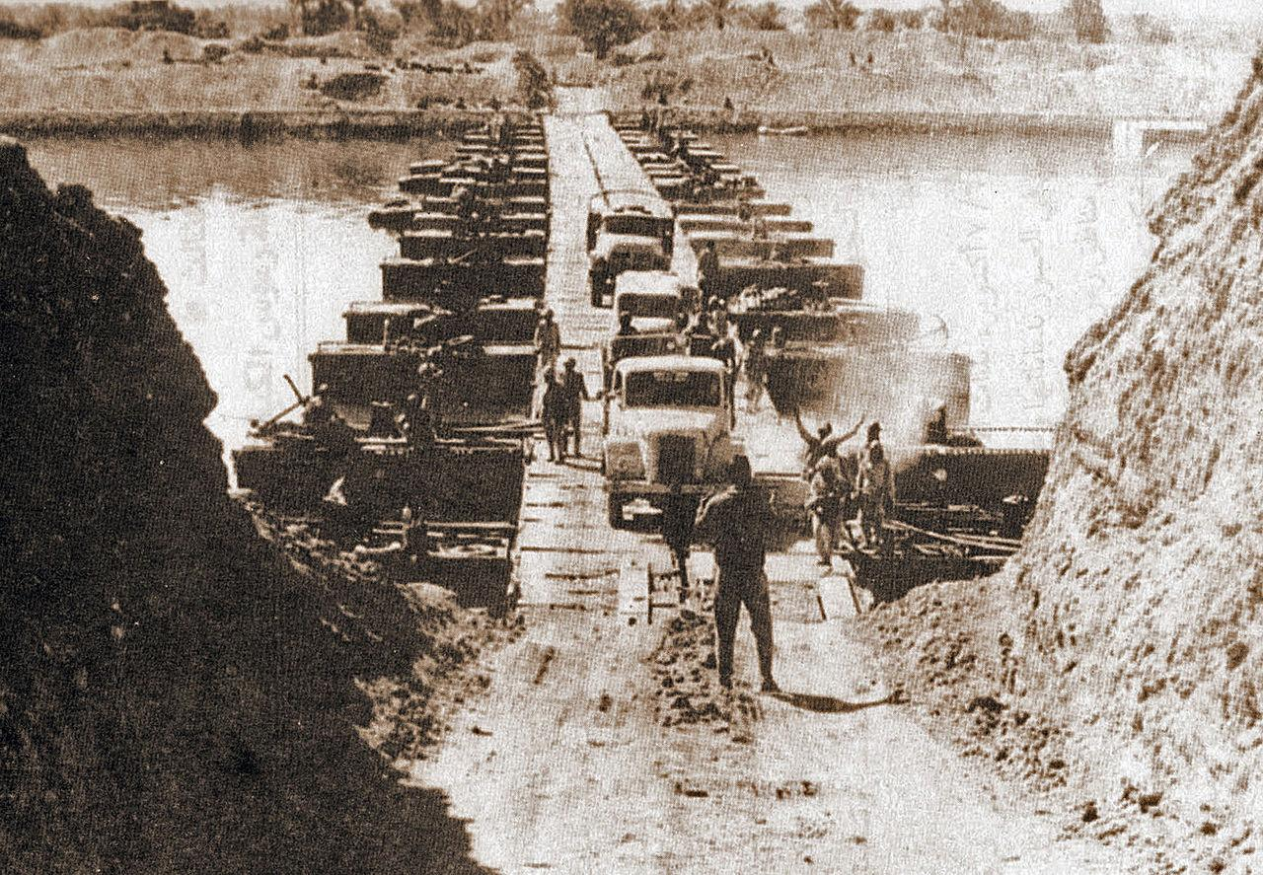
http://en.wikipedia.org/wiki/Yom_Kippur_War
Notes:
Egyptian forces crossing the Suez Canal on October 7 1973

Slide 29

Carefully Sequence Deception Events
Set up a set of deception events that tell a story to the target about what is going on.
The riskiest or most incredible parts of the deception should be left to the end.
  The earlier parts of the deception prepare the target to accept the later parts.
  If the target disbelieves the deception near the end, there is less time left to react.
Notes:
Egyptian deception prior to attack across Suez Canal to start Yom Kippur war in Oct 1973 is a great example here.
Several “exercises” over months, starting in May, to condition Israelis regarding the Egyptians movement of forces and buildup along the canal (Isrealis responded to early exercises by mobilizing, at considerable expense - eventually they stopped responding)
Sending troops ‘back to the barracks’ overnight during buildup to ‘exercise’
Moving ammunition and other supplies at night under cover of darkness
Announcing exercises in media to convey ‘saber rattling’ for internal consumption
85% of Egyptian troops didn’t know about the deception until immediately before crossing

Slide 30
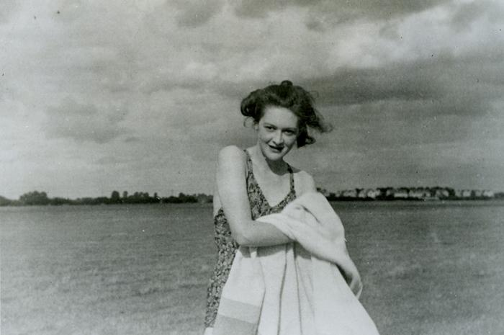
Notes:
operation mincemeat
https://en.wikipedia.org/wiki/Operation_Mincemeat
A picture of the fictitious girlfriend "Pam" of Major Bill Martin. In reality this picture is that of MI5 Staffer Nancy Jean Leslie.

Slide 31
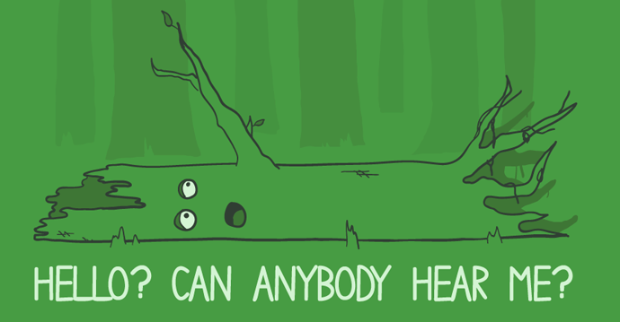
Feedback
Are the deceptive events being witnessed by the target? Does the target believe them?
Notes:
Desert Storm “Hail Mary” Deception: This involved a supposed amphibious landing along the Kuwaiti coastline on the Persian gulf, supported by lengthy rehearsals and demonstrations. Feedback from the deception came in the form of satellite and aerial imagery that showed Iraqi units positioning to repel a landing force and mounting an ‘economy of force’ mission along the border with Saudi Arabia. (In military terms, this is a ‘demonstration’ because forces are deployed to distract the enemy, but the deployment did not include actual contact or combat.
Another example is the Allies use of Ultra intercepts to confirm Axis powers’ massing at Calais to defend against expected European mainland invasion (instead of Normandy).

Slide 32
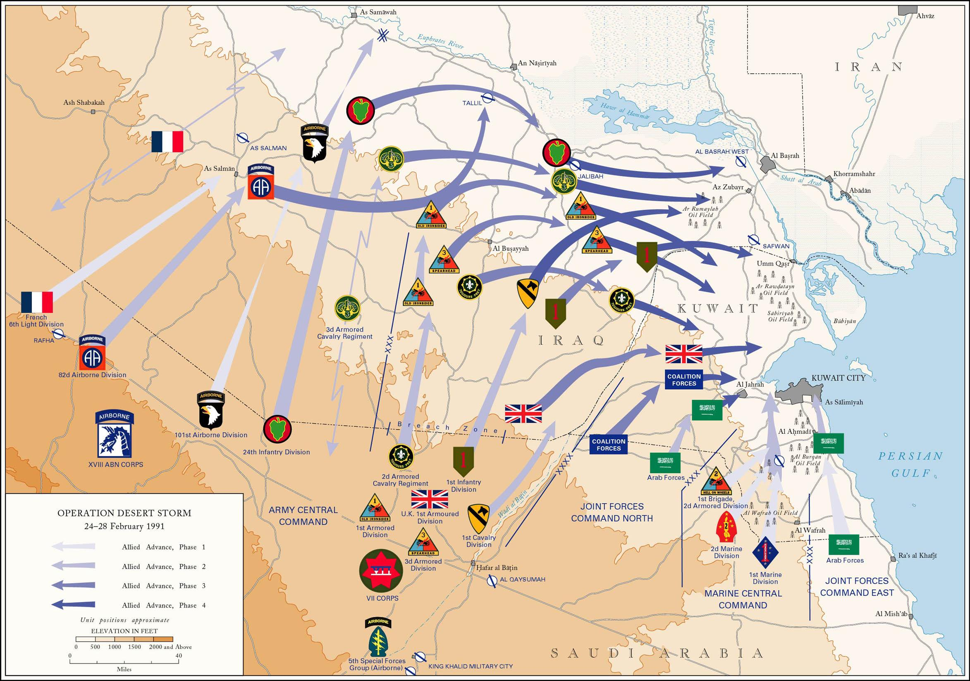
Notes:
How can you collect intelligence in this domain:
As an attacker - this is why we coach incident response teams to work in the same physical room - if you’re all on a conference call together, that conference call could be compromised by the attackers. This has been known to happen.
As a defender - you’d be amazed at the things that people who run IRC botnets will simply say in the channel that the bots are attached to!

Slide 33
Principles of Military Deception
Focus - the deception must target the adversary decision maker capable of taking the desired actions
Objective - to cause an adversary to take (or not to take) specific actions, not just to believe certain things
Centralized Planning and Control - military deception operations should be centrally planned and directed
Security - deny knowledge of a force’s intent to deceive and the execution of that intent to adversaries
Timeliness - a deception operation requires careful timing
Integration - fully integrate each deception with the operation that it is supporting

Slide 34
Deception Objectives
Cause adversary to take action that is advantageous to you
Paralyze action so he wastes time or assets
Cause adversary to reveal strengths and intentions
Cause adversary to reveal weaknesses in their preparations
Condition the adversary to a particular pattern of behavior (“cry wolf”)
Joint Publication 3-13.4 Military Deception
Notes:
“See, Think, Do” Deception Methodology. Deception must result in “action, or inaction, that supports the operational plan.”
See: What does the target “see” from friendly operations?
Think: What conclusions does the target draw from those observation?
Do: What action may the target take as a result of the conclusions based upon those observations?
Example of conditioning - the Yom Kippur war of 1973 was launched under the cover of training exercises that the Egyptian army conducted in May and August. The Israeli army mobilised in response to both exercises at great expense, and did not mobilize in early October when the Egyptians began exercises anew, and conducted a surprise attack across the Suez canal (coordinated with an attack by Syria and supported by several other Arab countries).

Slide 35
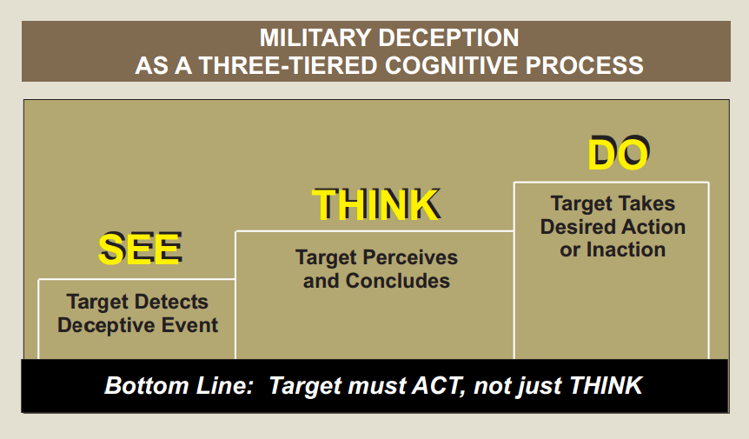

Slide 36
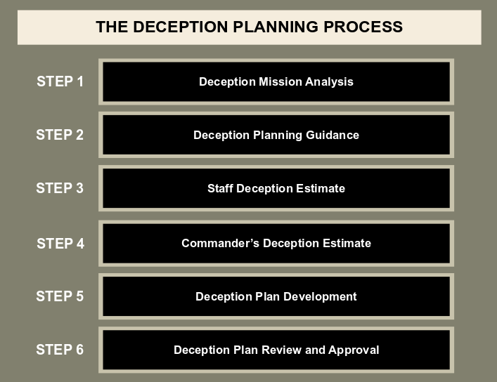
Centralized Planning
Joint Publication 3-13.4: Military Deception
Notes:
Step 1 - mission analysis (I will discuss on the next slide)
Planning guidance - commander tells staff how she wants to include deception in the overall operation
Deception estimates are the products produced by each staff element at the end of the mission analysis phase. For example, operational attorneys will provide a thorough legal analysis of the implications of potential deception efforts in the context of the planned operation.
Step 5: Deception Plan Development. Developing a complete plan is the most time-consuming part of the planning process and requires six major actions. They are: complete the deception story, identify the deception means, develop the deception event schedule, identify the deception feedback channels, determine the measures of effectiveness, and develop the termination concept.

Slide 37

Step 1: Deception Mission Analysis
Why deception?
Capabilities/assets?
Constraints/limitations?
Assumptions?
Risk assessment?
Notes:
I am not going to discuss all of the steps in detail, but the mission analysis step is of particular importance.
Risk assessment - does your deception plan induce a risk in your operation that would not be present without it? What legal risks are you taking? How will you mitigate those risks?

Slide 38
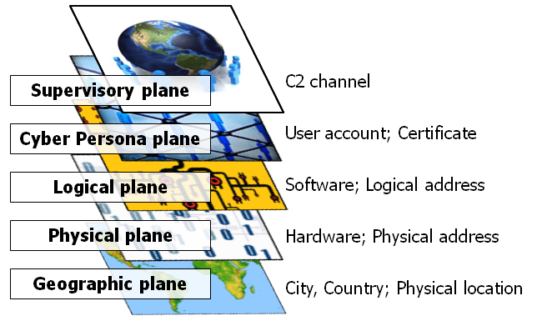
Cyberspace Planes
Notes:
Deception effort should consider all aspects of the information environment: physical, informational, and cognitive dimensions.
In fact, inconsistencies between planes could have implications on the success or failure of your plan . . .
Supervisory Plane
Cyber Persona Plane
Logical Plane (OSI Layer 2-7)
Physical Plane (OSI Layer 1)
Geographic Plane

Slide 39
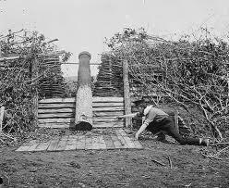
Representative Techniques
modify log files
phishing
deception in malware
spam
rooting a box
thumb drive in parking lot
darknets
social engineering
decoy website
honeypots/nets
fake water treatment plant pseudo flaws
variants of watering hole attacks
blue box
forged certificates
wifi sniffing toaster / pineapple
poisoned docs
trojan horse
fake docs
Notes:
monitor unused address space (darknets)

Slide 40
 | Attacker | Defender
Supervisory Plane | Phishing / Spam Social Engineering Watering Hole Attacks | Reverse Social Engineering
Cyber Persona Plane | Fake Social Network Avatar Fake User Accounts Privilege Escalation Time of Day Spoofing | Fake Social Network Avatar Fake User accounts
Logical Plane (OSI 2-7) | Trojan Horse Modify Logs Decoy Website Human Readable Shellcode Anti-reversing Code obfuscation Forged certificates Compiler Spoofing | Fake HTML Comments Fake DNS Records Invisible Links Fake robots.txt directories Honeypots/Honeynets Fake Water Treatment Plant Darknets DB Server Canaries Decoy / Beacon / Poisoned Files Pseudo Flaws
Physical Plane (OSI 1) | Fake Wireless Hotspot Spoofed Transmissions Blue Box | Fake Insecure Hotspot Spoofed Transmissions
Geographic Plane | Disguised PwnPlug Thumb drive in parking lot Mailing DVD to target | Printer Microdots

Slide 41

Pillars of Information Operations
Electronic Warfare
Computer Network Operations
Military Information Support Operations (MISO)
  (formerly Psychological Operations / PSYOPS)
Military Deception
(or MILDEC)
Operations Security
(or OPSEC)
http://www.publicdomainpictures.net/view-image.php?image=26597
Notes:
Define/elaborate on each ‘Pillar of IO’
Psyops: “Good psyops only deals with the truth” - can help provide a “bodyguard of truth” for the deception effort. [For example - a psyops effort can ‘leak’ the capabilities of certains systems (that we know the enemy already knows) without being part of the deception effort surrounding the use of those systems.]

Slide 42
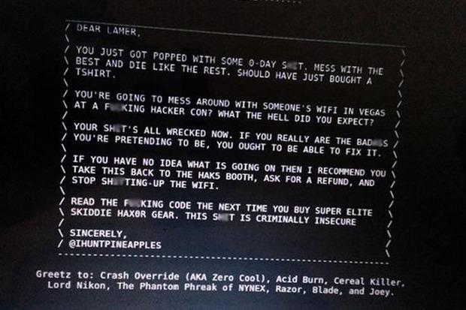
Secure Your Deception!

Slide 43
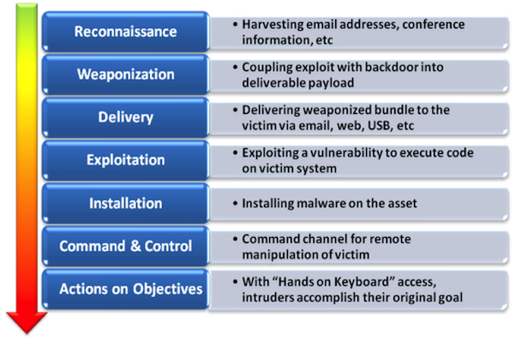
Timeliness - Attacker Methodology
NoVA Infosec, “Cyber Kill Chain 101.” May 2013
Notes:
Frustrate the kill chain

Slide 44
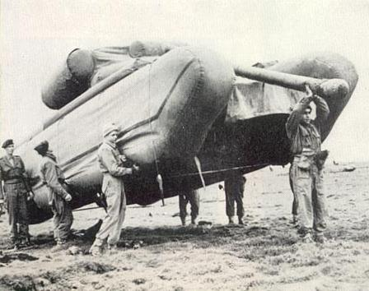
Integration
Fully integrate deception with the operation that it is supporting
Deception plan must:
  Support overall goal and objectives of operation
  Be practical within the context of the larger effort
Image: www.cywarrior.com
Notes:
Your deception operations must be integrated, but compartmented! OPSEC dictates that only those that “need to know” are aware of the deception. In fact in the days before the Egyptian invasion that began the Yom Kippur war, an estimated 85% of the Egyptian did not know it was a deception operation, even up until the time they started the crossing of the Suez canal!

Slide 45
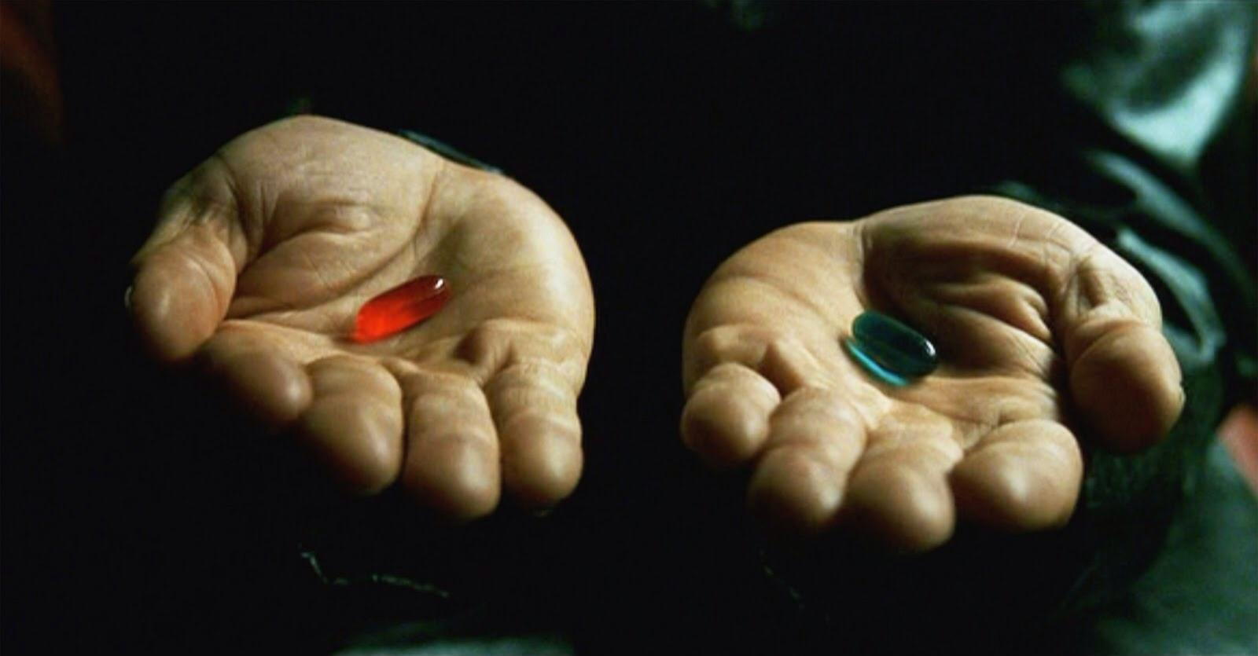
Counterdeception
“The detection of deception”
How do YOU know what is real?
image: http://www.mkltesthead.com/2012/01/my-testing-process-meandering-walk.html
Notes:
“The ideal deception makes the victim certain but wrong.”
Is this a subject for an entirely new talk? We’ve talked for almost an hour about how to approach deception in cyber defense. Another important consideration is how to identify when someone is executing a deception effort against YOU!

Slide 46
Conclusions
Deception is underutilized by the defender
Lawyers must be involved early and often
Thinking in terms of the five planes will help elicit new ideas
Beware deceiving yourself, your co-workers (or the SEC) by accident
Look for Misplaced Trust

Slide 47
Where to Go for More Information...
Talks
  BH USA 2014 The Devil Does Not Exist by Mateski and Devost
  BH USA 2014 The Library of Sparta by Conti, Raymond and Cook
  Lessons of the Kobayashi Maru by Caroland and Conti, ShmooCon 2012
Academic Papers
  2014 CyCon Key Terrain in Cyberspace by Raymond, Conti, Cross, and Nowatkowski
  2014 CyCon Deceiving Sophisticated Attackers
  Attacking Information Visualization System Usability by Conti, Ahamad, and Stasko
  Malicious Interface Design by Conti and Sobiesk
  Training Students to Steal by Dimkov, Pieters, and Hartel
Books
  The Art of Deception by Mitnick
  Deception in War by Jon Latimer
  Reverse Deception by Bodmer, Kilger, Carpenter, and Jones
Articles
  Why Cyber War Will Not and Should Not Have Its Grand Strategist by Libicki
White Papers
  Defending Your Organization Against Penetration Testing Teams by O’Connor
Military Doctrine
  Military Deception JP 3-13.4
  Battlefield Deception, FM 90-2
  36 Stratagems

Slide 48
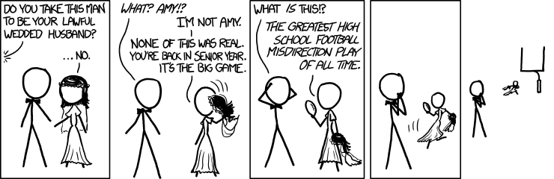
Questions???
https://xkcd.com/1100/
Notes:
Solicit for known or new deception techniques in cyber

