Slide 1
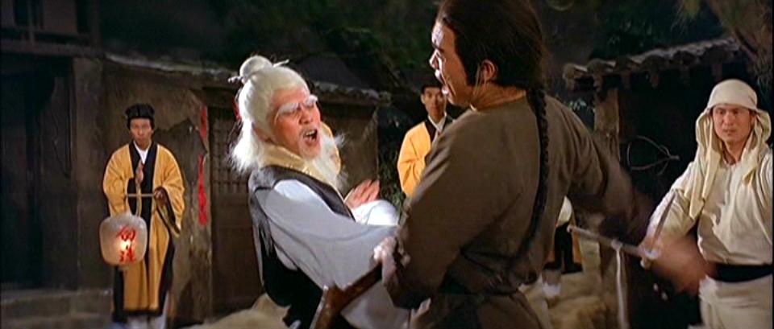
Dim Mak: A Study of the Pressure Points that Could Take Down Cyberspace
Gregory Conti / Robert Fanelli

Slide 2
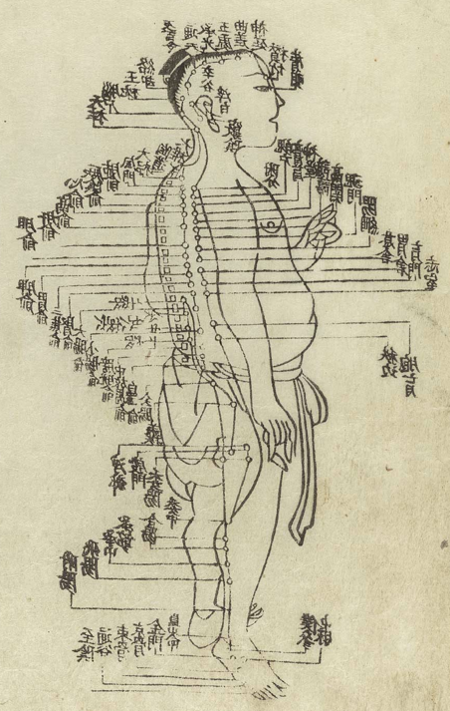
The views expressed in this talk are those of the authors and do not reflect the official policy or position of IronNet Cybersecurity, the United States Government, or any of our other current or past employers.
https://upload.wikimedia.org/wikipedia/commons/e/e0/Hua_t08.jpg

Slide 3



Greg Conti
greg.conti@ironnetcybersecurity.com
@cyberbgone
Bob Fanelli
robert.fanelli@ironnetcybersecurity.com

Slide 4

What is Dim Mak?
The touch of death refers to any martial arts technique reputed to kill using seemingly less than lethal force targeted at specific areas of the body.
https://medium.com/@martial_facts/the-touch-of-death-the-smell-of-bulls-t-4ee0bdaa072c

Slide 5

https://youtu.be/dgL-mBIIFpk?t=168

Slide 6
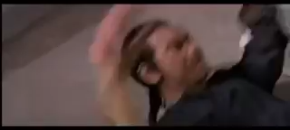
The Five Point Palm Exploding Heart Technique

Slide 7
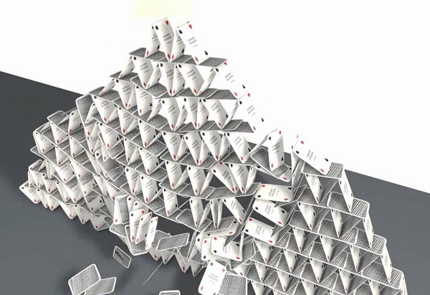
Seriously, here is the problem...
Cyberspace is riddled with points of vulnerability capable of destabilizing the whole.
Sophisticated actors are not blind to this and overtly or covertly target these points over time.
This talk provides a study of these points, how they are targeted, and how to better defend them.
Photo: http://www.thefringenews.com/a-mile-high-house-of-cards/

Slide 8
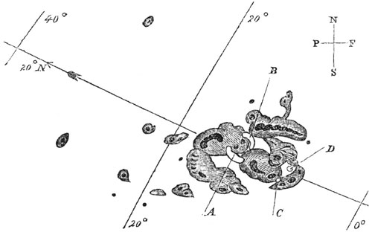
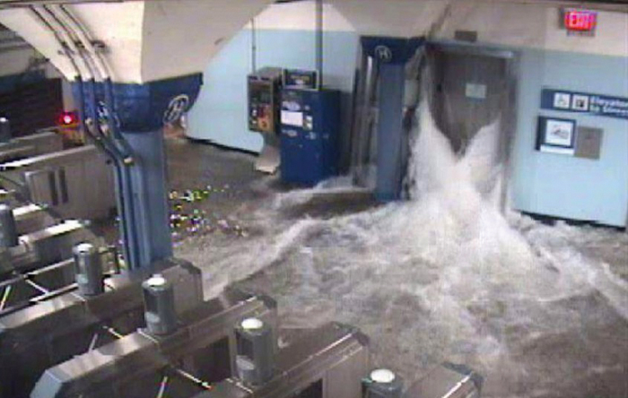
We are Focused on Deliberate
Man-made Attacks, Not Nature or Accident...
Sunspots of September 1, 1859, as sketched by Richard Carrington
NYC During Hurricane Sandy
https://journal.uptimeinstitute.com/disaster-recovery-lessons-learned-superstorm-sandy/
https://en.wikipedia.org/wiki/Solar_storm_of_1859#/media/File:Carrington_Richard_sunspots_1859.jpg

Slide 9
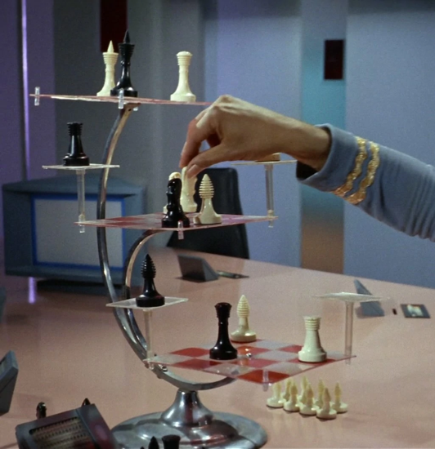
Outline
State Threat Actor Thinking
The Staircase of Apathy
State Targeting Processes and Priorities
A Multi-dimensional Attack Surface
What Can Help
Conclusions
http://memory-beta.wikia.com/wiki/File:3d_chess.jpg

Slide 10
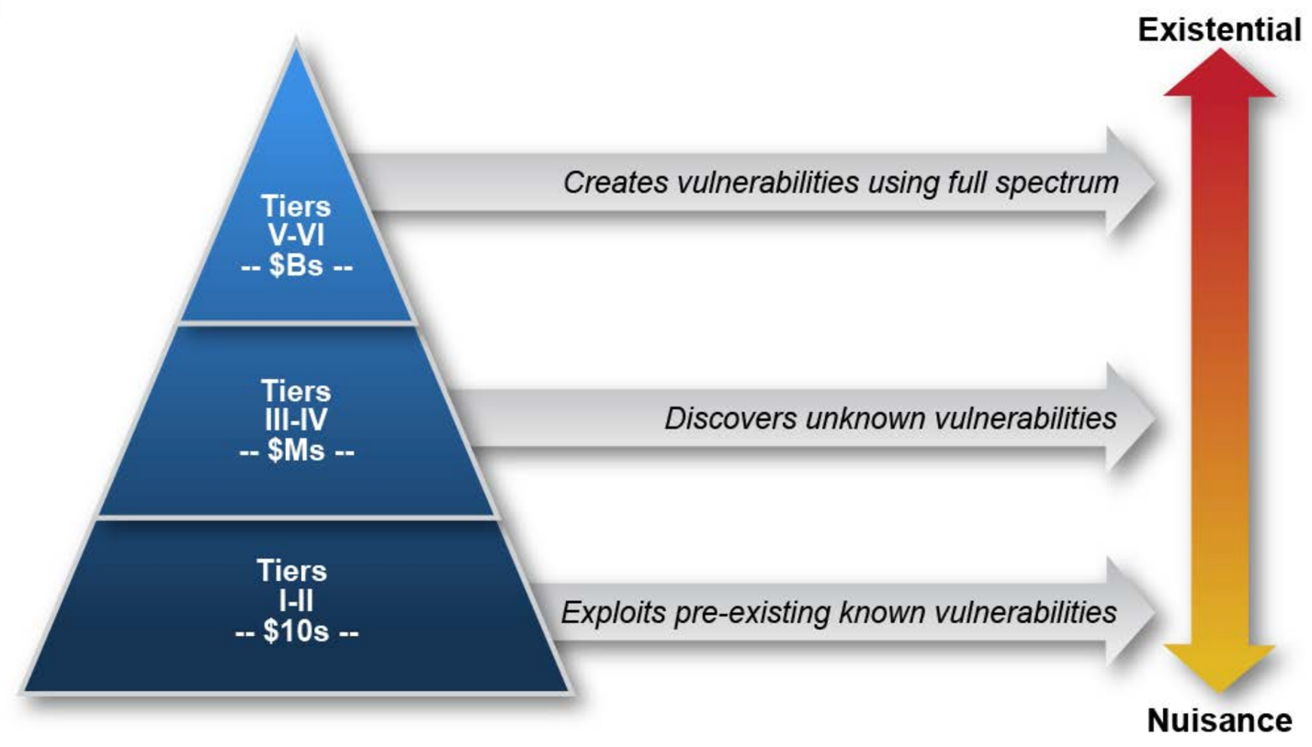
https://www.acq.osd.mil/dsb/reports/2010s/ResilientMilitarySystemsCyberThreat.pdf

Slide 11
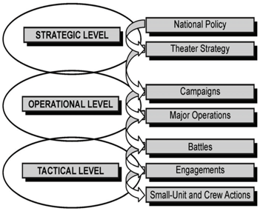
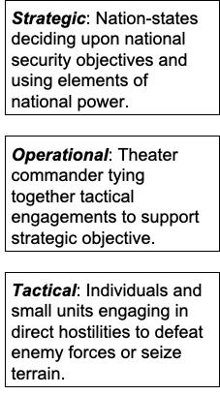

Slide 12
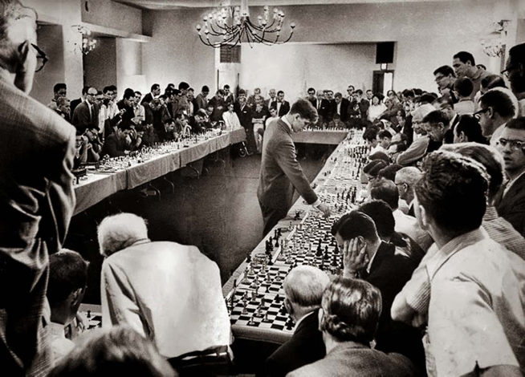
Thinking Like a State Actor
Access is King
Surveil or Cause Effects
Incentives are Different
Think at Massive Scale
Exploit Partnerships and Leverage
Create Vulnerabilities
Challenge Fundamental Security Assumptions
Employ Full Spectrum of National Power
Patiently Probe and Test
Plan Extensively
http://www.infovisual.co/bobby-fischer-vs-garry-kasparov.html

Slide 13
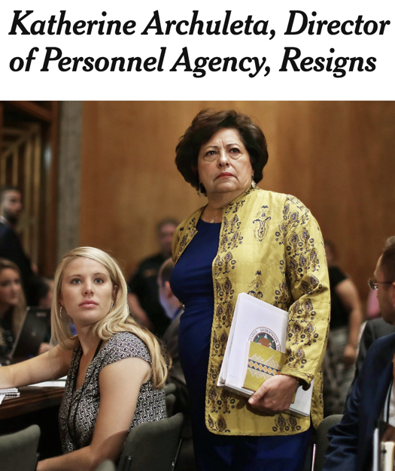
Staircase of Apathy
An adversary takes a series of steps over time toward their goal.
Small steps aren’t noticed or acted upon.
Large steps are noticed and generate increasingly organized response
A smart adversary seeks to operate below an apathy threshold to achieve their goal
… Except when the benefit is so high that an organized response is worth the cost
https://www.nytimes.com/2015/07/11/us/katherine-archuleta-director-of-office-of-personnel-management-resigns.html

Slide 14
Adversary
Goal
Progress
Presidential
Campaign
OPM Hack
Apathy Threshold
Time

Slide 15
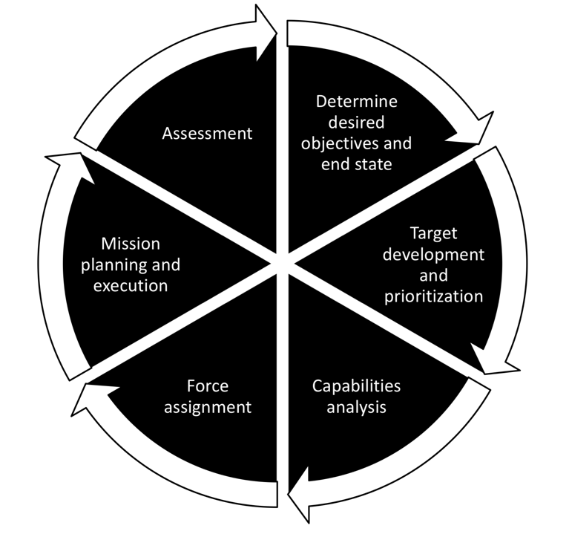
Targeting Process
The “Kill Chain” happens here
http://www.jcs.mil/Portals/36/Documents/Doctrine/pubs/jp3_09.pdf

Slide 16
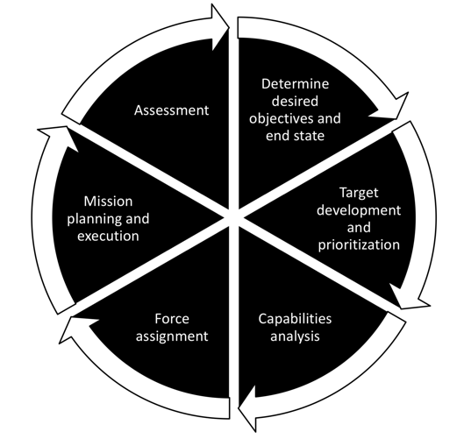
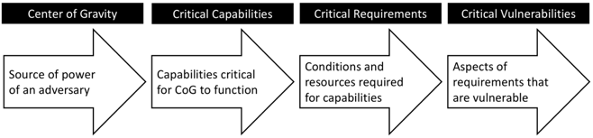
How to Find and Develop Targets: COG Analysis
“a source of power that provides moral or physical strength, freedom of action, or will to act.”
See: JP 5-0 Joint Planning, 2017, p. IV-23 or
Conti & Raymond, On Cyber, 2017, p. 186

Slide 17

DHS Critical Infrastructure Sectors
https://www.dhs.gov/cisa/critical-infrastructure-sectors

Slide 18
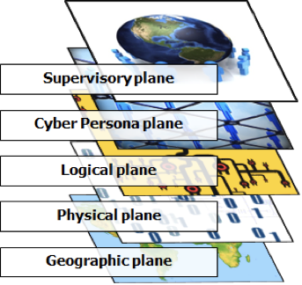
Planes
C2, humans...
Social media, IAM, accounts...
OSI 2-7: applications, packets, routing...
Hardware, OSI 1: fiber, EM spectrum...
Gates, locks, buildings...
See also: Conti & Raymond, On Cyber, 2017, p. 68
Peter Swire, “A Pedagogic Cybersecurity Framework, Communications of the ACM, October 2018

Slide 19
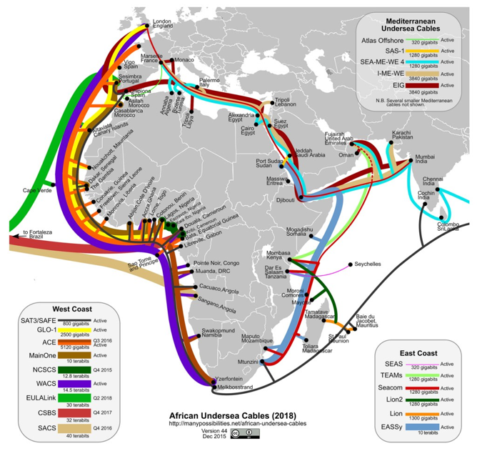
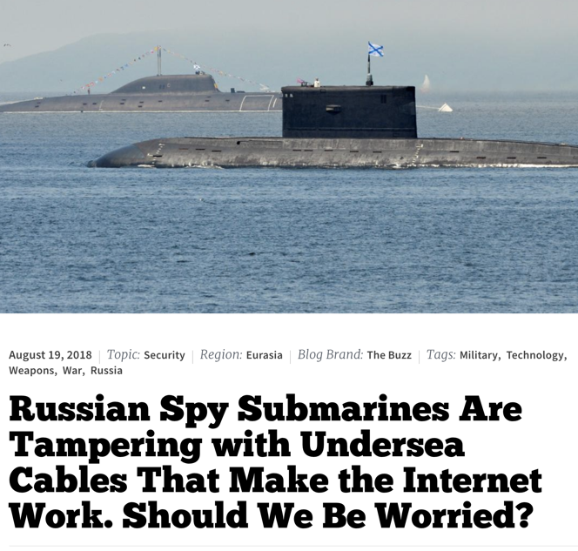
Undersea Cables
Geographic - Physical - Logical - Persona - Supervisory
https://upload.wikimedia.org/wikipedia/commons/2/22/African_undersea_cables_v44.jpg
https://nationalinterest.org/blog/buzz/russian-spy-submarines-are-tampering-undersea-cables-make-internet-work-should-we-be

Slide 20
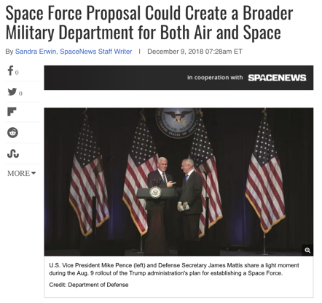
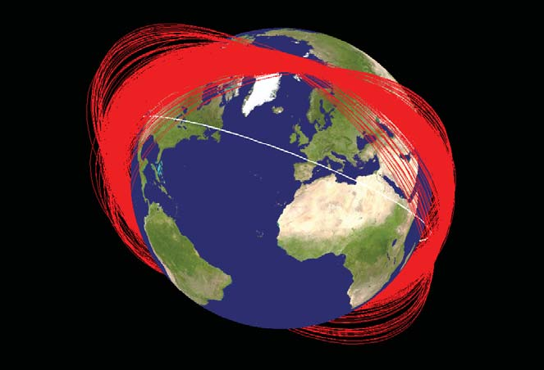
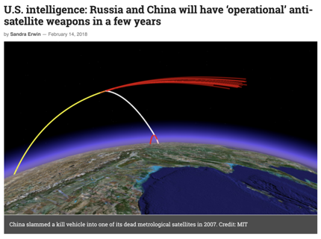
Satellites
Geographic - Physical - Logical - Persona - Supervisory
https://upload.wikimedia.org/wikipedia/commons/9/95/Fengyun-1C_debris.jpg
https://www.space.com/42638-space-force-proposal-broader-military-department.html
https://spacenews.com/u-s-intelligence-russia-and-china-will-have-operational-anti-satellite-weapons-in-a-few-years/

Slide 21
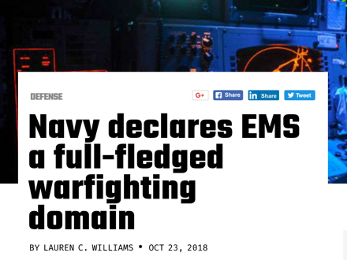
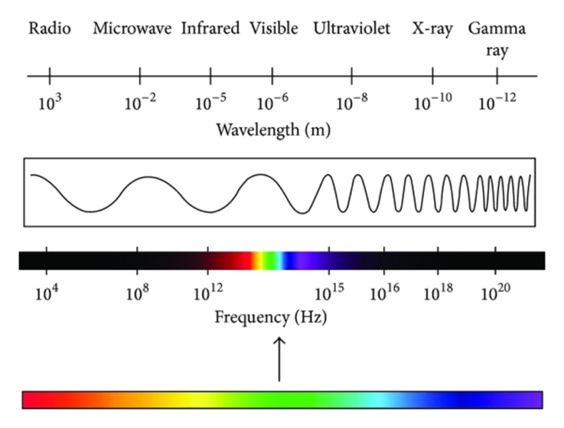
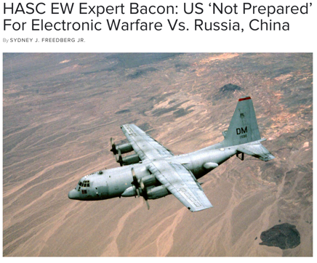
Electromagnetic Spectrum
Geographic - Physical - Logical - Persona - Supervisory
https://breakingdefense.com/tag/electromagnetic-spectrum-domain/
https://www.researchgate.net/figure/The-electromagnetic-spectrum_fig4_277912002
https://defensesystems.com/articles/2018/10/24/navy-electronic-warfare-williams.aspx?m=1

Slide 22
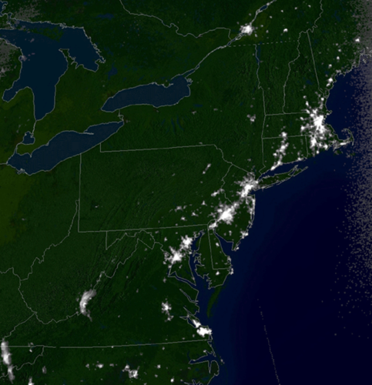

Power Grid
Geographic - Physical - Logical - Persona - Supervisory
https://en.wikipedia.org/wiki/Northeast_blackout_of_2003#/media/File:Northeast_blackout_2003.gif
https://www.wsj.com/articles/assault-on-california-power-station-raises-alarm-on-potential-for-terrorism-1391570879

Slide 23
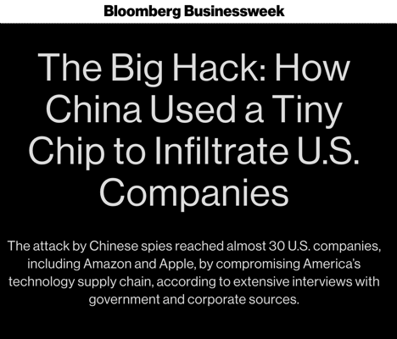
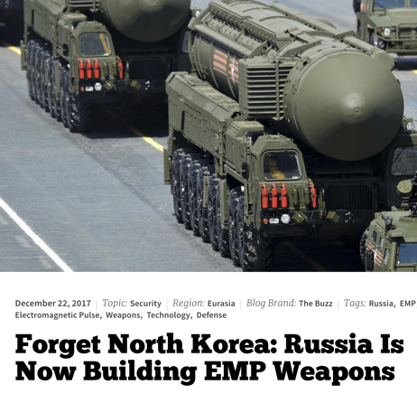
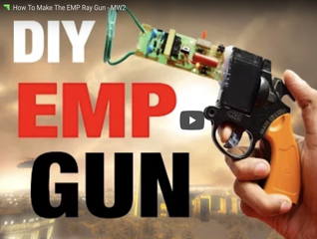
Hardware
Geographic - Physical - Logical - Persona - Supervisory
https://www.instructables.com/id/How-to-Make-EMP-Gun-/
https://commons.wikimedia.org/wiki/File:386DX40_MB_Jaguar_V.jpg
https://nationalinterest.org/blog/the-buzz/forget-north-korea-russia-now-building-emp-weapons-23760
https://www.bloomberg.com/news/features/2018-10-04/the-big-hack-how-china-used-a-tiny-chip-to-infiltrate-america-s-top-companies

Slide 24
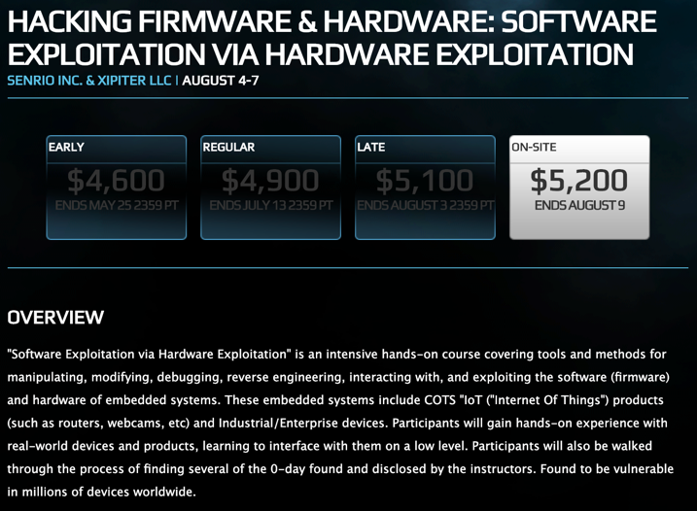
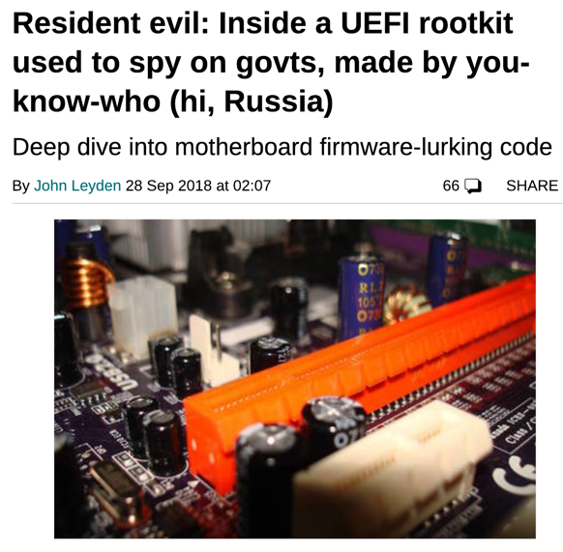
Firmware
Geographic - Physical - Logical - Persona - Supervisory
https://www.theregister.co.uk/2018/09/28/uefi_rootkit_apt28/
https://www.blackhat.com/us-18/training/hacking-firmware-and-hardware-software-exploitation-via-hardware-exploitation.html

Slide 25
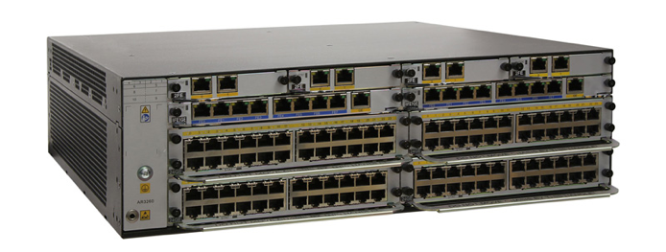
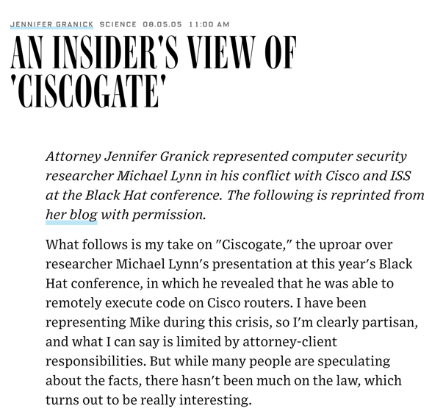
Machinery that makes the network run…
Deployed globally
Potential for kill switches that are very difficult to detect
Possibility of back doors for surveillance
Could be used to generate a wide range of offensive effects
Risks of government influence
Geographic - Physical - Logical - Persona - Supervisory
https://e.huawei.com/pl-pl/products/enterprise-networking/routers/ar-g3/ar3200
https://www.technologyreview.com/s/612556/the-6-reasons-why-huawei-gives-the-us-and-its-allies-security-nightmares/

Slide 26


Internet Routing BGP
BGP uses a path-vector, “routing by rumor” approach
Prefix announcements cannot [currently] be authenticated
“Why would someone do that?” design choices
Threats/Effects:
- Redirect traffic for intel collection
- Redirect traffic to facilitate MITM
attacks
- Traffic flood denial of service
- Route manipulation food-fight that
breaks global routing
Geographic - Physical - Logical - Persona - Supervisory

Slide 27
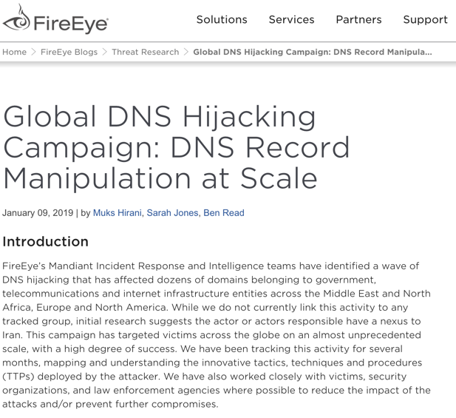
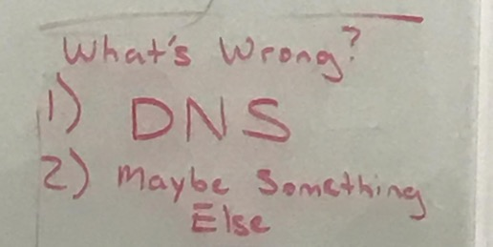
DNS (or Really, Directories in General)
DNS Root Servers
DNS Hijacking
Registrars
DNS attacks are an end and a means.
Geographic - Physical - Logical - Persona - Supervisory

Slide 28
The Crypto Protocols (and Implementation)
Critical vulnerability could lead to denial of service, loss of integrity, information disclosure
Possible systemic break of Elliptic Curve crypto or AES, easy quantum computing breaking RSA and Diffie-Hellman, etc.
Implementation tends to be the problem more often than the math
Subtly, or not so subtly, undermining the trust on the network
Historical data can be vulnerable
Geographic - Physical - Logical - Persona - Supervisory

Slide 29
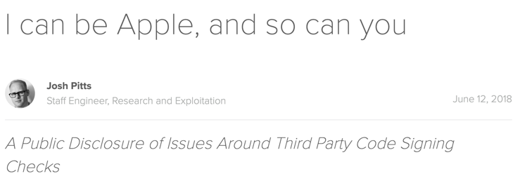
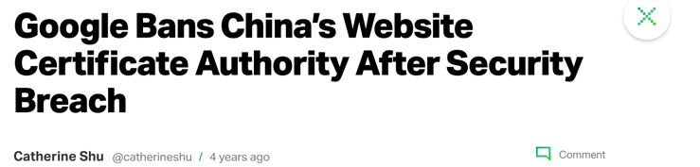
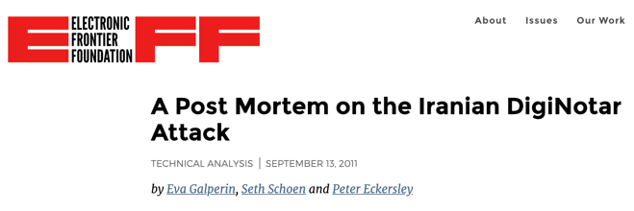
Identity Infrastructure
Geographic - Physical - Logical - Persona - Supervisory

Slide 30
The Internet of … Stuff
Zombie Android Bot Army – Systemic breach in Android OS results in 500 million DDoS and spam agents that are equipped to use LTE, WiFi, and Bluetooth for optimal connectivity.
Taint a mobile device chipset
Taint/attack IoT at software layer
Lots of care with pc/laptop but connected devices often ignored… and no less of a computer
Connected devices in the future
Geographic - Physical - Logical - Persona - Supervisory
https://slate.com/technology/2015/08/twitter-account-internet-of-shit-mocks-ridiculous-internet-of-things-technologies.html

Slide 31
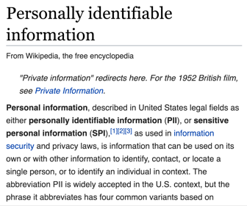
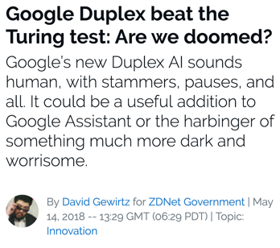
Persona
Someone figures out to to use on-line porn for offensive cyber ops
Large scale compromise of credit reporting agencies or sensitive government personnel databases
AI that can pass
a Turing Test used for massive information operations
Root compromise of major social media site
Geographic - Physical - Logical - Persona - Supervisory
https://en.wikipedia.org/wiki/Social_media#/media/File:Young_people_texting_on_smartphones_using_thumbs.JPG

Slide 32
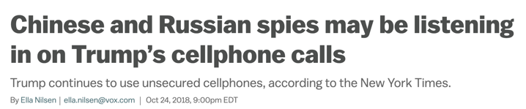
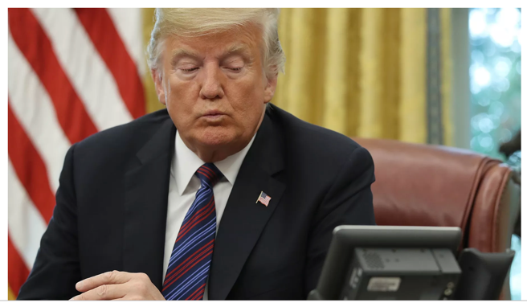
Humans as a Pressure Point
Geographic - Physical - Logical - Persona - Supervisory
https://unsplash.com/photos/KdeqA3aTnBY
https://www.vox.com/2018/10/24/18020906/trump-cell-phone-china-russia-new-york-times

Slide 33
Other Potential Concerns…
Subversion of a major provider:
rogue software deployed, loss of control of services
Large-scale compromise of lawful intercept backdoors/key escrow
Failure of virtualization/container integrity making shared cloud services insecure
Root certificate compromise of major PKI provider(s)
Subversion of widely-used open source software and libraries
Widely-deployed mobile device apps go rogue
Geographic - Physical - Logical - Persona - Supervisory

Slide 34
Bringing it All Together
Organizations, Sectors, Cities, Nations
C2, humans...
Social media, IAM, accounts...
OSI 2-7: applications, packets, routing...
Hardware, OSI 1: fiber, EM spectrum...
Gates, locks, buildings...

Slide 35
Think About These Other Ones Too…
Government
Military
Notes:
https://sourceforge.net/blog/sourceforge-attack-full-report/
https://it.slashdot.org/story/18/12/08/0355227/linuxorgs-dns-got-hijacked
https://www.businessinsider.com/mt-gox-ceo-mark-karpeles-hacked-i-was-about-to-die-2018-3?r=UK&IR=T
https://nakedsecurity.sophos.com/2018/06/29/linux-distro-hacked-on-github-all-code-considered-compromised/
https://www.bbc.com/news/business-46881978
https://www.thedailybeast.com/russians-hacked-joint-chiefs-of-staff
https://www.theverge.com/2014/2/18/5421636/us-navy-hack-by-iran-lasted-for-four-months-say-officials
https://it.slashdot.org/story/18/06/15/2011251/chinese-cyber-espionage-group-hacked-government-data-center
https://www.cnn.com/2015/01/12/politics/centcom-twitter-hacked-suspended/index.html
https://www.businessinsider.com/nasdaq-attacked-by-hackers-2014-7
https://en.wikipedia.org/wiki/2016_Democratic_National_Committee_email_leak
https://www.cnn.com/2015/04/07/politics/how-russians-hacked-the-wh/index.html
https://www.databreachtoday.asia/va-systems-hacked-from-abroad-a-5814
https://www.theregister.co.uk/2014/09/18/china_hacked_us_army_twenty_times_in_one_year/
https://www.taiwannews.com.tw/en/news/2968750

Slide 36

And More…
Software Repositories
Medical
Transportation
Finance
Notes:
https://www.10news.com/news/local-news/iranian-men-charged-in-port-of-san-diego-ransomware-hack
https://www.bbc.com/news/technology-44397872
https://news.clearancejobs.com/2018/10/15/dods-defense-travel-system-hacked-employee-credit-card-info-stolen/
https://www.cbsnews.com/news/cbsn-on-assignment-hackers-targeting-medical-industry-hospitals/

Slide 37
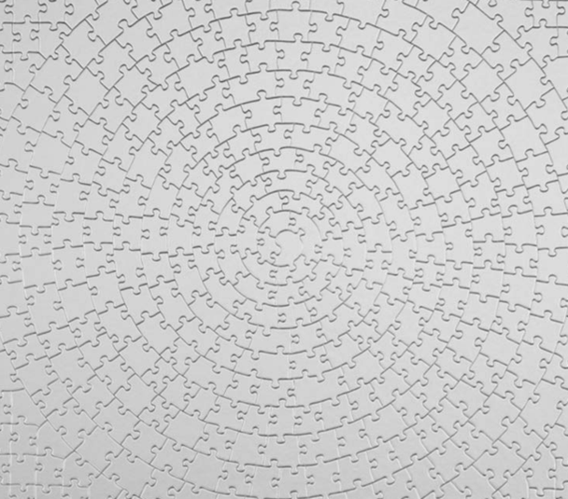
What Can Help
True collective defense
Improved threat information sharing
Public/private partnerships for the offense
Realistic informed assumptions
Organizational agility
Move to behavioral detection tools
Employ military strategy and tactics for cybersecurity
Improved security orchestration and automated response
https://www.amazon.com/Ravensburger-Silver-Jigsaw-Puzzle-Challenge/dp/B0009QXXB8/ref=pd_sbs_21_54?_encoding=UTF8&pd_rd_i=B0009QXXB8&pd_rd_r=538cde75-0d01-11e9-b62b-4defc69ef940&pd_rd_w=SIN8S&pd_rd_wg=5LEEO&pf_rd_p=7d5d9c3c-5e01-44ac-97fd-261afd40b865&pf_rd_r=Y8AXQW42PBQR55562C6P&psc=1&refRID=Y8AXQW42PBQR55562C6P

Slide 38

Conclusions
Think in longer time horizons, a sliding window view of threats is insufficient
If the tech is used directly or indirectly by millions, expect it to be targeted.
Move past the staircase of apathy and replace it with urgency
Much has been compromised at one time of the other, some still is pwned
Look for the puzzle pieces and put them together faster
https://www.amazon.com/Blank-Puzzle-100-Piece-Color-Projects/dp/B0799KC466/ref=sr_1_10?s=toys-and-games&ie=UTF8&qid=1546263041&sr=1-10&keywords=blank+puzzle

Slide 39
Questions
Greg Conti
greg.conti@ironnetcybersecurity.com
@cyberbgone
Bob Fanelli
robert.fanelli@ironnetcybersecurity.com
https://www.bfi.org.uk/news-opinion/news-bfi/lists/10-great-kung-fu-films

