Slide 1

The Library of Sparta
~
David Raymond
Greg Conti
Tom Cross
http://upload.wikimedia.org/wikipedia/commons/0/08/Jean-Jacques-Fran%C3%A7ois_Le_Barbier_-_A_Spartan_Woman_Giving_a_Shield_to_Her_Son.jpg
Notes:
Library of Sparta is a term we use to describe military doctrine and strategy, refined over thousands of years and reflected in the writings of military theorists, current doctrinal manuals, and other professional publications and online forums.
What we hope to do today is to give you a glimpse into this vast library and provide examples of how it can help you defend your network . . .
[We hope to show that this library can and should be mined for techniques and strategies that can be used in both offensive and defensive cyber operations. In fact, our adversaries may already be doing this . . .]

Slide 2
Disclaimer
~
The views expressed in this talk are those of the authors and do not reflect the official policy or position of Lancope, West Point, the Department of the Army, the Department of Defense, or the United States Government.
Notes:
This is just our standard disclaimer – the views presented here are our own and don’t reflect the official position or policy of any of our employers.

Slide 3



Our Background...
~@%
David Raymond
West Point
Greg Conti
West Point
Tom Cross
Lancope

Slide 4
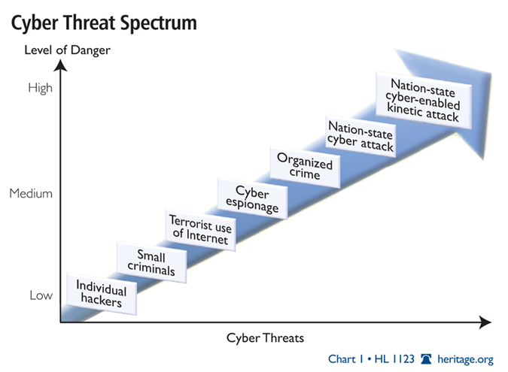
Why, So What, and Who Cares…
%
You used to be fighting individuals . . .
now you are defending yourselves against nation-states

Slide 5

On the Internet, the offense has all the cards
%

Slide 6
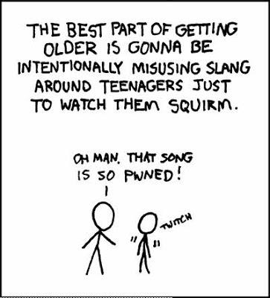
Also…
%
https://1.bp.blogspot.com/_qP-jX-ObdQA/R1LScdRbM2I/AAAAAAAAAKY/ABVwCnyrnx4/s400/misusing_slang.jpg
Notes:
You aren’t doing yourself any favors when you misuse military acronyms and slang

Slide 7
What We AREN’T Covering
@
Not another intelligence-based network defense talk
Not a step-by-step guide
No easy answers - it requires you to do some reading and research
No APT (or other amorphous concepts)
Notes:
We will be coming more from the Army perspective and less from the Joint (Navy, Air Force, Marine) perspective, and even less from the international perspective.
Perhaps make a joke about… “and no Sun Tzu”

Slide 8
What is Doctrine?
@

Slide 9

A Sacred Text For Some
@
http://upload.wikimedia.org/wikipedia/commons/8/8d/Bible_vaclav.jpg

Slide 10
An Anathema to Others
@
“The most difficult thing about planning against the Americans, is that they do not read their own doctrine, and they would feel no particular obligation to follow it if they did.”
Admiral Sergey Gorshkov
Commander, Soviet Naval Forces, 1956 - 1985
Notes:
Unsubstantiated but good

Slide 11
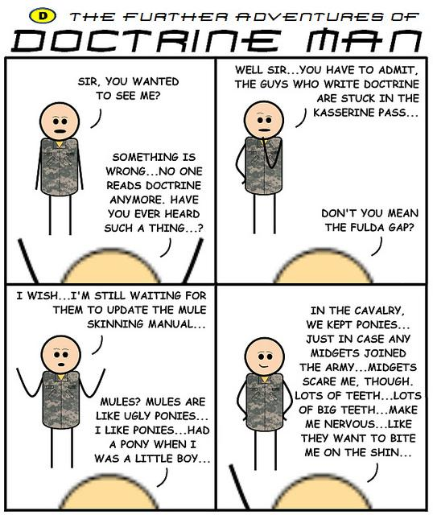
And then there is Doctrine Man...
@
See… http://www.nytimes.com/2010/11/19/us/19pentagon.html
Notes:
<this may be too small to use, and there may not be space, perhaps include in the “full” slide deck, but likely move to backup for the “presentation” slide deck>

Slide 12
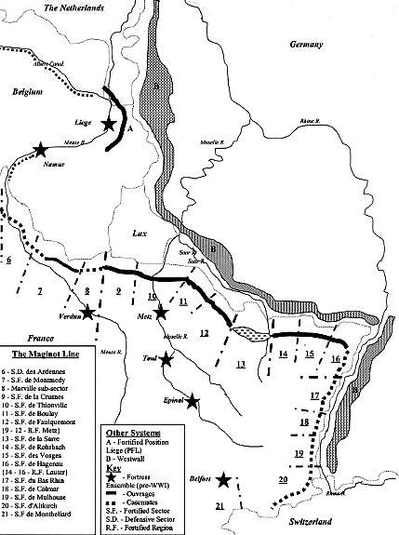
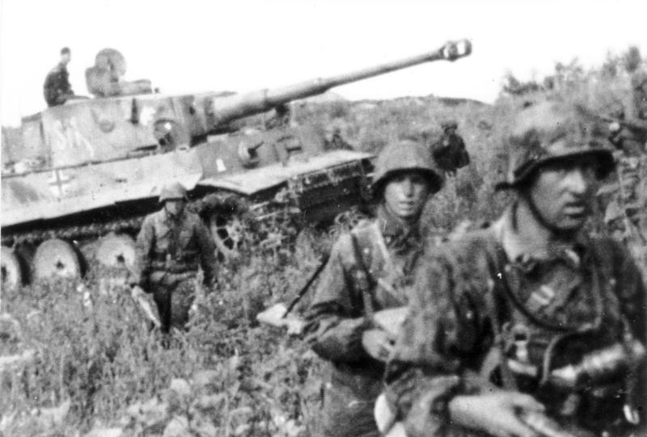
The Answer is Somewhere in the Middle
https://en.wikipedia.org/wiki/Maginot_Line#mediaviewer/File:Maginot_Linie_Karte.jpg
@
Bad Doctrine Good Doctrine
Notes:
Bad Doctrine - Maginot Line (was this “doctrine”)
Good Doctrine (at the time) - Blitzkreig (or was this just a strategy?), COIN manual is another example
Would like to use FM 3-38 but this might not be appropriate

Slide 13
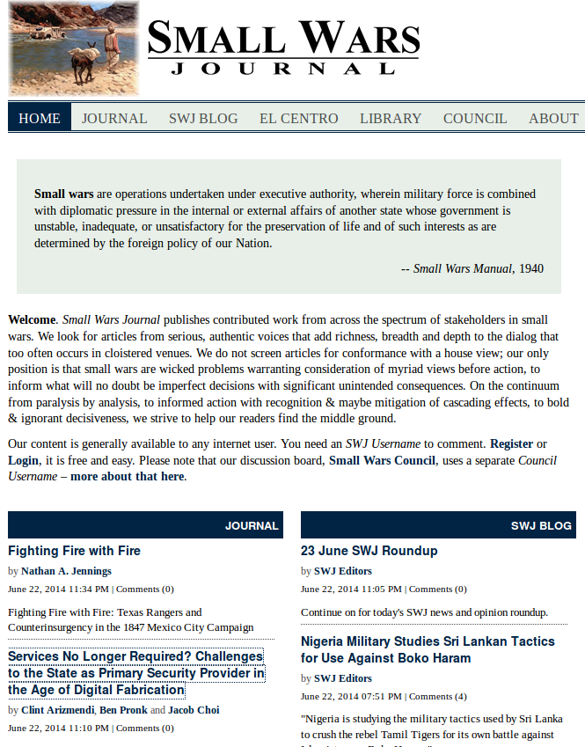
Sources of Military Thought
~
Military Theorists
Doctrinal Manuals
Print and Online Journals
  Small Wars Journal
    Parameters
    Military Review
    SIGNAL
    … many more
Policies
Notes:
There are a variety of sources of military thought and we’ve listed some examples here . . .
Military theorists
Doctrinal manuals – all available online
Military journals and online discussions (similar to IT and INFOSEC periodicals and blogs)
This is where emerging doctrine is shaped!
Maybe voice over states that military writing is used to develop “pre-doctrine,” interpret doctrine, and challenge doctrine
Maybe a comment on reaction time of Journals vs. SWJ (a full journal publication cycle ~= one turn of Moore’s law)

Slide 14




Foundations of Military Doctrine
~
Everything in war is very simple. But the simplest thing is difficult.
- Karl Von Clausewitz
Notes:
Most US military doctrine is based on the writings of a handful of military theorists . . .
Writings by Jomini and Clausewitz, both 19th century thinkers, continue to influence U.S. Military strategy and policy
Alfred Thayer Mahan is credited with developing the Navy doctrine that made the U.S. a major sea power
Pilots like Billy Mitchell and COL John Boyd have largely shaped and developed Air Force doctrine
* All rich sources of strategic thought!
Details:
Carl Von Clausewitz:
“War is the extension of politics by other means.” Clausewitz was a German military strategist who saw warfare as an extension of politics and as a ‘last resort’ in the political process. Focused largely on psychological and political aspects of war. Saw generalship and the approach to warfare as more an art than a science. Known for his ‘trinity’, People/Army/Government: success in warfare required the support of the population (People), competent generals (Army), and political will to win (Government).
- ‘fog of war’
- offensive/defensive asymmetry
- ‘friction’
- ‘military genius’ - personality and character over (or besides) pure intellect
Antoine-Henri (Baron Von) Jomini
General in the French and Russian service. Sometimes called ‘founder of modern strategy’. Often seen as having a formulaic approach to warfare.
- strategic positioning of forces
- interior lines
Alfred Thayer Mahan:
19th century US Navy Admiral, historian, and strategist. Saw seapower as a way to control commerce, leading to the US becoming one of the world’s major sea powers. Ironically, he was a bad ship captain, racking up several sea-borne collisions including some with stationary objects, and as a result he avoided sea duty.
COL John Boyd:
USAF Fighter pilot and military strategist. Father of the “OODA Loop” Observe, Orient, Decide, Act. Decision making occurs in this recurring cycle and an individual (or organization) that can do this faster than their adversary, or get ‘inside their OODA loop’, will prevail. Originally conceptualized in the context of aerial dog fights, but is now applied to litigation, business, and general military strategy.
Others:
- Xenophon - Greek historian, soldier, and strategist. Student of Socrates.
- SunTzu
- Dennis Hart Mahan - military theorist (in the spirit of Jomini) and West Point professor. Alfred Thayer Mahan’s father.
- J.F.C. Fuller - British Army officer and theorist of early modern armored warfare
- Erwin Rommel - German field marshal and armored warfare theorist - practitioner of ‘blitzkrieg’.
- B.H. Liddell Hart - British soldier, military historian, and military theorist.
- Giulio Douhet - Italian general and air power theorist (early 20th century)
- Billy Mitchel - US Army general and airpower theorist. ‘Father of the U.S. Air Force’. Favored the use of aircraft to bomb warships and other strategic targets.
- Mao Zedong, “On Guerrilla Warfare” - Best-known guerrilla warfare strategist.
- Vo Nguyen Giap - North Vietnamese Army general and insurgency strategist. Architect of the Tet Offensive, Easter Offensive, and Ho Chi Minh Campaign.
- David Kilcullen - Contemporary Australian author, strategist, and counterinsurgency expert

Slide 15
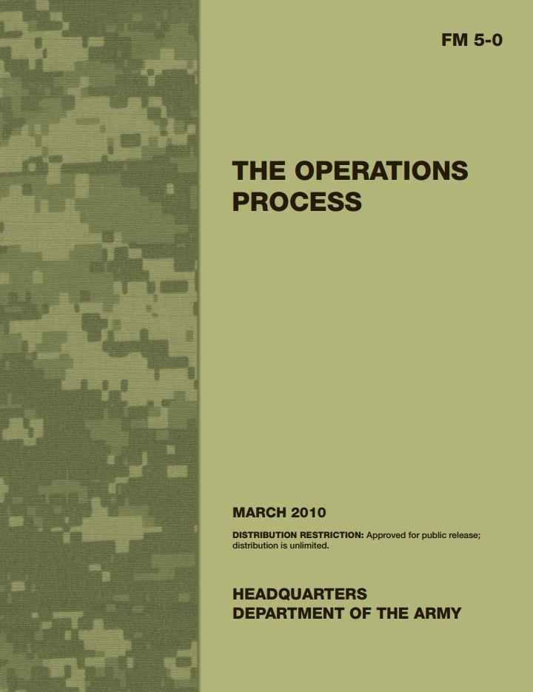
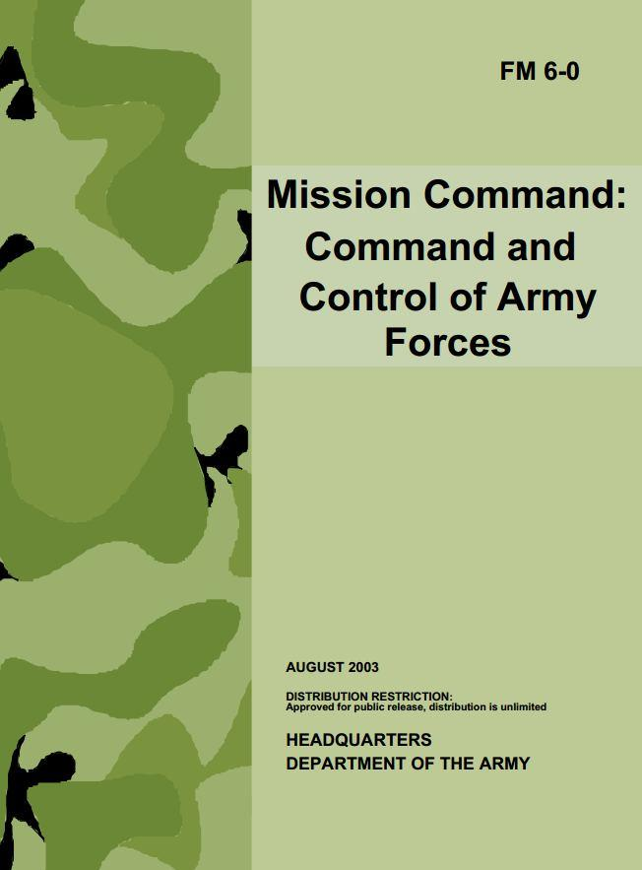
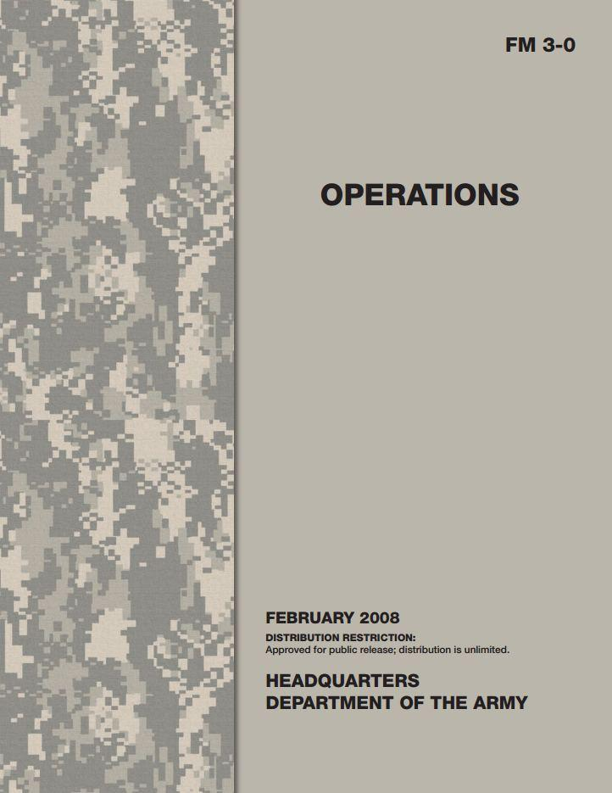
Cornerstones of US Army Doctrine
~
Doctrinal manuals available online at:
(Army) http://armypubs.army.mil/doctrine/Active_FM.html
(Joint) http://www.dtic.mil/doctrine/new_pubs/jointpub.htm
and here… http://fas.org/irp/doddir/dod/
Notes:
Overarching military doctrine is referred to a ‘joint’, referring to operations being conducted jointly between multiple services. We are most familiar with U.S. Army doctrine.
If you were only to read one Army doctrinal manual, it would be FM3-0, Operations. This manual describes in detail the Army’s approach to warfare at the strategic, operational, and tactical levels.
FM 5-0 describes the staff processes that are used to plan and execute Army operations
Finally, FM 6-0 describes how commanders should visualize the battlefield and express their vision (and intent?) to their subordinates and staff.

Slide 16
Doctrine: Finding What You Are Looking For
~
U.S. doctrinal manuals are numbered hierarchically.
First digit uses the continental staff numbering system:
  manpower or personnel
  intelligence
  operations
  logistics
  plans
  signal (communications or IT)
  training
  finance and contracts
  civil-military operations or civil affairs
e.g.: Army FM 2-0 is “Intelligence Operations”
FM 2-91.4 is “Intelligence Support to Urban Operations”
Notes:
We’ll need to mention what the continental staff numbering system means

Slide 17
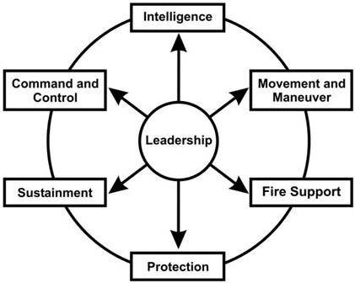
Army Operations Doctrine
~
3-series FMs cover operations
3-0 Operations
3-09 Field Artillery and Fire Support
3-24 Counterinsurgency
3-60 The Targeting Process
3-90 Offensive and Defensive Ops
These manuals describe how to synchronize the six warfighting functions
Movement and Maneuver
Command and Control
Intelligence
Fire Support
Protection
Sustainment
Notes:
Warfighting functions:
- Movement and Maneuver
- Command and Control
- Intelligence
- Fire Support
- Protection
- Sustainment
These, plus ‘Leadership’ comprise the Elements of Combat Power

Slide 18
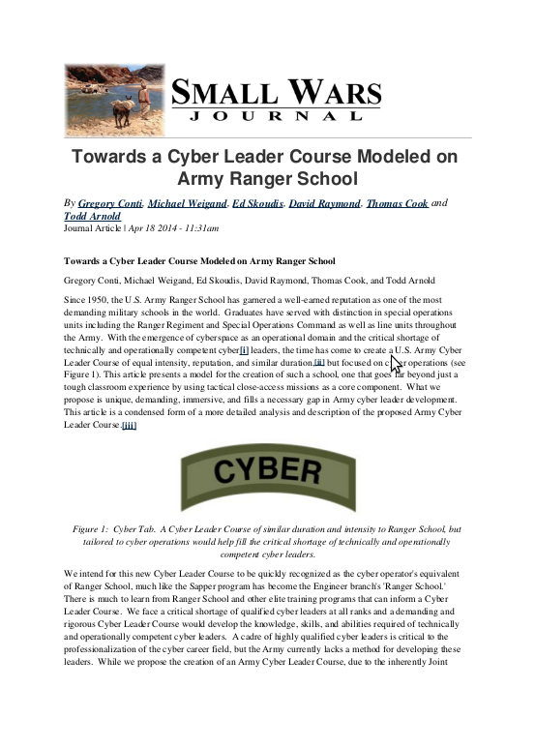
A Short Story...
@
“Towards a Cyber Leader Course Modeled on Army Ranger School”
Small Wars Journal
18 April 2014
http://smallwarsjournal.com/jrnl/art/towards-a-cyber-leader-course-modeled-on-army-ranger-school
Notes:
Publish and engender professional discourse and debate.

Slide 19
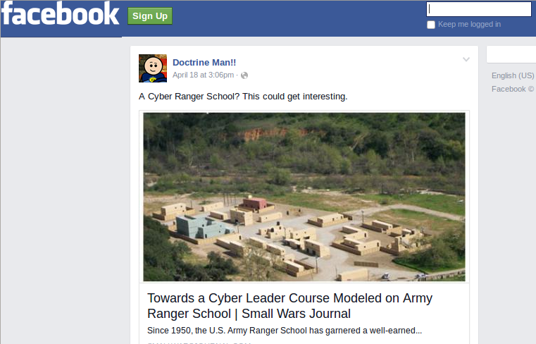
And Doctrine Man was There...
@
Notes:
Like a moth to a flame doctrine man was there.

Slide 20
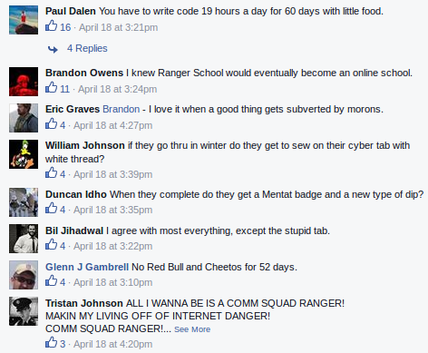
@
“You have to write code 19 hours a day with little food.”
“I knew Ranger School would eventually become an online school”
Notes:
Indicative of a clash of cultures
This is just an excerpt, but it is safe to say every powerpoint ranger joke was used
However, if you go to the Small Wars Journal site, there was much more thoughtful feedback
Maybe make the quoted (highest voted comment) appear after a mouse click
Regardless, both types of feedback were useful to refine the idea

Slide 21
Some Specific Examples...
~
We’ve picked a few key concepts of relevance to the infosec community:
OPSEC
Kill Chain
Cyber Terrain
Disinformation (Denial and Deception)
Threat Intelligence & TTPs
Intel Gain/Loss
OODA Loop
Targeting

Slide 22
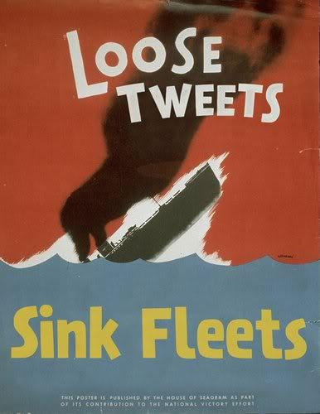
Operations Security (OPSEC)*
~@
The OPSEC process is a systematic method used to identify, control, and protect critical information and subsequently analyze friendly actions associated with military operations.
The purpose of operations security (OPSEC) is to reduce the vulnerability of US and multinational forces from successful adversary exploitation of critical information. OPSEC applies to all activities that prepare, sustain, or employ forces.
There is an entire Joint Publication on OPSEC... Joint Publication 3-13.3
* JP 3-13.3, Operations Security, 4 January 2012, available at https://publicintelligence.net/jcs-opsec/
Notes:
<greg comment. Tom pointed out that many in the infosec community misuse the term “OPSEC” (at least in the military context), we may want to highlight that Military OPSEC != CISSP definition>
(CISSP definition) Operations Security – used to identify the controls over hardware, media and the operators with access privileges to any of these resources.
Resource protection
Incident response
Attack prevention and response
Patch and vulnerability management
As a comment we could also state that CISSP’s operational, tactical, and strategic terminology is also different the military uses tactical, operational, and strategic more in terms of scope (and the ordering is different)

Slide 23
So How Can Good OPSEC Help Me?
%
Attackers:
Secrecy of the fact of the operation
  Avoiding detection
  When detected, appear to be something else
Secrecy of information about the operation
  Protect details of the operation
  Prevent defenders who are aware of the operation from being able to stop it
  C&C addresses, vulnerabilities, malware samples, etc…
Secrecy of the identity of the operators
  Prevent defenders from directly striking the attacker
  Is it possible to connect aspects of your operation to your real identity and location?

Slide 24
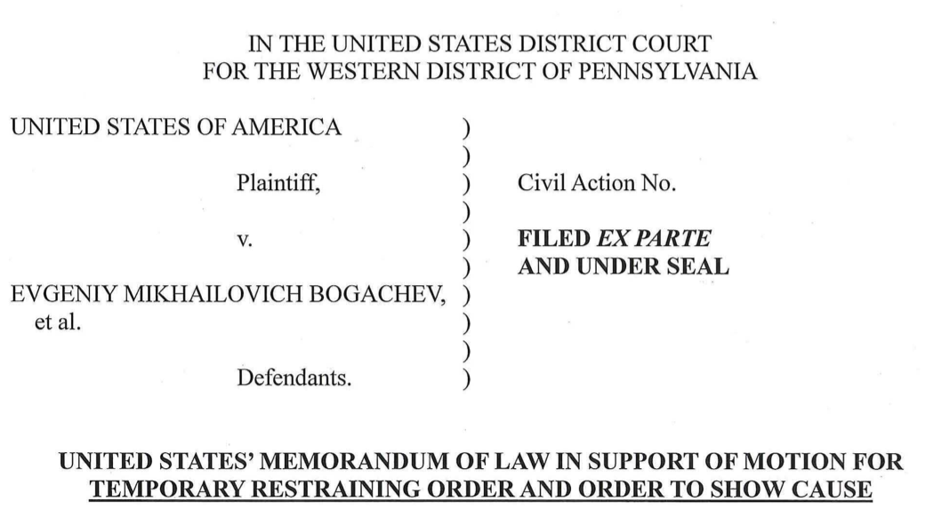
Operation Tovar
%

Slide 25
So How Can Good OPSEC Help Me?
%
Defenders:
What can attackers learn about your organization through open sources?
  Material for Spear Phishing attacks
  Aspects of your Information Security Program
  What products do you use?
  What do your IT staff say on their resumes, linkedin profiles, and twitter accounts?
Its hard for large commercial organizations to maintain good OPSEC - focus on the most important secrets.

Slide 26

The OPSEC Process from JP3-13.3
%
Identification of Critical Information
What are you trying to protect?
Analysis of Threats
Who is trying to get it?
Analysis of Vulnerabilities
How might they get to it?
Assessment of Risk
Risk=threat X vulnerability; what are you willing to accept?
Application of Appropriate Operations Security Countermeasures
Plug the holes!

Slide 27
Kill Chain
~
Find
Fix
Track
Target
Engage
Assess
US Air Force targeting methodology dating to late 1990’s
Also referred to by clever acronym: F2T2EA
"In the first quarter of the 21st century,it will become possible to find, fix or track, and target anything that moves on the surface of the Earth."
GEN Ronald R. Fogleman, USAF Chief of Staff
October 1996
Notes:
John A. Tirpak. “Find, Fix, Track, Target, Engage, Assess”, Air Force Magazine, 2 July 2000. Available at http://www.airforcemag.com/magazinearchive/pages/2000/july%202000/0700find.aspx

Slide 28
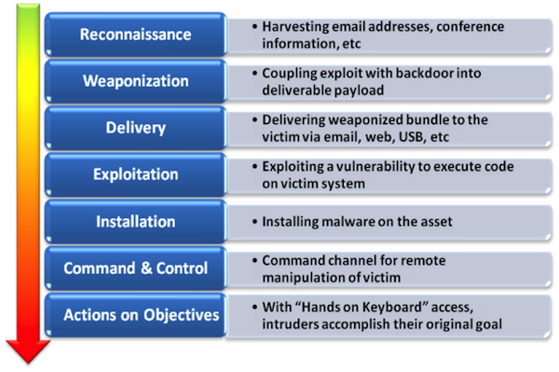
Cyber Kill Chain
~
Cyber Kill Chain first proposed in a 2010 Lockheed-Martin whitepaper: “Intelligence-Driven Computer Network Defense Informed by Analysis of Adversary Campaigns and Intrusion Kill Chains”, by Hutchins, et. al.
*Image source: NoVA Infosec, “Cyber Kill Chain 101.” May 2013, https://www.novainfosec.com/2013/05/29/cyber-kill-chain-101/
Notes:
The idea of a ‘cyber kill chain’ is based on the USAF ‘kill chain’ and was introduced in a Lockheed Martin whitepaper by Hutchins, et. al, entitled “Intelligence-Driven Computer Network Defense Informed by Analysis of Adversary Campaigns and Intrusion Kill Chains”, http://www.lockheedmartin.com/content/dam/lockheed/data/corporate/documents/LM-White-Paper-Intel-Driven-Defense.pdf. Paper presented at the 6th Annual International Conference on Information Warfare and Security, Washington, DC, 2011.
- The ideas is simply that the attacker has to be successful along several sequential ‘kill chain’ steps and to stop him, you only have to disrupt one link in the chain. It argues for defense-in-depth.
Other Resources:
Kill Chain Analysis of the Target Breach
http://www.commerce.senate.gov/public/?a=Files.Serve&File_id=24d3c229-4f2f-405d-b8db-a3a67f183883
Image: NoVA Infosec, “Cyber Kill Chain 101.” May 2013, https://www.novainfosec.com/2013/05/29/cyber-kill-chain-101/

Slide 29
The Value of the Kill Chain
%
Drives the defender to take a comprehensive view of the lifecycle of an attack rather than focusing on a single stage.
Provides a framework for organizing artifacts of an attack collected during an investigation.
Turns asymmetry on its head – the attacker must remain covert through each stage of their operation – each stage presents the defender with an opportunity to detect the attack.

Slide 30
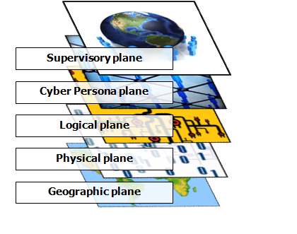
Cyberspace Planes and Cyber Terrain
~
Supervisory plane
  Command and Control
Cyber persona plane
  Persons or ‘accounts’
Logical plane further divided into top 6 OSI layers (data link – application)
  Operating system and application programs
  Services – web, email, file systems
  Logical network protocols
Physical plane == OSI PHY layer (layer 1)
  Network devices – switches, routers
Geographic plane == physical location
  Location in which an info system resides
Most references to cyber terrain consider only the physical plane.
For more on cyber terrain and cyber key terrain, see Raymond, et. al, “Key Terrain in Cyberspace: Seeking the High Ground,” in 6th Annual NATO Conference on Cyber Conflict, Tallinn, Estonia, June 2014.

Slide 31
Cyber Terrain Analysis (OCOKA)
~
Observation and Fields of Fire
What portions of my network can be seen from where?
Cover and Concealment
What can I hide from observation?
Obstacles
How can I make my network harder to attack?
Key Terrain
Cyber terrain that can provide a ‘marked advantage’
Avenues of Approach
Don’t just think of routers and cables . . .
* D. Hobbs, “Application of OCOKA to Cyberterrain,” White Wolf Security White Paper, June 2007.

Slide 32
Leveraging Cyber Key Terrain
%
An approach to leveraging key terrain emerges from considering the terrain analysis as an attacker and as a defender.
As a defender:
  Identify Potentially Targeted Assets
  Enumerate Avenues of Approach
  Consider Observation and Fields of Fire
  Place Obstacles, Cover, and Concealment

Slide 33
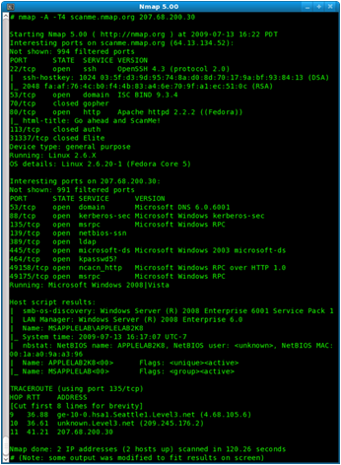
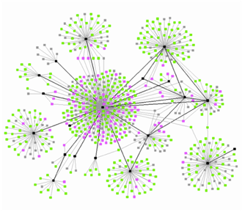
Observation and Fields of Fire
%
What does an attacker need access to in order to observe or attack a particular interface associated with a potentially targeted asset?
This is an iterative analysis. For example, if the attacker needs access to a particular network in order to reach a critical asset, how can that network, in turn, be accessed?
It is through this iterative analysis that a picture of Key Terrain begins to emerge, which include highly interconnected resources as well as resources with connectivity to critical assets.
Its important to consider terrain that your organization doesn’t control – attacks on supply chain integrity, waterhole attacks, etc…

Slide 34
Lessons from Cyber Terrain Analysis
%
Battlefield Terrain Analysis maps fairly closely to the sort of analysis that network security people perform when thinking about a network’s exposures.
Defenders know the terrain they are defending – attackers must discover it through iterative reconnaissance.
Defenders can exploit an attacker’s lack of knowledge of the terrain.

Slide 35
Denial*
%
Denial includes those measures designed to hinder or deny the enemy the knowledge of an object, by hiding or disrupting the means of observation of the object.
The basis of denial is dissimulation, the concealing of the truth.
* Counterdeception Principles and Applications for National Security, Bennett & Waltz

Slide 36
Deception*
%~
Deception is actions executed to deliberately mislead adversary military, paramilitary, or violent extremist organization decision makers, thereby causing the adversary to take specific actions (or inactions) that will contribute to the accomplishment of the friendly mission.
The basis of deception is simulation, the presentation of that which is false.
* JP 3-13.4, Military Deception, 26 January 2012, available at https://publicintelligence.net/jcs-mildec/

Slide 37
Network Denial & Deception
%
On the Internet, there is no way to tell whether or not something is actually real.
Denial
  Hidden file systems
  Real services on unusual ports
Deception
  Fake database records (Canaries)
  Fake employees or user accounts
  Phoney systems and services
Remember - what is important to you isn’t necessarily what is important to your adversary.

Slide 38
Exploiting the Human
%
It is often observed that the human is the weakest link in any network defense.
Often, the human is also the weakest link in any network offense.
What are you doing in your network defense to exploit the human behind the attacks that are targeting you?

Slide 39
What is Threat Intelligence?
@
00dbb9e1c09dbdafb360f3163ba5a3de
00f24328b282b28bc39960d55603e380
0115338e11f85d7a2226933712acaae8
0141955eb5b90ce25b506757ce151275
0149b7bd7218aab4e257d28469fddb0d
016da6ee744b16656a2ba3107c7a4a29
01e0dc079d4e33d8edd050c4900818da
024fd07dbdacc7da227bede3449c2b6a
0285bd1fbdd70fd5165260a490564ac8
02a2d148faba3b6310e7ba81eb62739d
02c65973b6018f5d473d701b3e7508b2
034374db2d35cf9da6558f54cec8a455
03ae71eba61af2d497e226da3954f3af
0469a42d71b4a55118b9579c8c772bb6
0496e3b17cf40c45f495188a368c203a
04a7b7dab5ff8ba1486df9dbe68c748c
04e83832146034f9797d2e8145413daa
04f481d6710ac5d68d0eacac2600a041
0501bb10d646b29cab7d17a8407010d9
0522e955aaee70b102e843f14c13a92c
052ec04866e4a67f31845d656531830d
0545a524a6bb0b042f4b00da53fec948
05552a77620933dd80f1e176736f8fe7
0583f58ac3d804d28cd433d369b096b8
0588ffa0a244a2c4431c5c4faac60b1f
aoldaily.com
aolon1ine.com
applesoftupdate.com
arrowservice.net
attnpower.com
aunewsonline.com
avvmail.com
bigdepression.net
bigish.net
blackberrycluter.com
blackcake.net
bluecoate.com
booksonlineclub.com
bpyoyo.com
businessconsults.net
businessformars.com
busketball.com
canadatvsite.com
canoedaily.com
chileexe77.com
cnndaily.com
cnndaily.net
cnnnewsdaily.com
12.38.236.32
71.6.141.230
72.240.45.65
203.231.234.23
202.64.109.187
223.25.233.36

Slide 40
Doctrinal Definition of Intelligence
@
Joint Publication 2-0, Joint Intelligence*:
“The product resulting from the collection, processing, integration, evaluation, analysis, and interpretation of available information concerning foreign nations, hostile or potentially hostile forces or elements, or areas of actual or potential operations.”
In practice, it is a thorough analysis and understanding of the threat’s capabilities, strategy, and tactics and how they can be used on the cyber terrain comprising your operational environment.
* Definition from JP 2-0, Joint Intelligence, 22 October 2013, available at http://www.dtic.mil/doctrine/index.html

Slide 41
The Intelligence Cycle
@
Planning and direction
Collection
Processing and exploitation
Analysis and production
Dissemination and integration
Evaluation and feedback
Nothing is more worthy of the attention of a good general than the endeavor to penetrate the designs of the enemy.
Niccolò Machiavelli
Discourses, 1517
http://armypubs.army.mil/doctrine/DR_pubs/dr_a/pdf/adrp2_0.pdf

Slide 42
Characteristics of Effective Intelligence
@
Information Quality Criteria
Accuracy
Timeliness
Usability
Completeness
Precision
Reliability
Additional Criteria
Relevant
Predictive
Tailored
Commanders’ Considerations include
Reducing operational uncertainty
Determine appropriate balance between time alloted for collection and operational necessity
Prioritize finite resources and capabilities, including network bandwidth
Employing internal and supporting intel assets as well as planning, coordinating, and articulating requirements to leverage the entire intelligence enterprise.
http://armypubs.army.mil/doctrine/DR_pubs/dr_a/pdf/adrp2_0.pdf

Slide 43
Tactics, Techniques, and Procedures (TTPs)
@
Tactics - The employment and ordered arrangement of forces in relation to each other
Techniques - Non-prescriptive ways or methods used to perform missions, functions, or tasks
Procedures - Standard, detailed steps that prescribe how to perform specific tasks
The term TTP is used to refer broadly to the actions that one might take in a particular problem domain.
* JP 1-02, DoD Dictionary of Military and Associated Terms, 8 Nov. 2010, available at http://www.dtic.mil/doctrine/

Slide 44
Risk Analysis
@%
Intel Gain/Loss Calculus
You’ve discovered an attacker in your network. You could kick them out, but they’d notice that.
How do you decide when to kick them out and when to let them continue?
Counter-intuitively, the risk of allowing them to continue increases the more that you know about them.

Slide 45
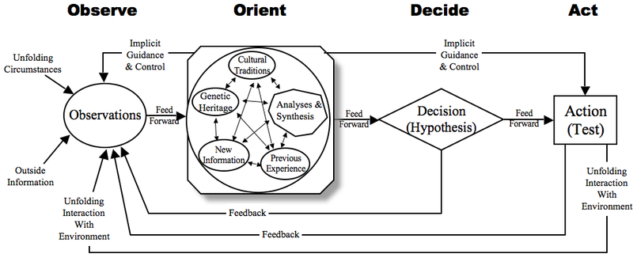
The OODA Loop
~
COL John Boyd, USAF
Writings can be found at http://dnipogo.org/john-r-boyd/, provided by the Project on Government Oversight
Image from http://crossvale.com/blog/boiling-ocean-analysis-paralysis-and-ooda-loop

Slide 46
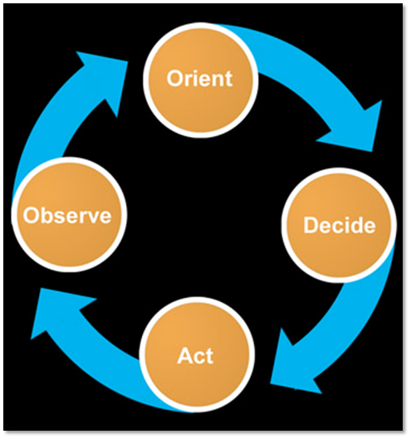
Simplified OODA in the Context of Time
%
Intelligence
  Observation
  Orientation
Execution
  Decision
  Action

Slide 47
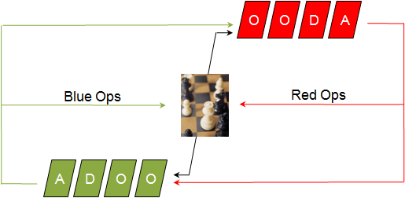
OODA for Cyber Security
%
Conflict: Red vs. Blue
Spin your loop faster than your adversary

Slide 48
OODA Loop Summary*
%
Observation and Orientation (OO) increases your perceptive boundaries.
Superior Situational Awareness
Sampling Rate of the OO is relative to the rate of change
Fast enough to represent change
Decision and Actions raise the cost to your adversaries’ Observation/Orientation
Operate at a faster tempo or rhythm than our adversaries
Ultimately you are making it more expensive for the adversary to operate and hide
* TK Keanini - The OODA Loop: A Holistic Approach to Cyber Security - https://www.youtube.com/watch?v=RBv82THpBVA

Slide 49
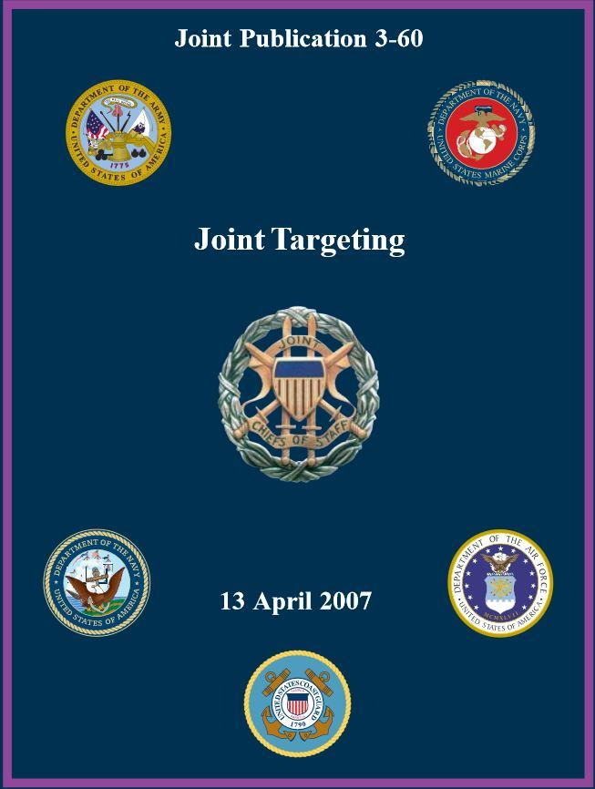
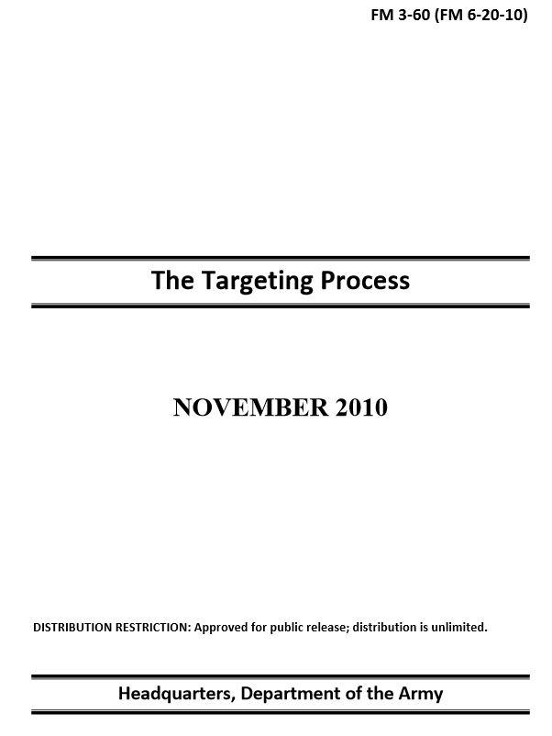
Targeting
~
Targeting: The process of selecting and prioritizing targets and matching the appropriate response to them.
Target: An entity or object considered for possible engagement or action . . . to support commander’s objectives.
Purpose: integrate and synchronize fires into joint operations.
Joint Publication 3-60 Joint Targeting http://www.dtic.mil/doctrine/new_pubs/jointpub_operations.htm
Army FM 3-60 The Targeting Process http://armypubs.army.mil/doctrine/DR_pubs/dr_a/pdf/fm3_60.pdf

Slide 50
Targeting
~
Targeting: The process of selecting and prioritizing targets and matching the appropriate response to them.
Continuous cycle that begins with the effects the commander wants to achieve
Can be lethal or “non-lethal” Effects might include:
  Deceive
  Degrade
  Destroy
  Influence
Targeting Methodology
DECIDE Scheme of Maneuver/Fires, High-Payoff Target List
DETECT Execute Intelligence Collection Plan
DELIVER Execute Attack Guidance Matrix
ASSESS Combat Assessment
Joint Publication 3-60 Joint Targeting http://www.dtic.mil/doctrine/new_pubs/jointpub_operations.htm
Army FM 3-60 The Targeting Process http://armypubs.army.mil/doctrine/DR_pubs/dr_a/pdf/fm3_60.pdf
Notes:
Targeting is the process by which military commanders select appropriate tools, either lethal (bombs and bullets) or non-lethal (flyers and press releases) to achieve a specific effect in their battlespace. Non-lethal tools are almost always favored over lethal ones. They have less risk of collateral damage, usually less risk to operational forces, and minimize international outrage. A great example of this is Israel’s 2007 air raid on Syrian nuclear reactors in Dayr az-Zawr. Isreal used jamming and other cyber attacks to shut down Syrian air defense for the duration of the attack (http://defensetech.org/2007/11/26/israels-cyber-shot-at-syria/). This tactic minimized collateral damage, reduced the extent of the bombing, and required fewer sorties into Syria, reducing threat to Israeli pilots.

Slide 51
How Does This Apply to Cyber Ops?
~
Computer-based effects can be used as part of, or instead of, lethal military action.
Israeli cyber attack on Syrian air defense systems (2007)
Russia’s coordinated virtual attack and physical invasion of Georgia (2008)
Stuxnet (2010)
Notes:
50 years ago Israel would have used aerial attack or artillery bombardment to take Syrian air defense systems offline in preparation for their aerial attack on

Slide 52
Other Useful Doctrinal Concepts
~
The following discussion provides pointers to other areas that warrant continued research.

Slide 53
Military Operational Planning
~
Planners use the Military Decision Making Process (MDMP)
Step 1: Receipt of Mission
Step 2: Mission Analysis
Step 3: Course of Action (COA) Development
Step 4: COA Analysis (wargaming)
Step 5: COA Comparison
Step 6: COA Approval
Step 7: Orders Production
Appendix B of Army FM 5-0, The Operations Process, provides excellent coverage of MDMP. This systematic decision-making process mirrors the Engineering Design Process, which should be familiar to many in this audience.
Notes:
Source: Army FM 5-0, The Operations Process, Appendix B.

Slide 54
Dave
STEP 1
Receipt of Mission
STEP 7
Orders
Production
STEP 2
Mission
Analysis
Military Decision Making Process
STEP 6
COA
Approval
STEP 3
Course of Action Development
STEP 5
COA
Comparison
STEP 4
COA Analysis
(War Gaming)
STEP 1
Identify the Problem
STEP 8
Redesign
STEP 2
Research the Problem
Engineering Design Process
STEP 7
Communicate the Solution
STEP 3
Develop Possible Solutions
STEP 6
Test and Evaluate the Solution
STEP 4
Select the Best Possible Solution
STEP 5
Construct a Prototype

Slide 55
~
“Design” - the DoD’s latest doctrinal buzzword
Design is a methodology for applying critical and creative thinking to understand, visualize, and describe complex, ill-structured problems and develop approaches to solve them.
Army FM 5-0 The Operations Process
Emphasizes role of the commander
Requires creative thinking, dialog, and collaboration
Is executed in parallel with operational planning
Designed to be iterative:
  question assumptions
  incorporate new facts
  abandon dead ends
  refine the problem statement
Commander
Conceptual
Component
Detailed
Component
* Best doctrinal reference: Army FM 5-0:
https://www.fas.org/irp/doddir/army/fm5-0.pdf
Staff
Notes:
Good reference (besides FM 5-0): The Art of Design, SAMS Student Text Version 2.0, http://usacac.army.mil/cac2/cgsc/events/sams/artofdesign_v2.pdf
- Quite applicable to the often ill-defined problems facing a network defender (or attacker).
- Good quote (from FM 5-0): 3-8. Persistent conflict presents a broad array of complex, ill-structured problems best solved by applying design. Design offers a model for innovative and adaptive problem framing that provides leaders with the cognitive tools to understand a problem and appreciate its complexities before seeking to solve it.

Slide 56
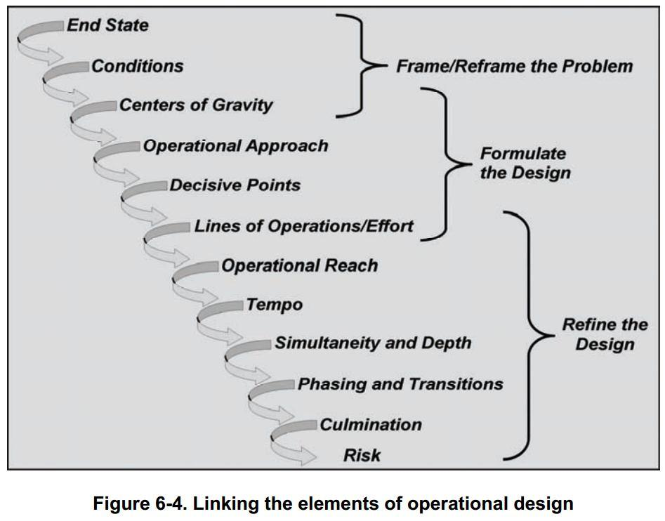
Origins of “Design”
~
Conceived at the School for Advanced Military Studies, or SAMS, in mid-2000’s
Intended as a thought process for the commander to translate desired strategic effects to tactical actions on the battlefield
Actually useful as a conceptual model!
Design (or “Operational Design”):
Introduced in Joint Pub 3-0, Operations in chapter on “The Art of Joint Command”
Refined in doctrinal manuals on planning (e.g.: FM5-0, The Operations Process)

Slide 57
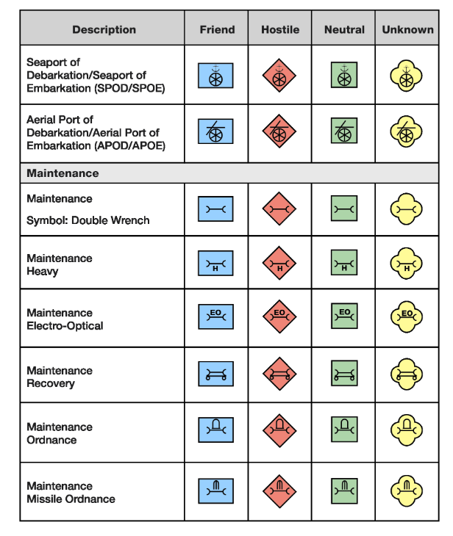
Graphics and Symbology
@
484 pages of operational terms and graphics.
See FM 1-02
http://armypubs.army.mil/doctrine/DR_pubs/dr_a/pdf/fm1_02.pdf
Notes:
This is an example of the quick “survey” slides I mentioned. This manual should be of great interest for anyone in the infosec community trying to graphically present information.

Slide 58
Deconstructing <Reversing> Doctrine…
@
Ukraine
Georgia
Estonia
Stuxnet
  Legal review
  Clarke analysis
  Collateral damage mitigation

Slide 59
Great Resources for More Information
~
DoD and Military Branch doctrine:
Intelligence and Security Doctrine (including DoD and all military branches) Federation of American Scientists’ Intelligence Resource Program http://www.fas.org/irp/doddir
DOD Dictionary. http://www.dtic.mil/doctrine/dod_dictionary/
Joint Doctrine. http://www.dtic.mil/doctrine/doctrine/
Army Doctrine. http://armypubs.army.mil/doctrine/Active_FM.html
Publications:
Small Wars Journal: http://smallwarsjournal.com (all online content)
Military review: http://militaryreview.army.mil (online and print)
Parameters: http://strategicstudiesinstitute.army.mil/pubs/parameters (online and print). US Army War College quarterly journal.
Army Branch Magazines (Armor magazine, Infantry magazine, Artillery magazine, ArmyAviation magazine, etc.
Combined Arms Research Digital Library: http://cgsc.contentdm.oclc.org

Slide 60
More resources
~
Military Theorists:
Clausewitz, Carl von. On War, [available at www.clausewitz.com], 1832
Jomini, Antoine Henri. The Art of War, [available at www.gutenberg.org], 1862
Mitchell, William. Winged Defense: The Development and Possibilities of Modern Air Power--Economic and Military. The University of Alabama Press, Tuscaloosa, AL. 1925
Coram, Robert. Boyd: The Fighter Pilot Who Changed the Art of War. Little, Brown and Company, 2002
Mao Zedong. On Guerilla Warfare, [Online]. Available at http://www.marxists.org/, 1937
Mahan, Alfred Thayer. The Influence of Sea Power Upon History: 1660 - 1783, Little, Brown and Co. 1890
Lots more . . .

Slide 61
Yet more . . .
~
Conferences:
NATO Conference on Cyber Conflict (CyCon): http://ccdcoe.org/cycon/home.html
IEEE/AFCEA Annual Military Communications Conference (MILCON): http://www.milcom.org/
Other:
Center for Army Lessons Learned: http://usacac.army.mil/CAC2/call/
[See our whitepaper for lots more references!]

Slide 62
~@%
Questions?

Slide 63
Backup Slides

Slide 64
`%~@
Questions?

Slide 65
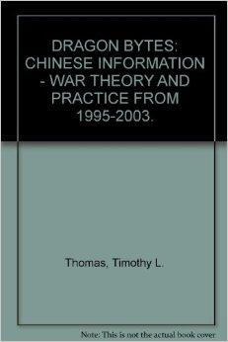
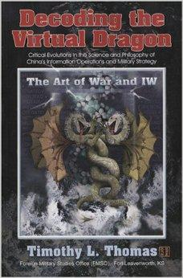
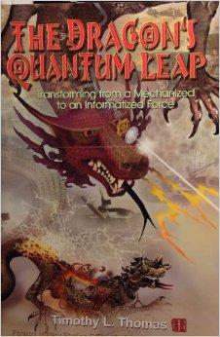

Resources on Adversary Doctrine and Strategy: China
Timothy Thomas’ trilogy and Chinese Information Warfare doctrine, published by the Army’s Foreign Military Studies Office at Fort Leavenworth.
  Dragon Bytes, 2003
  Decoding the Virtual Dragon, 2007
  The Dragon’s Quantum Leap, 2009
Liang, Qiao and Xiangsui, Wang. Unrestricted Warfare. Summaries and translations abound on the web; extensively covered in Thomas’ Chinese IW trilogy.
Notes:
Timothy Thomas is a retired Army Foreign Area Officer and currently an analyst at the Army’s Foreign Military Studies Office at Fort Leavenworth. He has extensively studied Chinese Information Warfare doctrine and his trilogy is an excellent source of information.
All three works were published by FMSO and are available from Amazon and other booksellers.
Unrestricted Warfare is a book on Chinese strategy by two senior PLA Colonels, Qiao Liang and Wang Xiangsui. This work examines differences between American and Chinese thinking on warfare and analyzes how America’s strategic approach can be used against it.

Slide 66
More Adversary Doctrine and Strategy: Russia
Russian Military Publications:
“Doctrine of Information Security of the Russian Federation” (2000)
“Conceptual Views on the Activity of the Russian Federation Armed Forces in Information Space” (2011)
American Foreign Policy Council’s Defense Dossier:
“How Russia Harnesses Cyberwarfare,” by David J. Smith.

Slide 67
But the government is here to help, right?
“DoD will employ new defense operating concepts to protect DoD networks and systems.”
- DoD Strategy for Operating in Cyberspace
“The Department of Homeland Security (DHS) is responsible for helping Federal Executive Branch civilian departments and agencies secure their unclassified networks (.gov).”
- DHS. Preventing and Defending Against Cyber Attacks. June 2011
“The mission of the [FBI] Cyber Division is to coordinate, supervise, and facilitate the FBI's investigation of those federal violations in which the Internet, computer systems, or networks are exploited as the principal instruments or targets . . .”
- FBI Cyber Division mission statement
Notes:
DoD protects classified and unclassified DoD networks (.mil)
DHS has the charter to protect civilian government network (.gov)
FBI investigates cyber crime, terrorism, etc.
NO GOVERNMENT AGENCY has the mission to protect US civilian cyber infrastructure.
Others quotes:
DHS is responsible for overseeing the protection of the .gov domain and for providing assistance and expertise to private sector owners and operators.
- DHS Website
CS&C leads efforts to protect the federal “.gov” domain of civilian government network and to collaborate with the private section - the “.com” domain - to increase the security of critical networks.
- DHS Officer of Cybersecurity and Communications mission statement
Nobody is going to help YOU defend YOUR network!

Slide 68
Attributes of Effective Doctrine
Success in Combat
Acceptability by the Military and Nation
Adaptability and Flexibility
Relevancy
Attainability
Brent Morgan, “Employment of Indications and Warning Methods to Forecast Potentially Hostile Revolutions in Military Affairs,” Naval Postgraduate School Thesis, 1995.

Slide 69
Why Does Doctrine Change
Strategic Objectives
Strategic Environment
Changes in Leadership
Defeat/Success on the Battlefield
Changes in Technology
Changes in Available Resources
Enlightened Vision
Brent Morgan, “Employment of Indications and Warning Methods to Forecast Potentially Hostile Revolutions in Military Affairs,” Naval Postgraduate School Thesis, 1995.

Slide 70
Indicators of Doctrinal Change
Use Against a Third Party
War Games and Exercises
New Manuals or Doctrinal Publications
New Service School Curriculum
Professional Publications
Brent Morgan, “Employment of Indications and Warning Methods to Forecast Potentially Hostile Revolutions in Military Affairs,” Naval Postgraduate School Thesis, 1995.

Slide 71
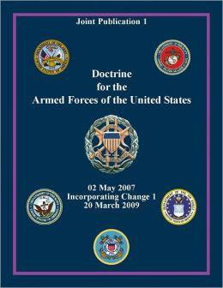
Joint Doctrine
Codified in Joint Publications
Approved by Chairman of the Joint Chiefs of Staff
Provides a common frame of reference among the branches of service and helps standardize operations
Each service must create it’s own doctrine that is nested (or compliant with) Joint Doctrine
Available online on the Joint Electronic Library. http://www.dtic.mil/doctrine/

Slide 72
US Cyber Operations Doctrine
JP 3-12 - Cyberspace Operations
Overarching doctrine for US approach to cyberspace operations
Unfortunately, it is classified SECRET
Army FM 3-28 - Cyber Electromagnetic Activities
Describes how cyberspace operations planning is integrated into Army operational planning
Unclassified!

