Slide 1
Leading Cybersecurity Innovation:
Lessons Learned from Government, Academia, and Industry
Gregory Conti // greg.conti@ironnet.com // @cyberbgone
https://blog.xkcd.com/2019/08/16/serena-versus-the-drones/

Slide 2


Director (4 Years)
Army-level Initiative
Created from Scratch
Senior Security Strategist & Director of Security Research (3.5 years+)
Overlay within a Start-up
Greg Conti
Senior Security Strategist
IronNet
Director (7 Years)
EECS, West Point
Inherited
Course Developer & Instructor (6 months)
US Cyber Command
Created Course and Train the Trainer
The views expressed in this talk are those of the author and do not reflect the official policy or position of IronNet, the US Government, or any other current or past employers.

Slide 3
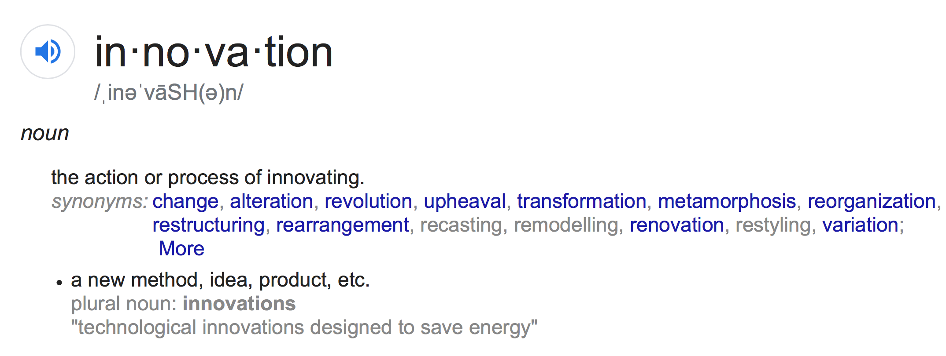
Rearrangement
Change
Restyling
Reorganization
Revolution
Transformation
Variation
Upheaval
Restructuring
Innovation
Alteration
Metamorphosis
Recasting
Renovation
Remodeling

Slide 4

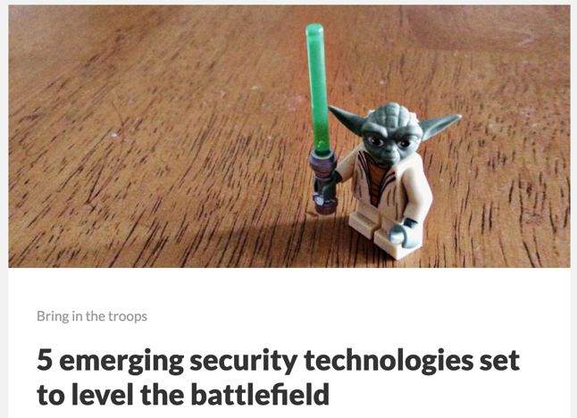

Why, So What, Who Cares…
Improve morale
Increase retention
Aid recruiting
Unlock potential of your people
Solve problems that matter,
Contribute to your organization, and your customers
Contribute to your community, no matter how you define it
Lead
Content-based Marketing
Be recognized as a leader
Create new products and services
Compete
https://medium.com/@HockeyInJune/rsa-conference-2019-recap-cf612101ad96

Slide 5
Institutional Agility

Slide 6
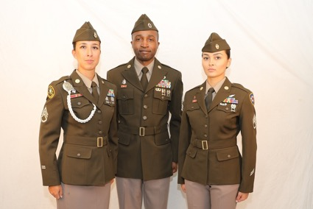
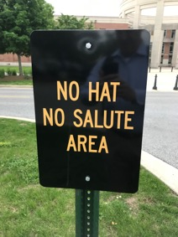
What is Your Culture?
or
or
or
or
http://operational-strategies.com/color-outside-lines/
https://www.cshub.com/security-strategy/news/rsa-coverage-includes-automation-threat-landscape
https://www.armytimes.com/news/your-army/2018/11/09/excited-about-the-armys-new-pinks-and-greens-uniform-stand-by-to-stand-by/

Slide 7
But it Can Be Done…

Slide 8
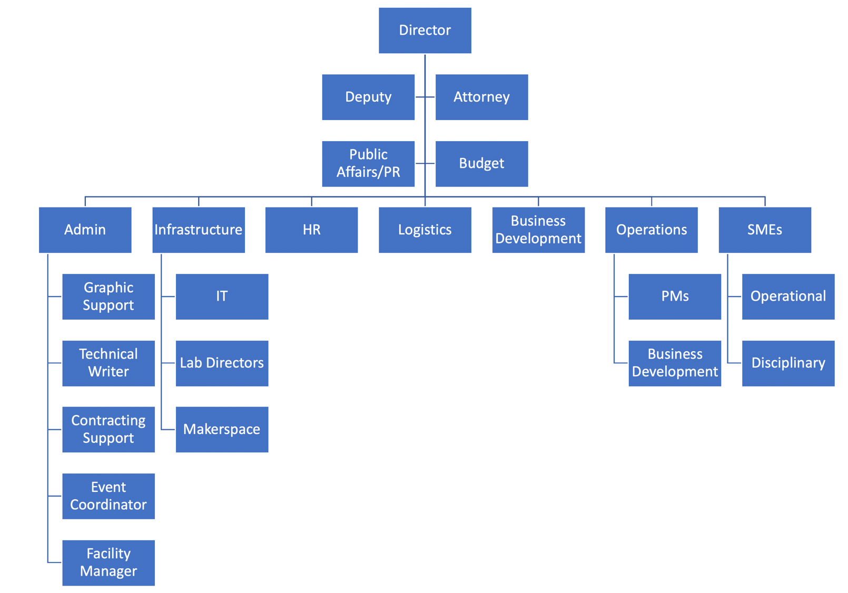
Secret sauce
Organize for agility

Slide 9
Weapons
Leadership
EE
Training
Maneuver
OPSEC
Law
Effects Based Ops
Political Science
Targeting
Systems Engineering
Command
and Control
CS
Economics
Information Operations
InfoSec
Psychology
Counter Intelligence
Terrain Analysis
Information Assurance
Intelligence
Electronic Warfare
Deception
Ethics
Military Planning
Math
History
Business

Slide 10
Role of the Leader
Understand what Success Looks Like
Evangelize the Mission
Acquire and Protect Resources (People, Money, Space) from Poaching and Misuse
”Approve,” Prioritize and Track Projects
Herd Cats
Communicate Upward, Downward, Laterally
Create a Culture Where People want to Work
Minimize Bureaucracy
Incident Response
https://www.goodfruitandvegetables.com.au/story/6243807/horticulture-industrys-cat-herding-mentality-not-all-bad/

Slide 11
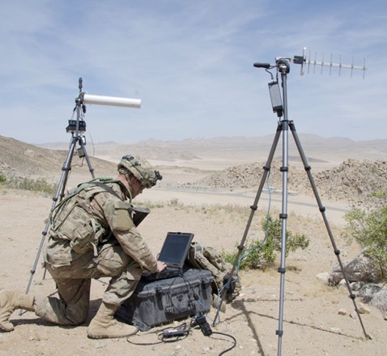
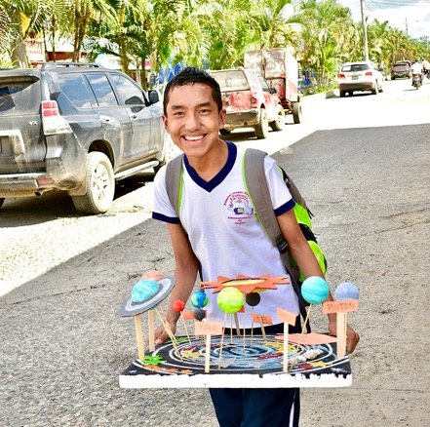
Project Selection
Near-term Operational Issues
vs.
vs.
Science Projects
Staff Work
Hill After Next
https://en.wikipedia.org/wiki/Science_project#/media/File:Guatemalan_Boy_and_His_Science_Project.jp
http://www.aerotechnews.com/blog/2017/09/29/borderless-threat-army-cyber-command-helping-defend-nations-network/
https://www.discoverzq.com/fullscreen-page/comp-jpal4yhl/ab306a94-8dde-4503-8355-a9a4a926918f/9/%3Fi%3D9%26p%3Daf14z%26s%3Dstyle-jpal4yj0

Slide 12

Problem Selection
Relevant
“Interesting”
Tractable w/i the right timeframe
Right time horizon (now - 5 years out?)
You have the right expertise
Do no harm
It’s okay to take on senior leader/customer problems
Keep a running list of problems
Final
Goal

Slide 13

The Target May Move
But you have to connect to the organization’s
(sponsor’s) mission
Final
Goal
Initial
Goal

Slide 14
Open the aperture pretty wide, but not to infinity
https://en.wikipedia.org/wiki/Aperture#/media/File:Lenses_with_different_apertures.jpg

Slide 15
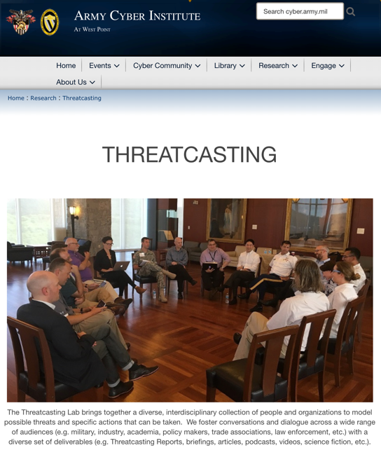
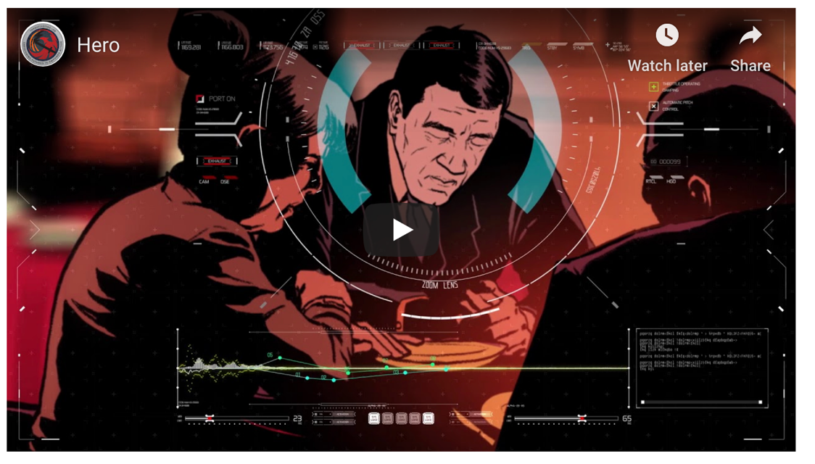
Example: Threatcasting
Workshops
Graphic Novels
https://threatcasting.com/about/sci-fi-prototypes/

Slide 16
Do Your Homework Though
Don’t rediscover fire
Buy, borrow, or partner if it is already done
Your operators (and customers) have a good idea where the gaps are
Study related work (really important)
https://en.wikipedia.org/wiki/Campfire#/media/File:Campfire_Pinecone.png

Slide 17

Top Down vs. Bottom Up Innovation
Senior Leader Champions
Grassroots
https://unsplash.com/s/photos/crowd
https://www.youtube.com/watch?v=mWSBPRFd1UU

Slide 18
A Little More on Herding Cats
Choose your team carefully, they should be compatible and complementary
Find people who are wired to do the type of work
Having a bright team player is (far) more valuable than a toxic genius
Set expectations, they can’t work on any science project they want
Incentives and (a little) leverage doesn’t hurt
https://meowpost.me/cowboy-herding-cats-commercial-is-seriously-the-best-ad-ive-ever-seen-and-i-cant-stop-laughing/

Slide 19
Stay Focused
“[Focus] means saying no to the hundred other good ideas that there are.
You have to pick carefully.
I’m actually as proud of the things we haven’t done as the things I have done.
Innovation is saying no to 1,000 things.”
Steve Jobs
https://www.clipartwiki.com/iclip/hTJmoJ_bloch-sphere-qubit-quantum-computing-physics-national-basketball/

Slide 20
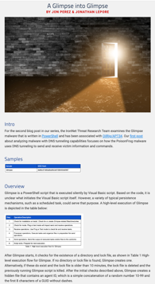
Sharing Your Results
Do good work and people come to you
Create tangible artifacts
  White papers
  Research papers
  Shorter thought pieces
  Talks (Local, National)
  Media interviews
  Data
  Code
  Blog posts
  …
Create forums and communities
Keep a (public) archive
Communicate business impact
https://arstechnica.com/information-technology/2019/10/an-army-hacker-con-goes-big-the-return-of-avengercon/

Slide 21
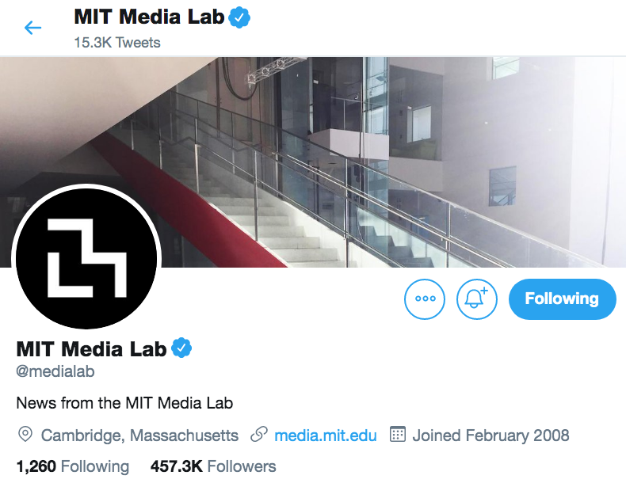
Communications
Personal
Organizational
Tell your story
Leverage social media (but be careful)
Place nice with the media (but know the rules)
Photos or it didn’t happen
It helps to have a PAO/PR person
You can’t fake it
Feeding the beast

Slide 22

Ethics and Safety Bumpers
https://nmap.org/
https://en.wikipedia.org/wiki/Rio_de_Janeiro#/media/File:Cidade_Maravilhosa.jpg
https://en.wikipedia.org/wiki/Rotary_dial#/media/File:Ericsson_Dialog_in_green.JPG
https://www.tripadvisor.com.ph/LocationPhotoDirectLink-g32431-d3846000-i60421781-Jewel_City_Bowl-Glendale_California.html

Slide 23
Manage Expectations
Write a CFP
Get accepted at a Top Tier Conference
Create a Top Tier Presentation
Write a White Paper
Organize a Workshop/Conference
Prime an Innovation Pipeline
Hire Talent
Spend Money (Government)
Subcontract Work
Transfer Technology
Default Assumption
Typical Reality
Time
3:1-10:1 and never in your favor

Slide 24
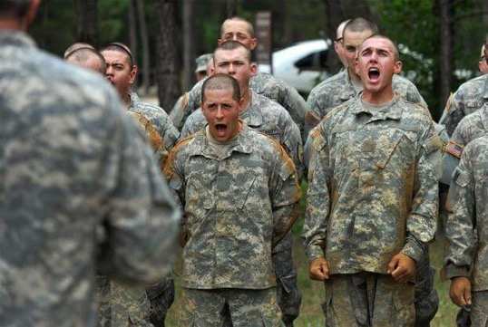
Programming, De-Programming, and Re-Programming

Slide 25
Prioritization
Spillover or leaves
organization
Innovation
120%
Innovation
Day Job
100%
100%
100%
Innovation
Day Job
Day Job
Innovation
Innovation
80%
80%
80%
Day Job
Day Job
Innovation
Day Job
Theory
Reality 1
Reality 2
Reality 3
See also Google’s take… https://www.businessinsider.com/google-20-percent-time-policy-2015-4

Slide 26
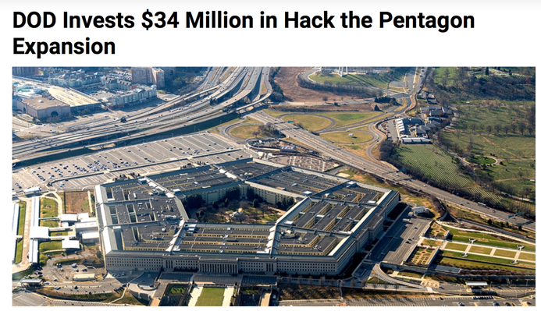
Isolation
Insiders vs. Outsiders
https://survivor.fandom.com/wiki/Exile_Island_(twist)

Slide 27
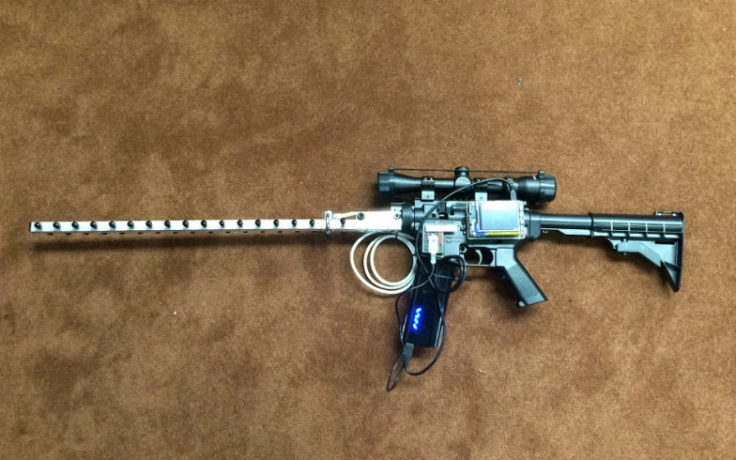
Case Study: Cyber Capability Rifle
Built over a weekend
$150
Raspberry Pi
Wi-Fi radio
Antenna
Exploited a known vulnerability in Parrot quadcopters
Quick Reaction Innovation

Slide 28
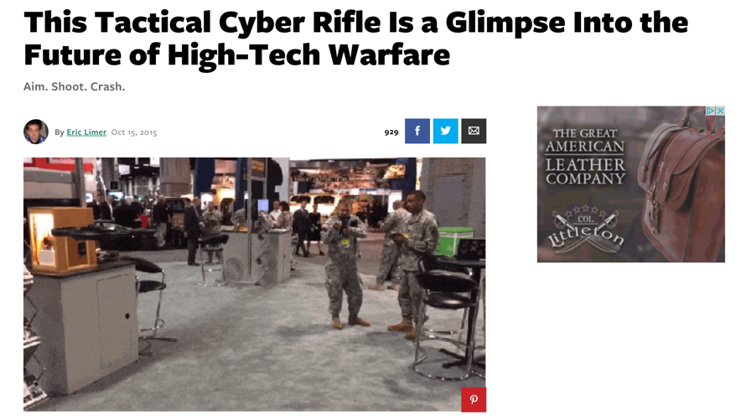
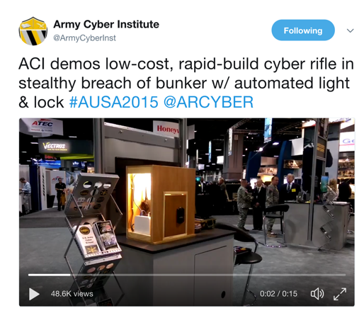
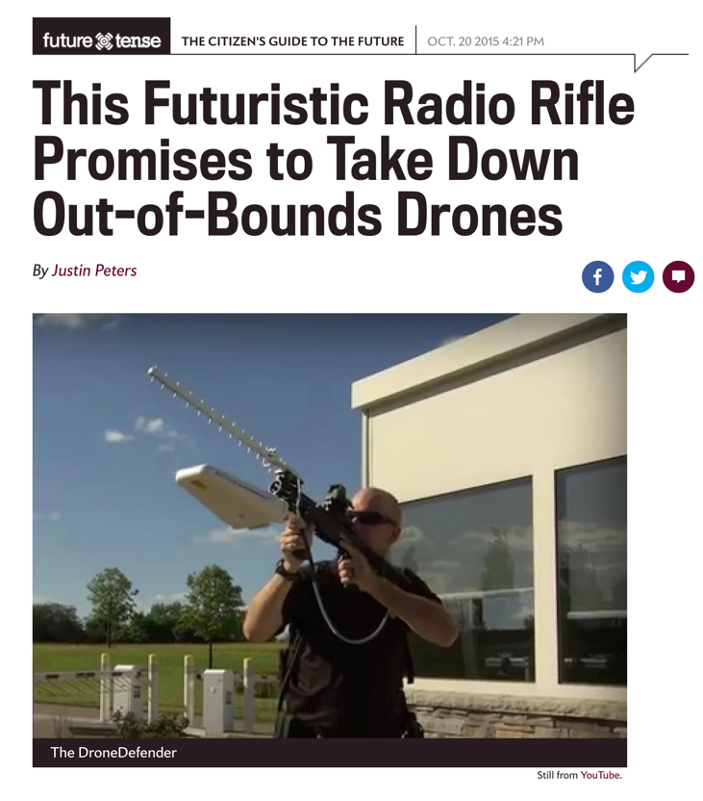
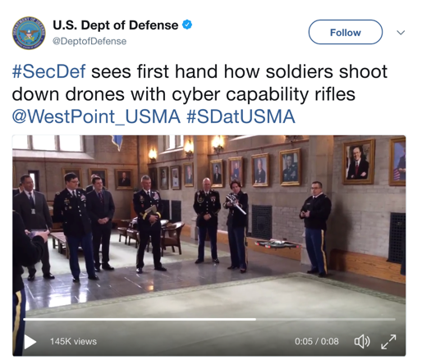

Slide 29
Case Study: Cyber Threat Emulation
Really interesting (novel) work being done by Red Team
Told them so, and encouraged them to submit to BSides DC
Helped with CFP submission and slides, but they owned it
Gave great talk, lots of social media play
Superpower unlocked
Identifying Innovation
https://www.youtube.com/watch?v=WMDQOVy1nWM

Slide 30
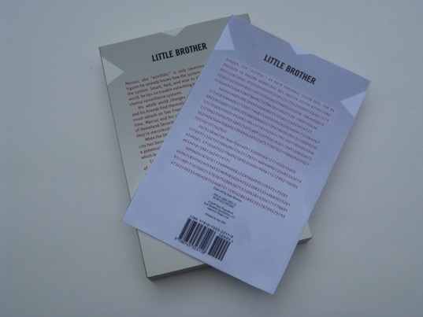


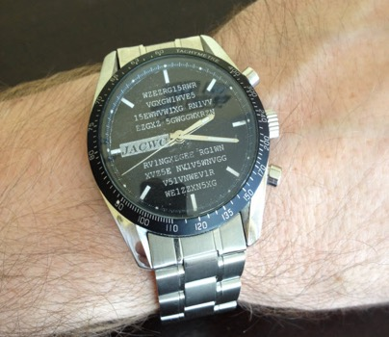
Case Study: Joint Advanced Cyber Warfare Course
Teaching Innovation

Slide 31
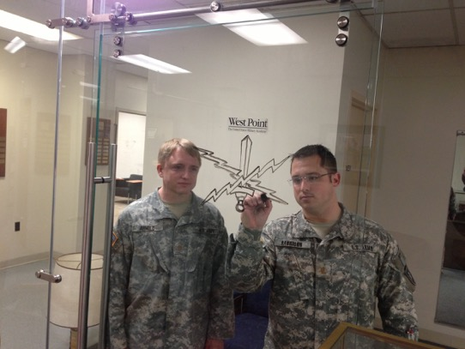
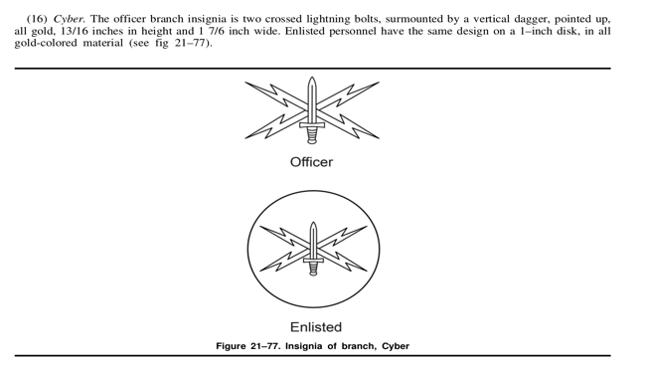
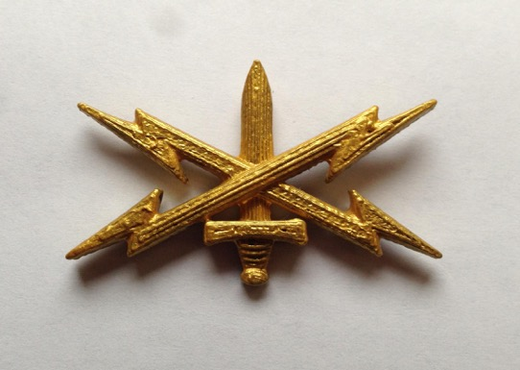
Case Study: Cyber Branch Insignia
Anticipatory Innovation

Slide 32
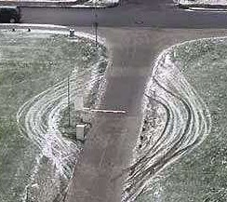
Conclusions
Yes, you can (should) do this.
Start small
Develop a sense for important problems (keep a list)
Find people already doing interesting work
Provide basic seed capital (books, local conference attendance)
Encourage, mentor, support, and recognize
But keep in mind the risks, put safety bumpers in place
Grow from there

Slide 33
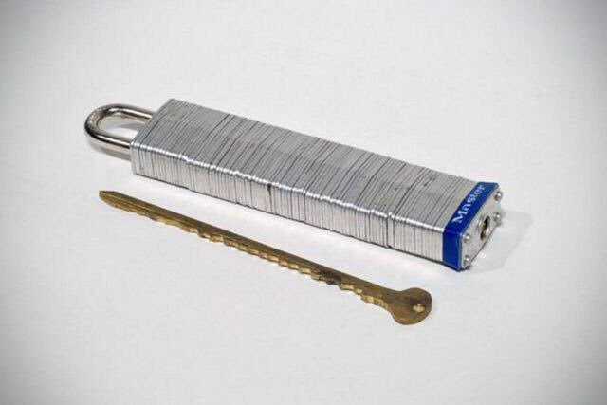
Questions and Discussion
Greg Conti
Senior Security Strategist
greg.conti@ironnet.com
@cyberbgone
https://twitter.com/linkibol/status/1114068821399072769

